Slide 1

ASDWA’s 40th Anniversary Celebration
A Longer Look Back

Slide 2
ASDWA Original
Logo

Slide 3
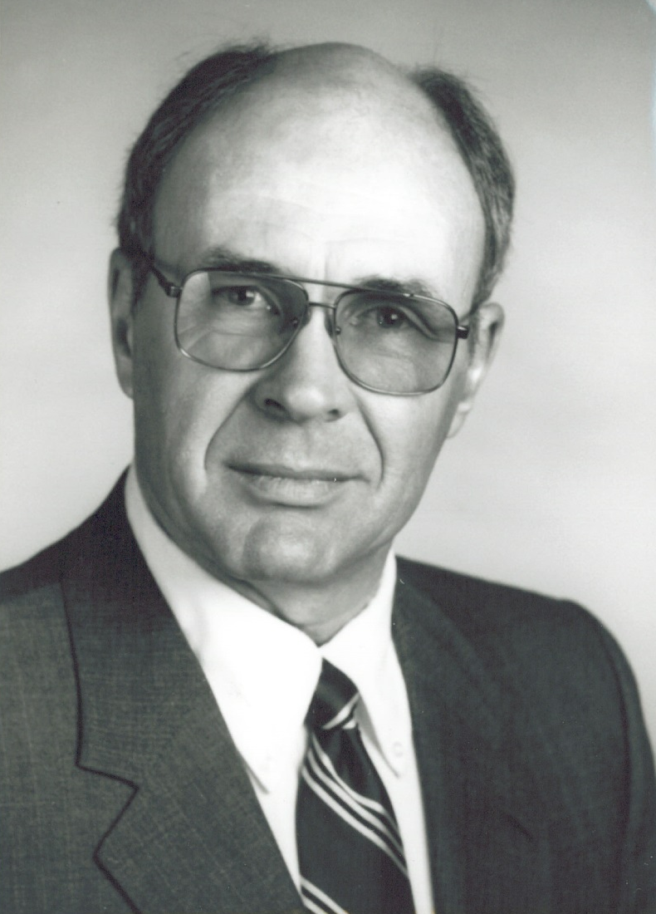
Bill Kelley (MI) – ASDWA’s 1st President 1985

Slide 4
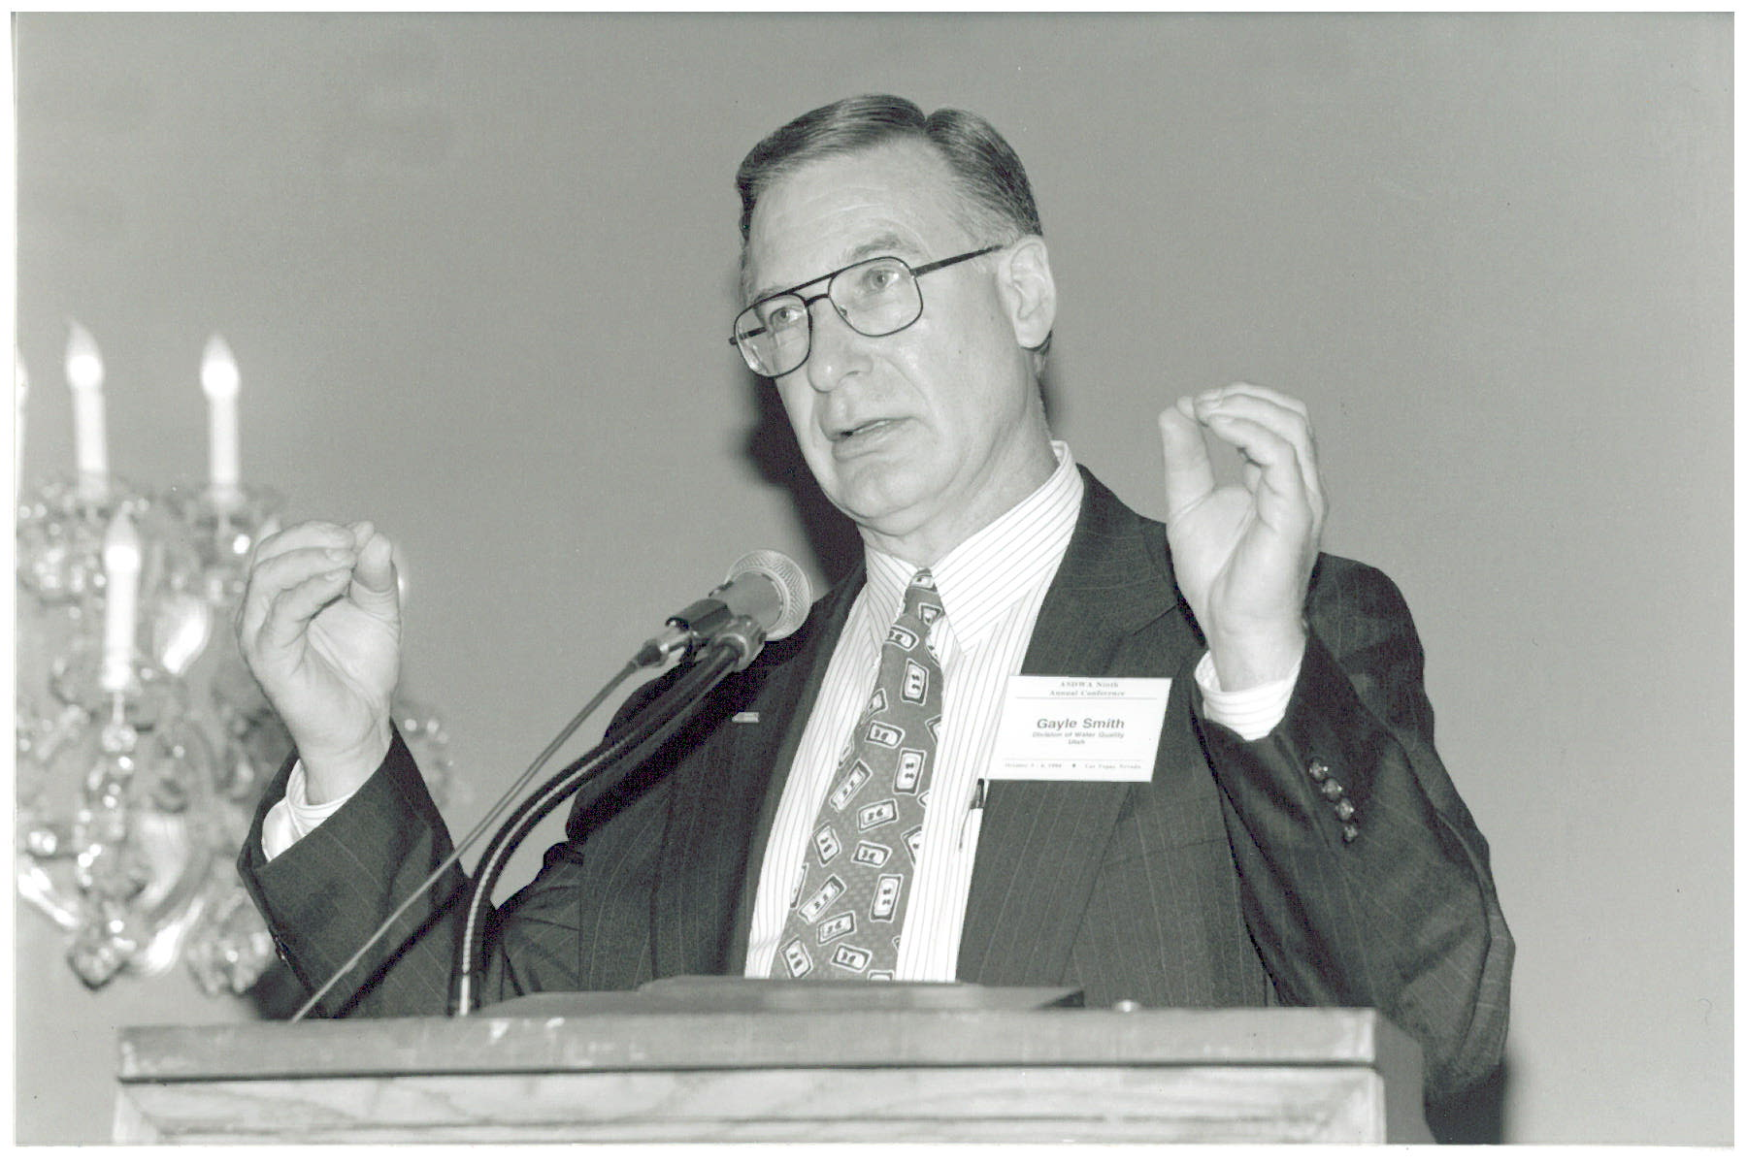
Gayle Smith (UT) – ASDWA’s 2nd President 1986
“All together now: cleansing breath and say ‘Ommmmmmmm’”

Slide 5
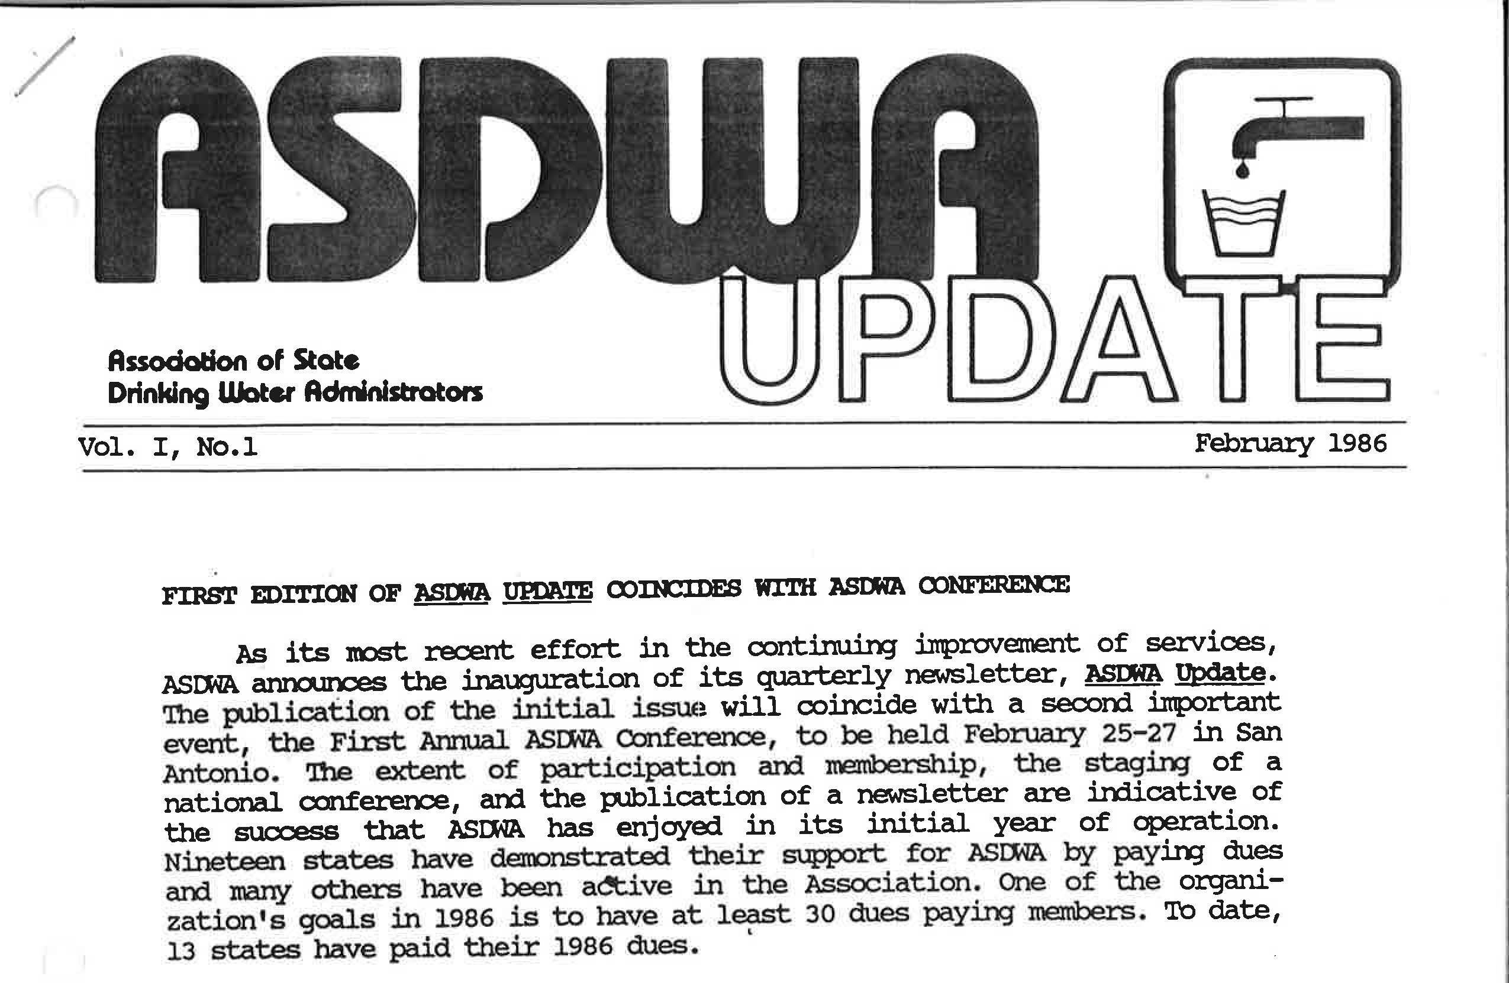
ASDWA’s First Newsletter

Slide 6
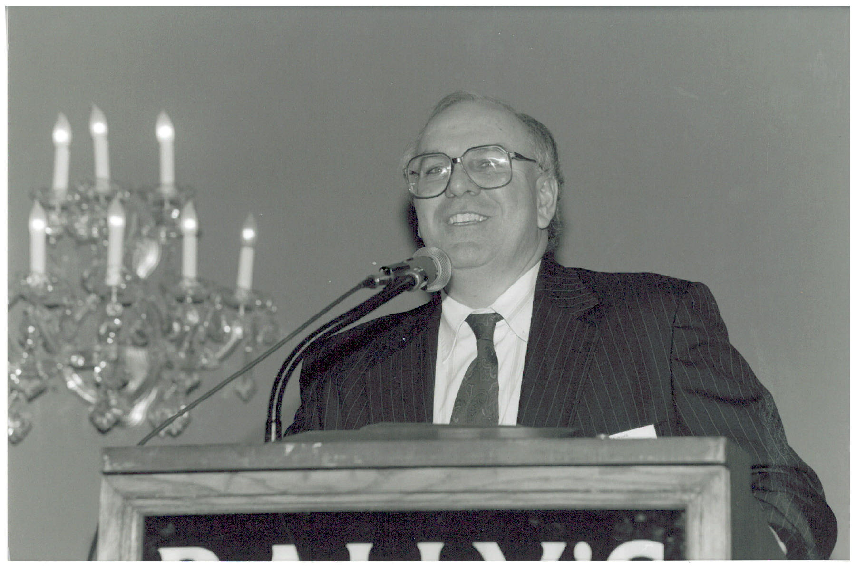
Mike Burke (NY) – ASDWA’s 3rd President 1987

Slide 7
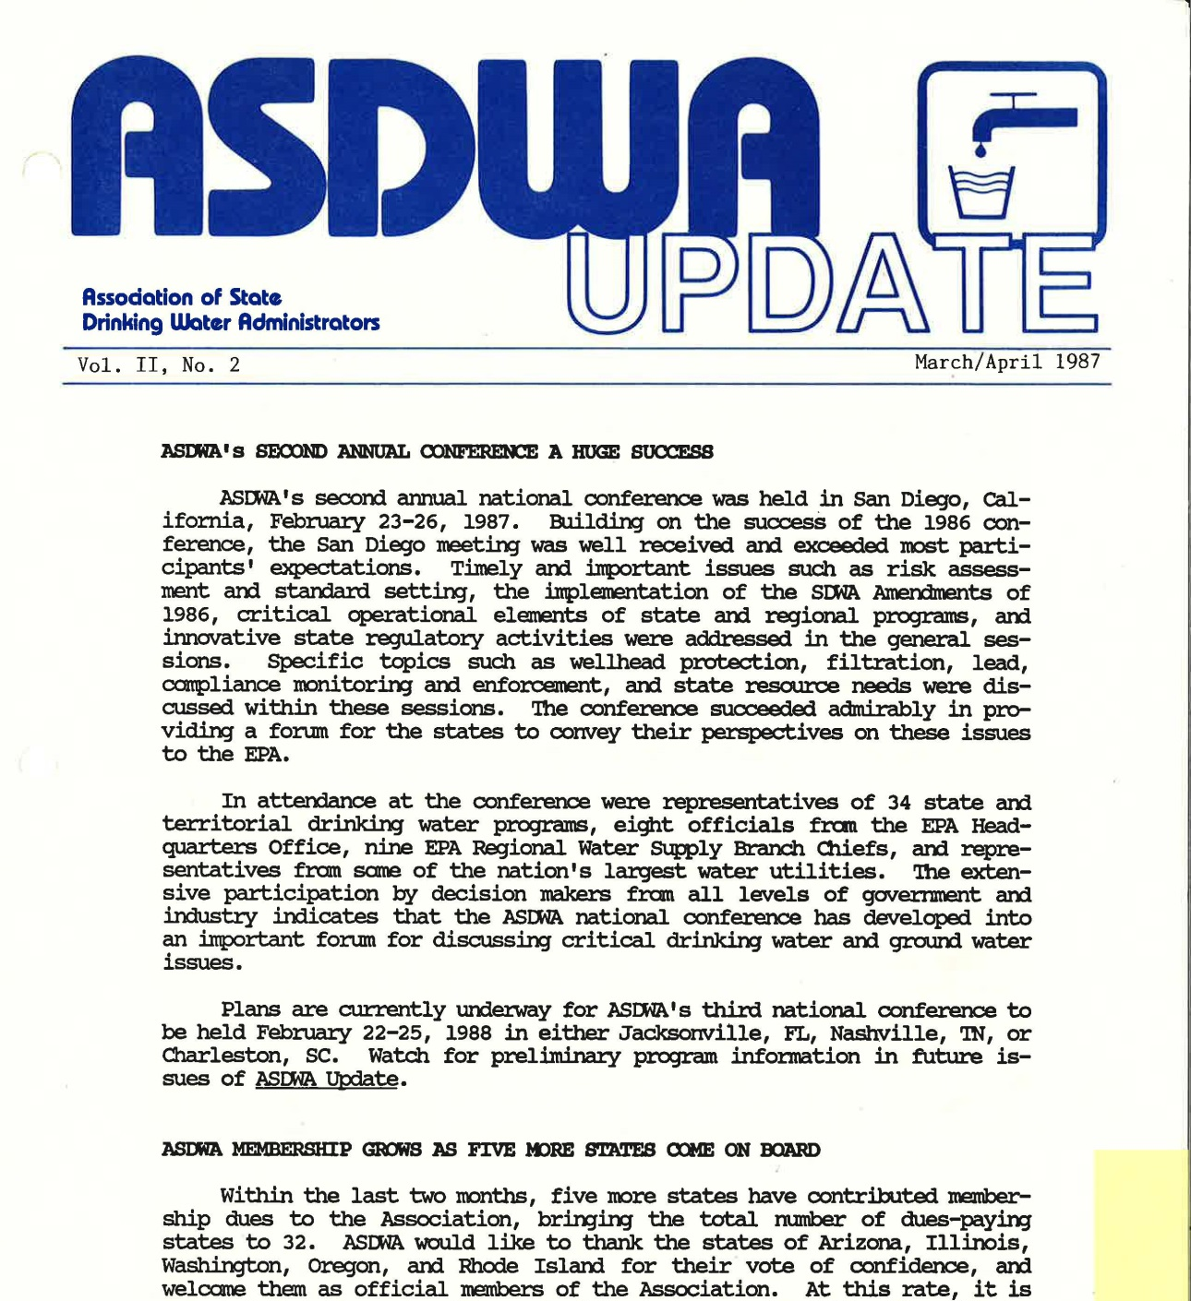

Slide 8
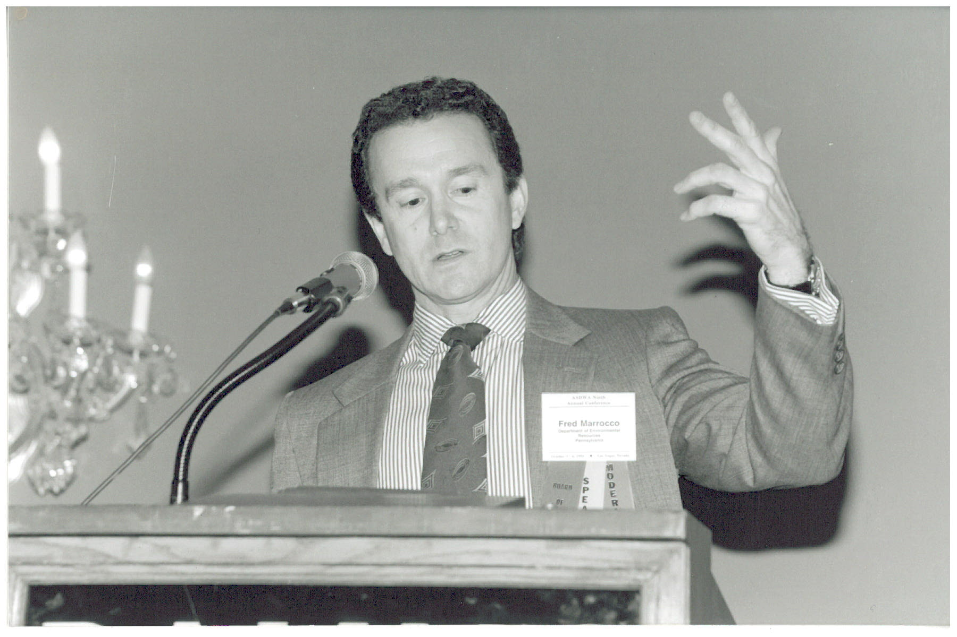
Fred Marrocco (PA) – ASDWA President 1988
“Nothing in my hands or up my sleeves….”

Slide 9
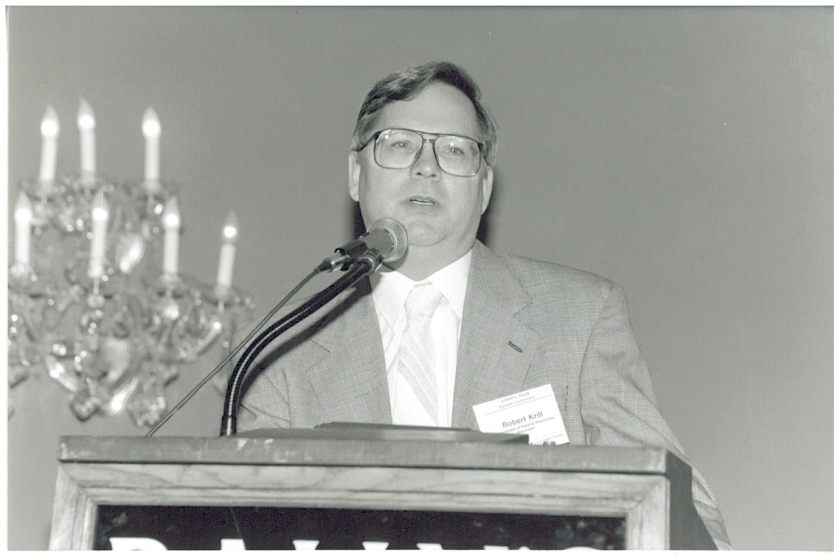
Bob Krill (WI) – ASDWA President 1989

Slide 10
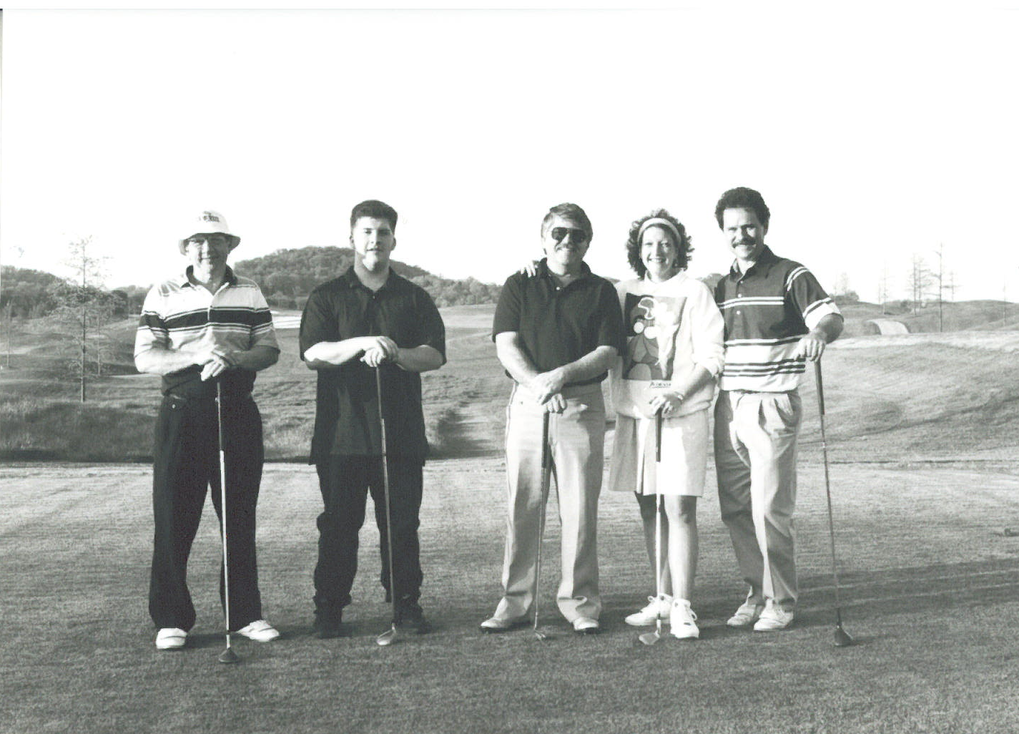
Bob Malpass, Dave Clark, Vanessa Leiby, and others:
High level “Conference” on the 10th Tee

Slide 11

Allen Hammer (VA) – ASDWA President 1990

Slide 12
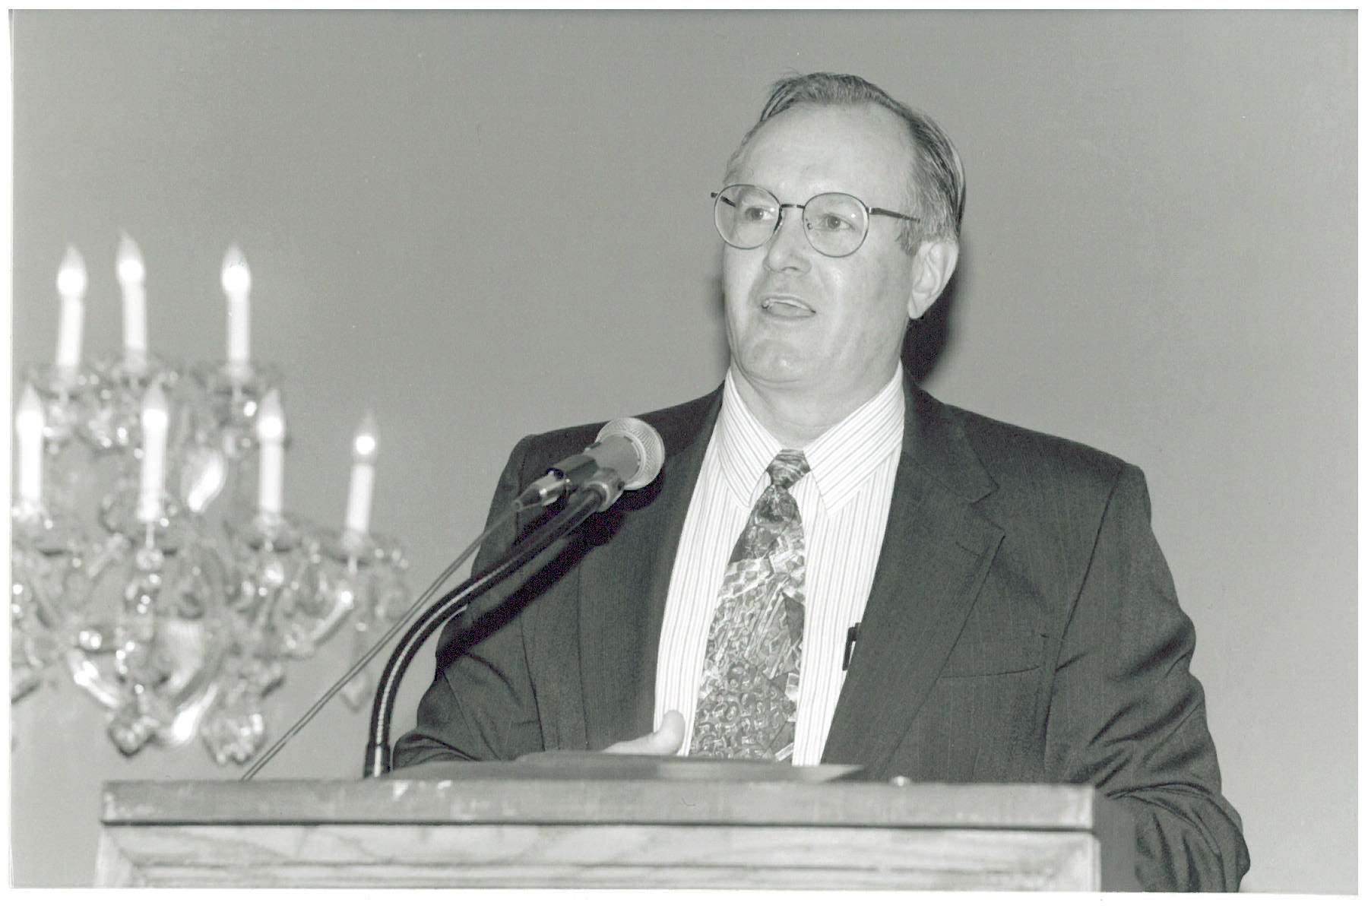
Dan Fraser (MT) – ASDWA President 1991

Slide 13
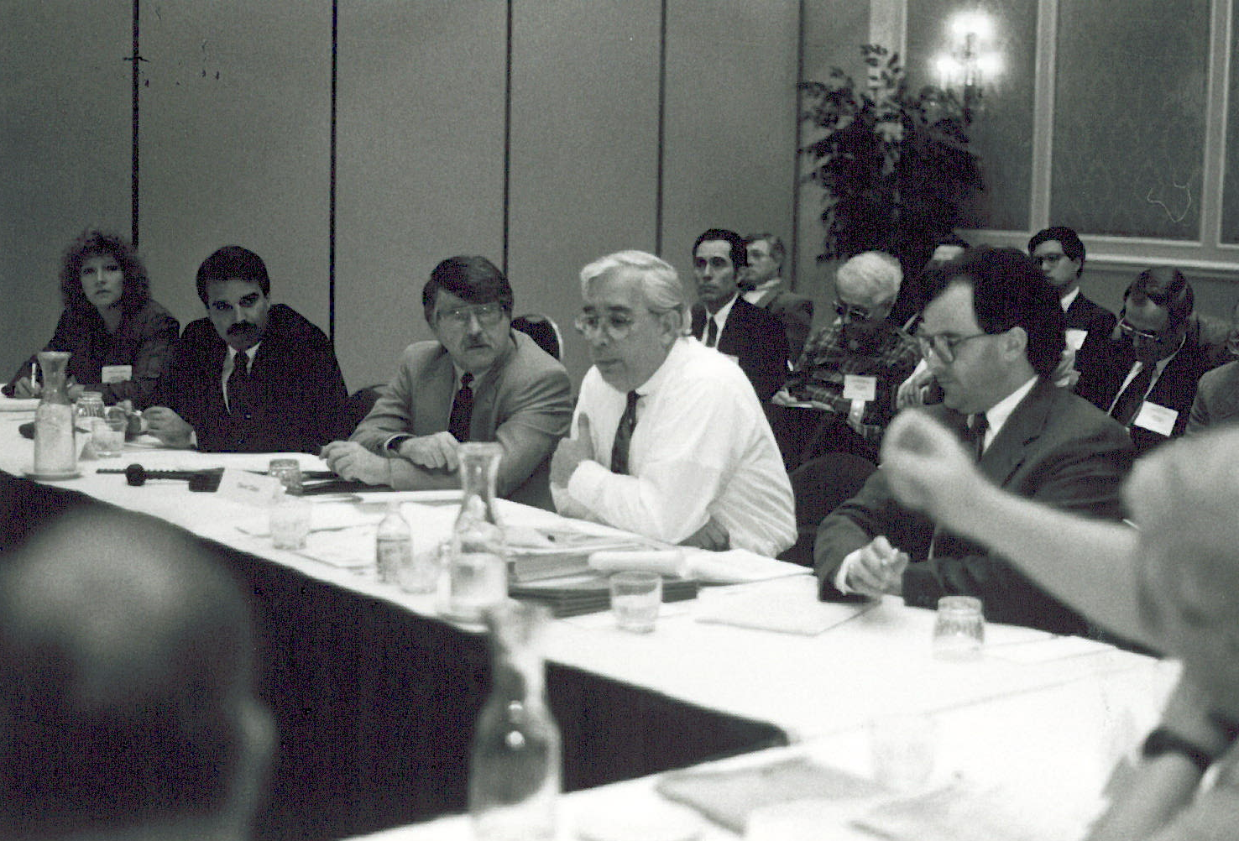
Vanessa Leiby (ASDWA), Jeff Fontaine (NV), Dave Clark (WA), Bob Blanco and Peter Shanaghan (OGWDW):
“Hey Bob, can you please pass the Junior Mints?”

Slide 14
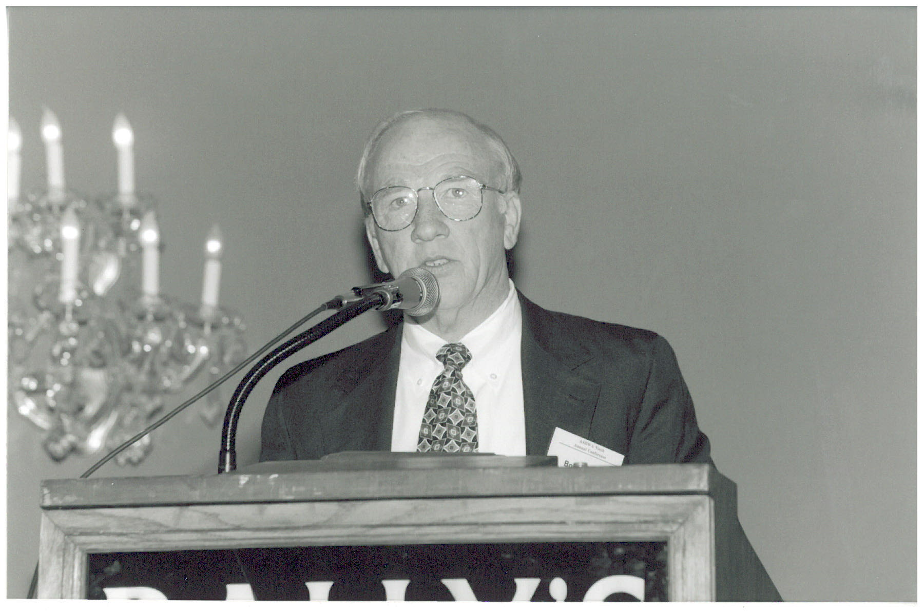
Bob Malpass (SC) – ASDWA President 1992

Slide 15
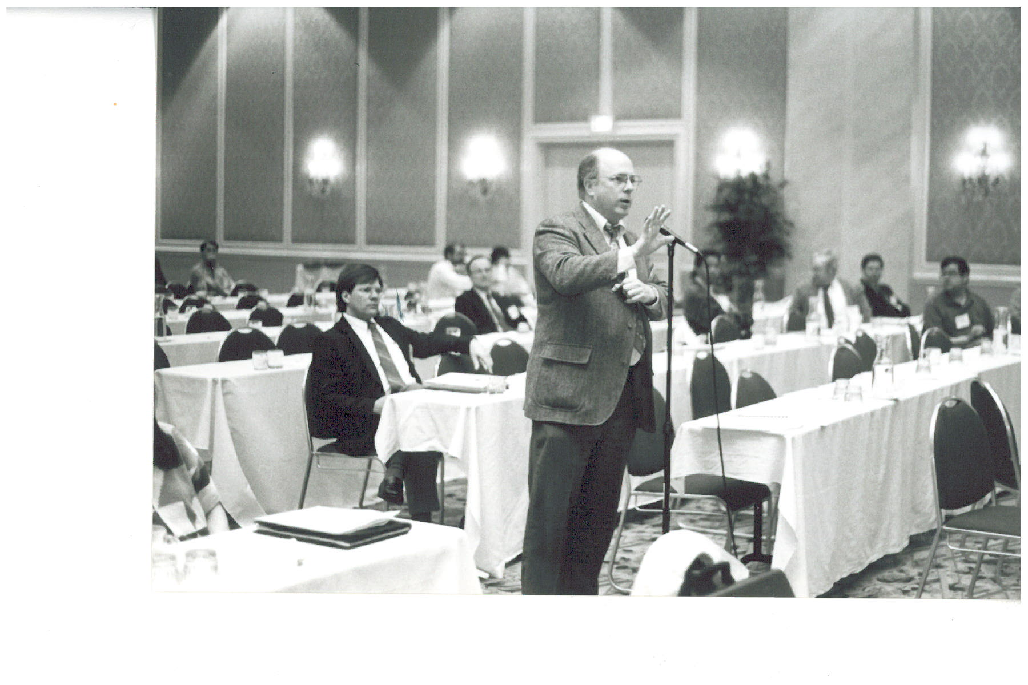
Barker Hamill (NJ)
“O.K., here’s the thing -- in New Jersey, we do things a little, well, differently….”

Slide 16
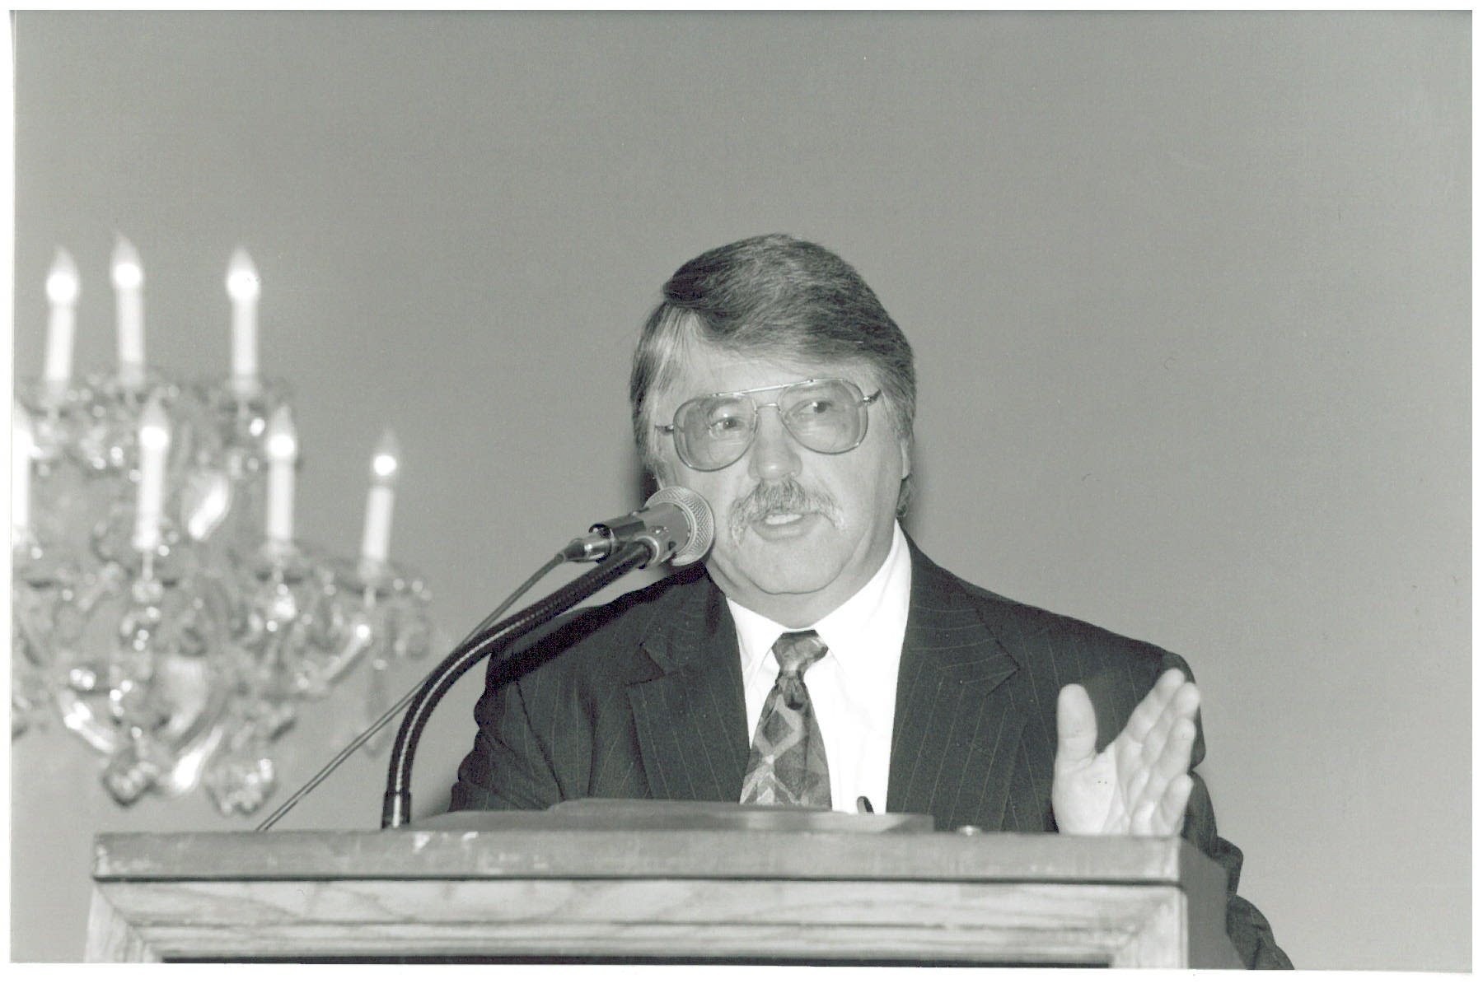
Dave Clark (WA) – ASDWA President 1993

Slide 17
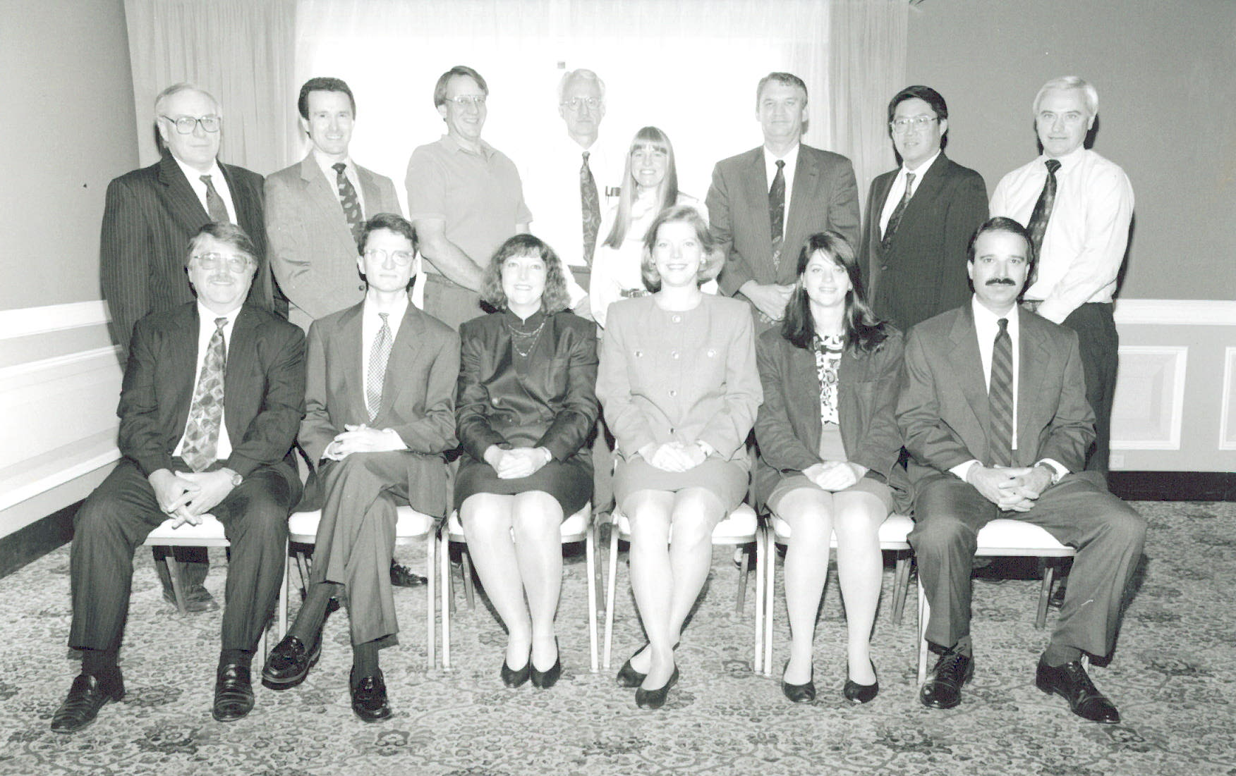
Front – Dave Clark (WA), ASDWA Staff Tom Outlaw, Vanessa Leiby, Bridget O’Grady, and Deirdre Mason, Jeff Fontaine (NV) Back – Mike Burke (NY), Fred Marrocco (PA), Joe Cottingham (AK), Jim Melstad (MT), June Swallow (RI), TJ Ray (LA), Tom Arizumi (HI), Jim Cleland (MI)

Slide 18
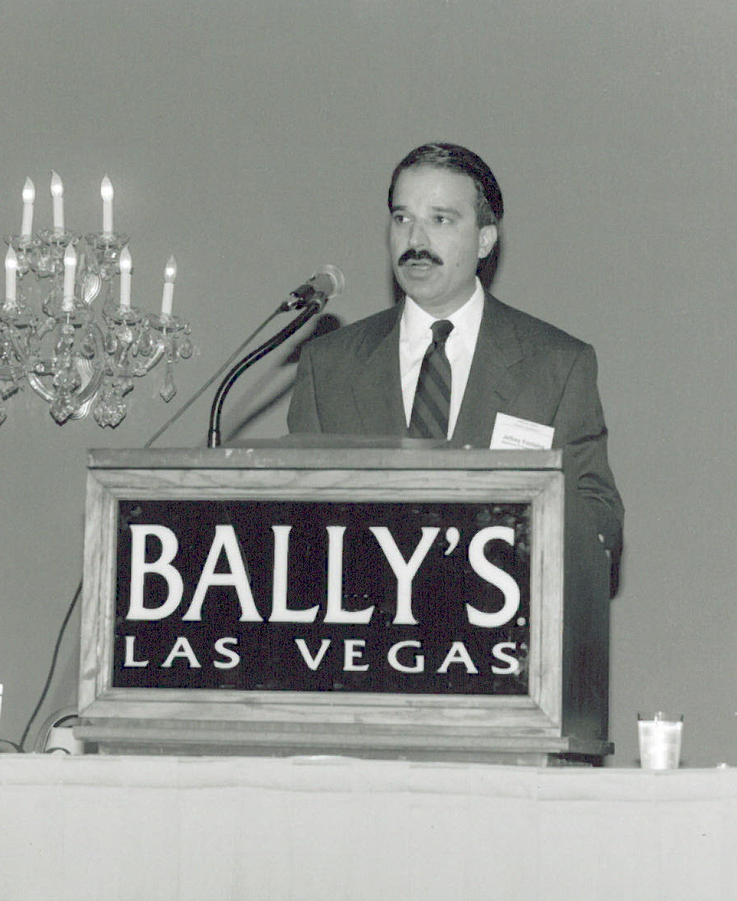
Jeff Fontaine (NV) – ASDWA President 1994
Hey, where else would you expect a Nevada President to speak from?

Slide 19


Slide 20
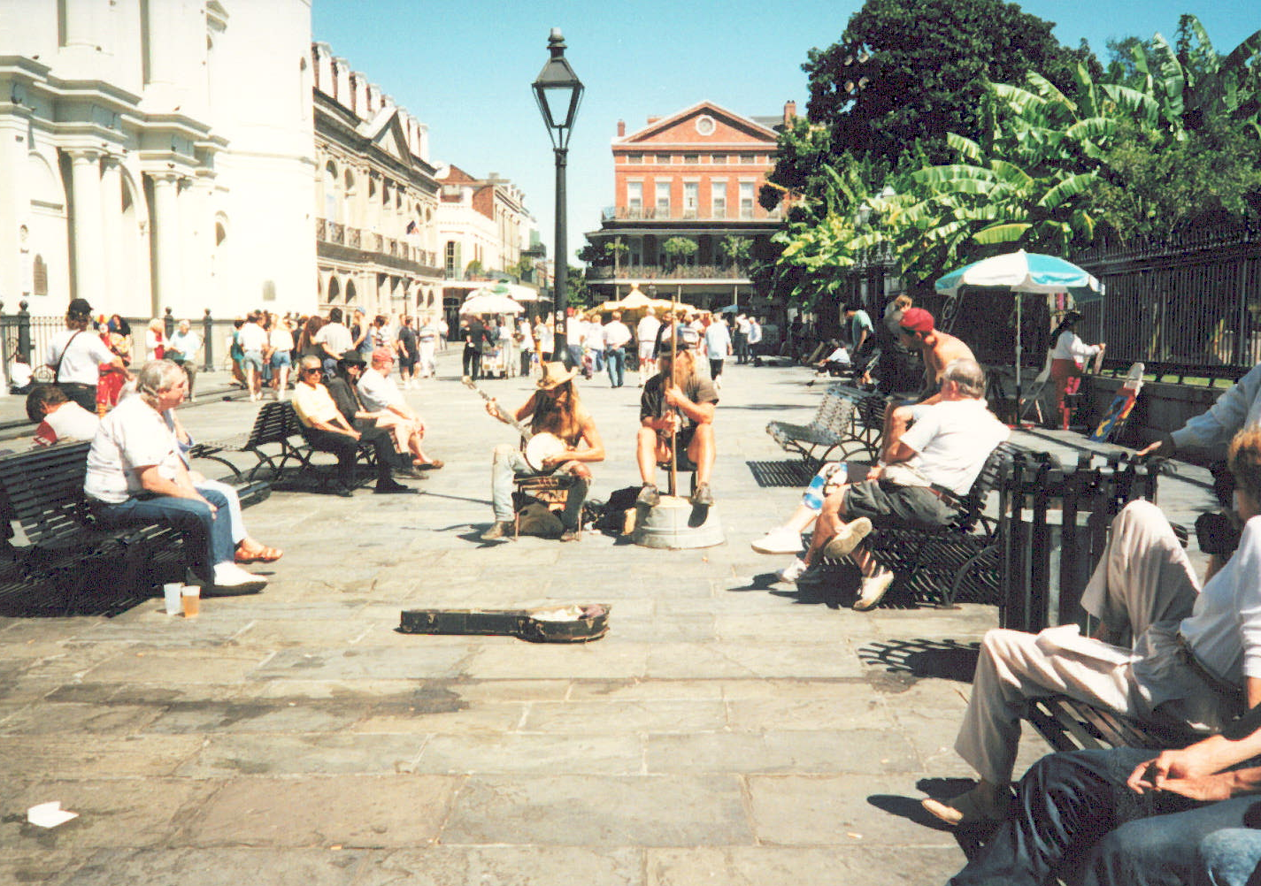
New Orleans 1995 ASDWA Annual Conference

Slide 21
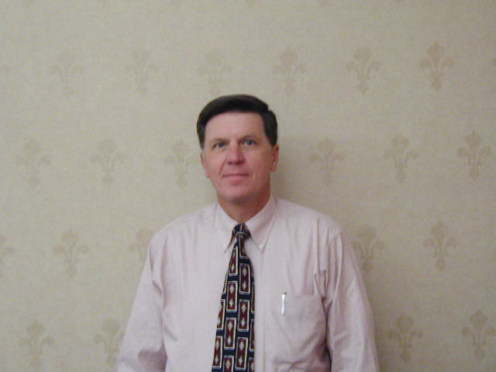
Joe Alan Power (AL) - ASDWA President 1995

Slide 22
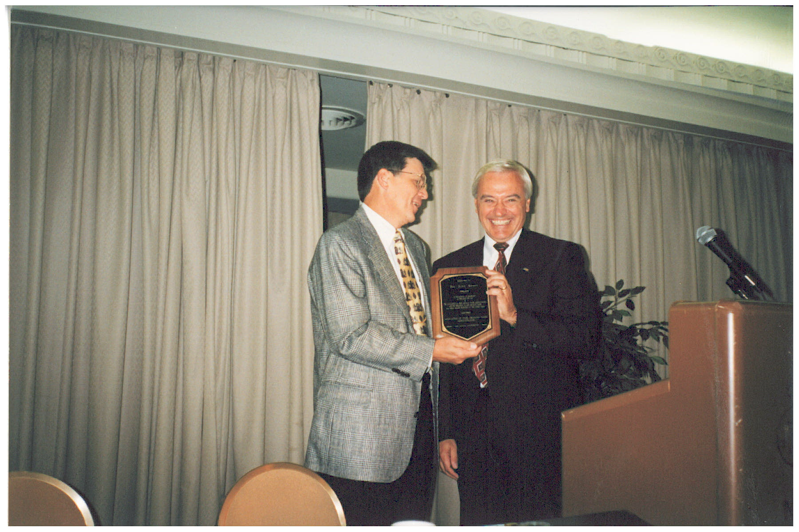
Joe Power (AL) – President 1995,
Jim Cleland (MI) – President 1996

Slide 23
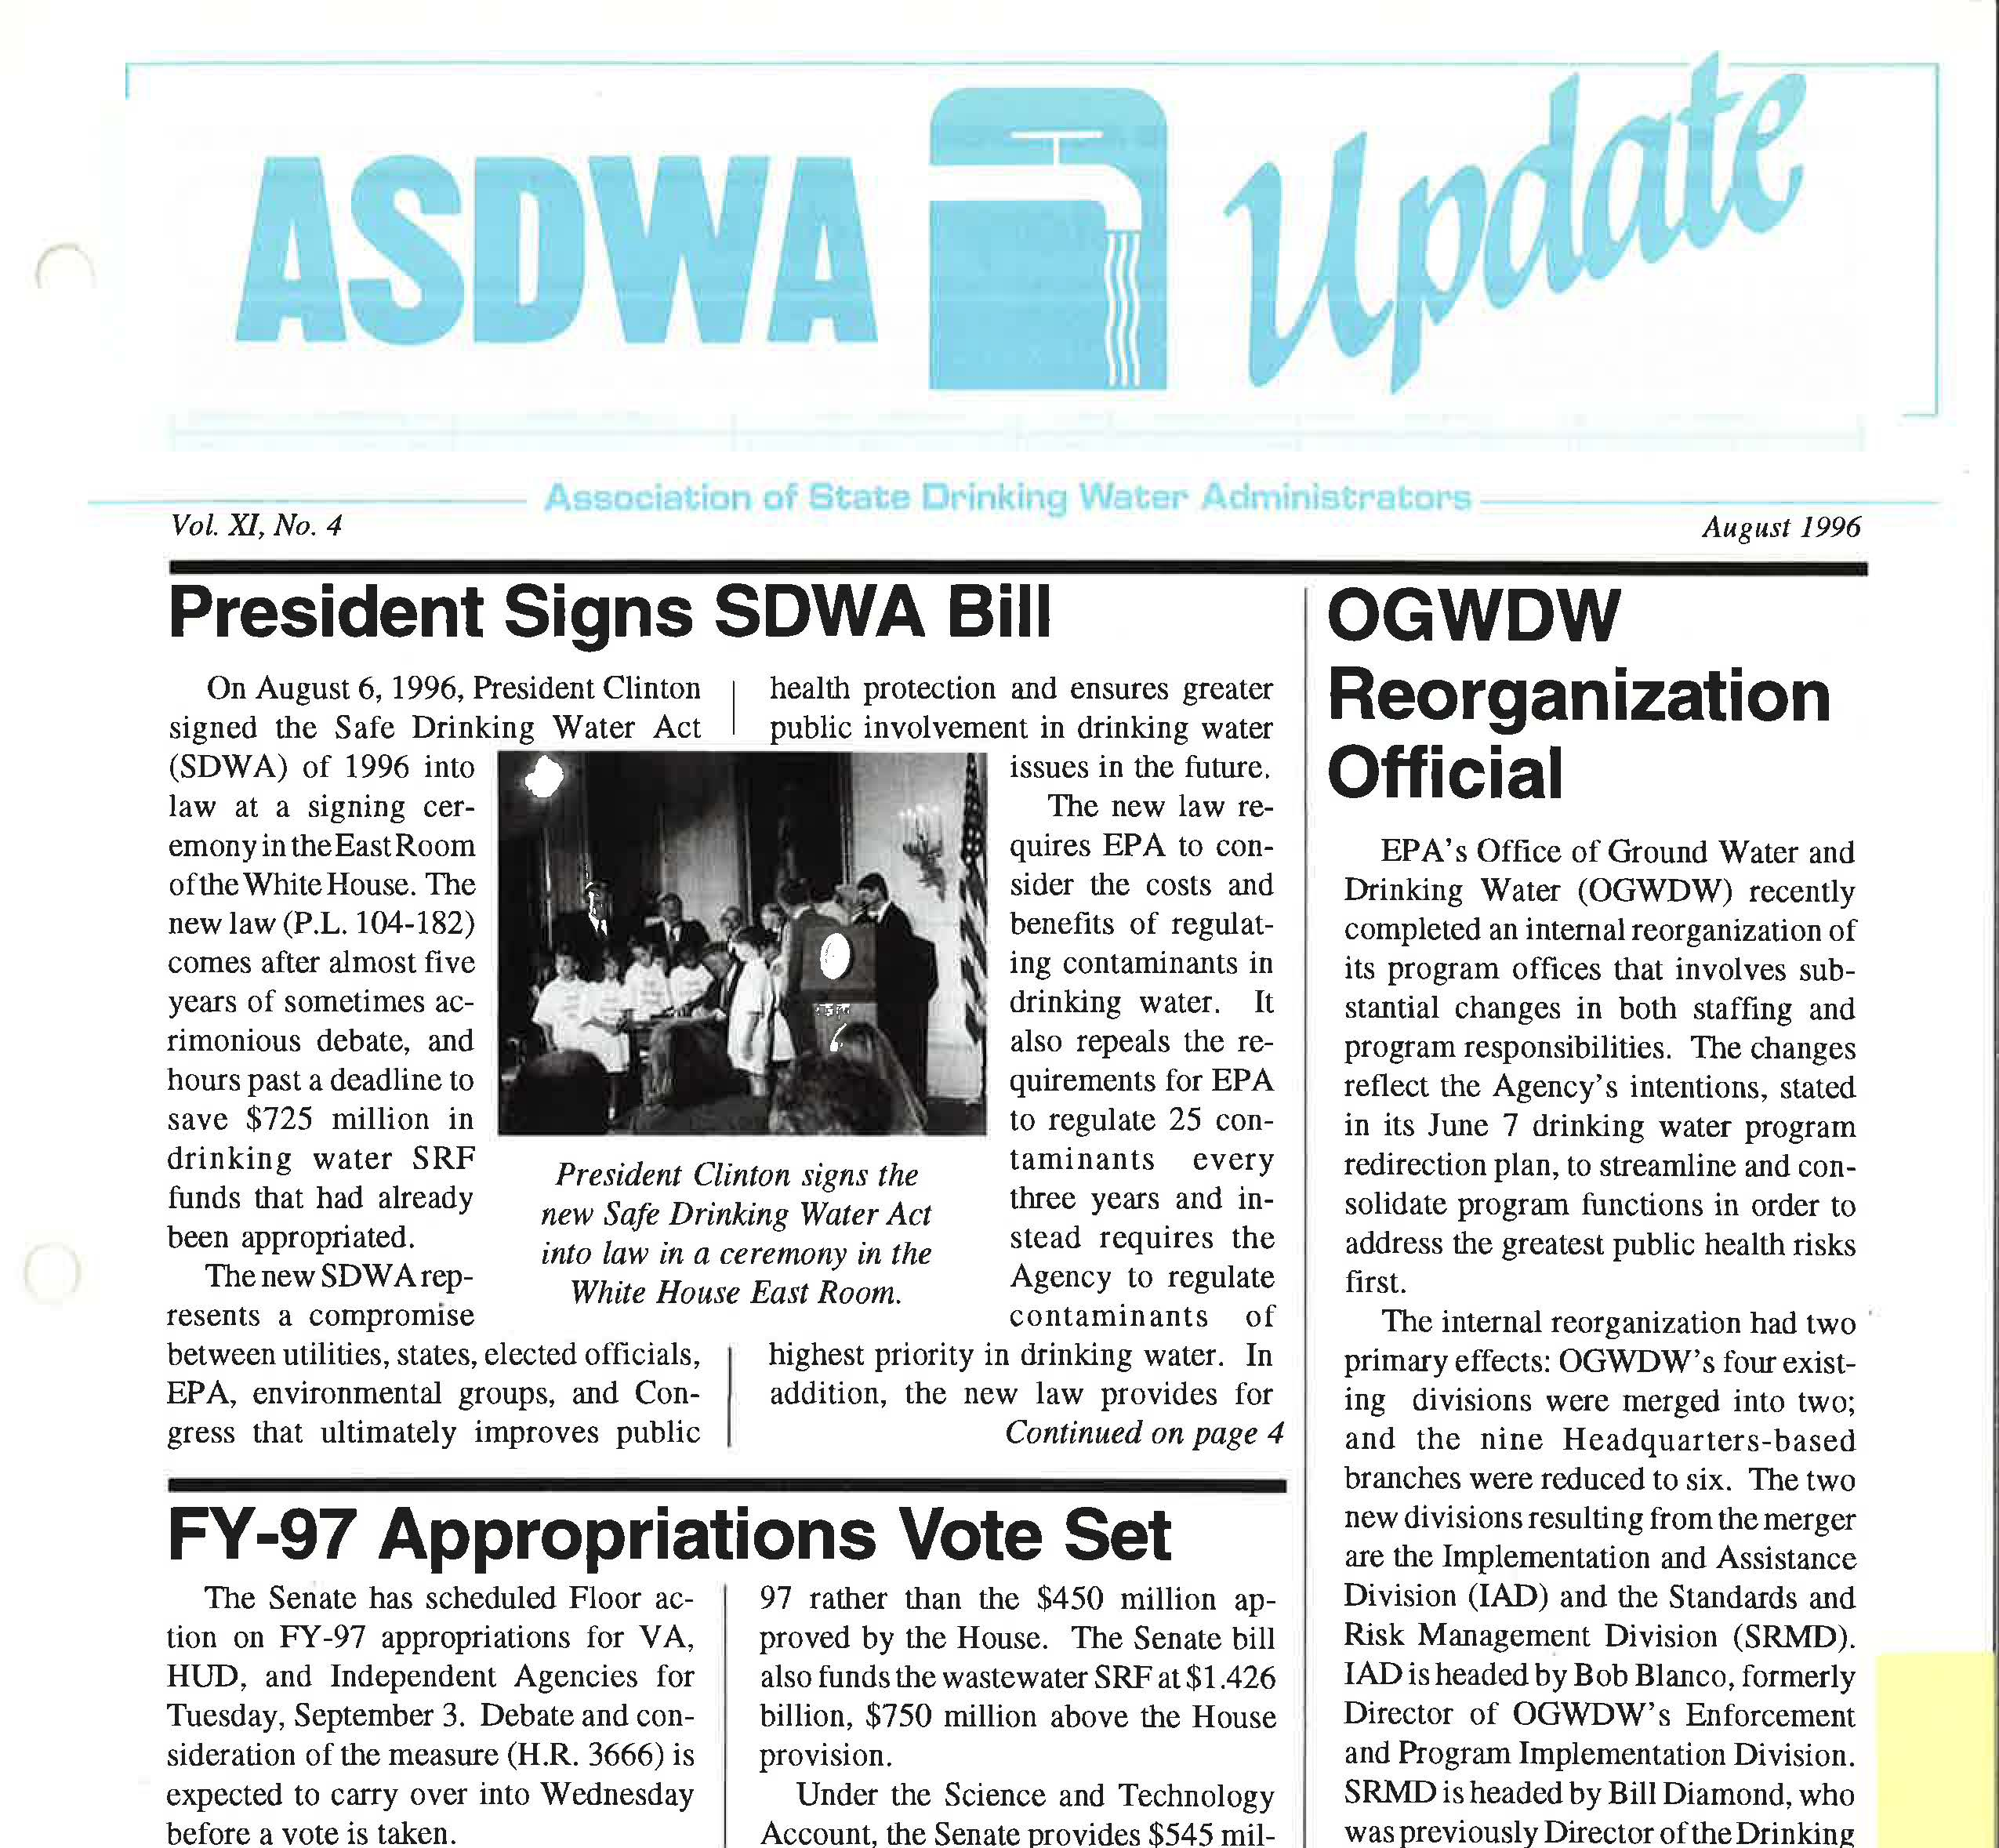

Slide 24
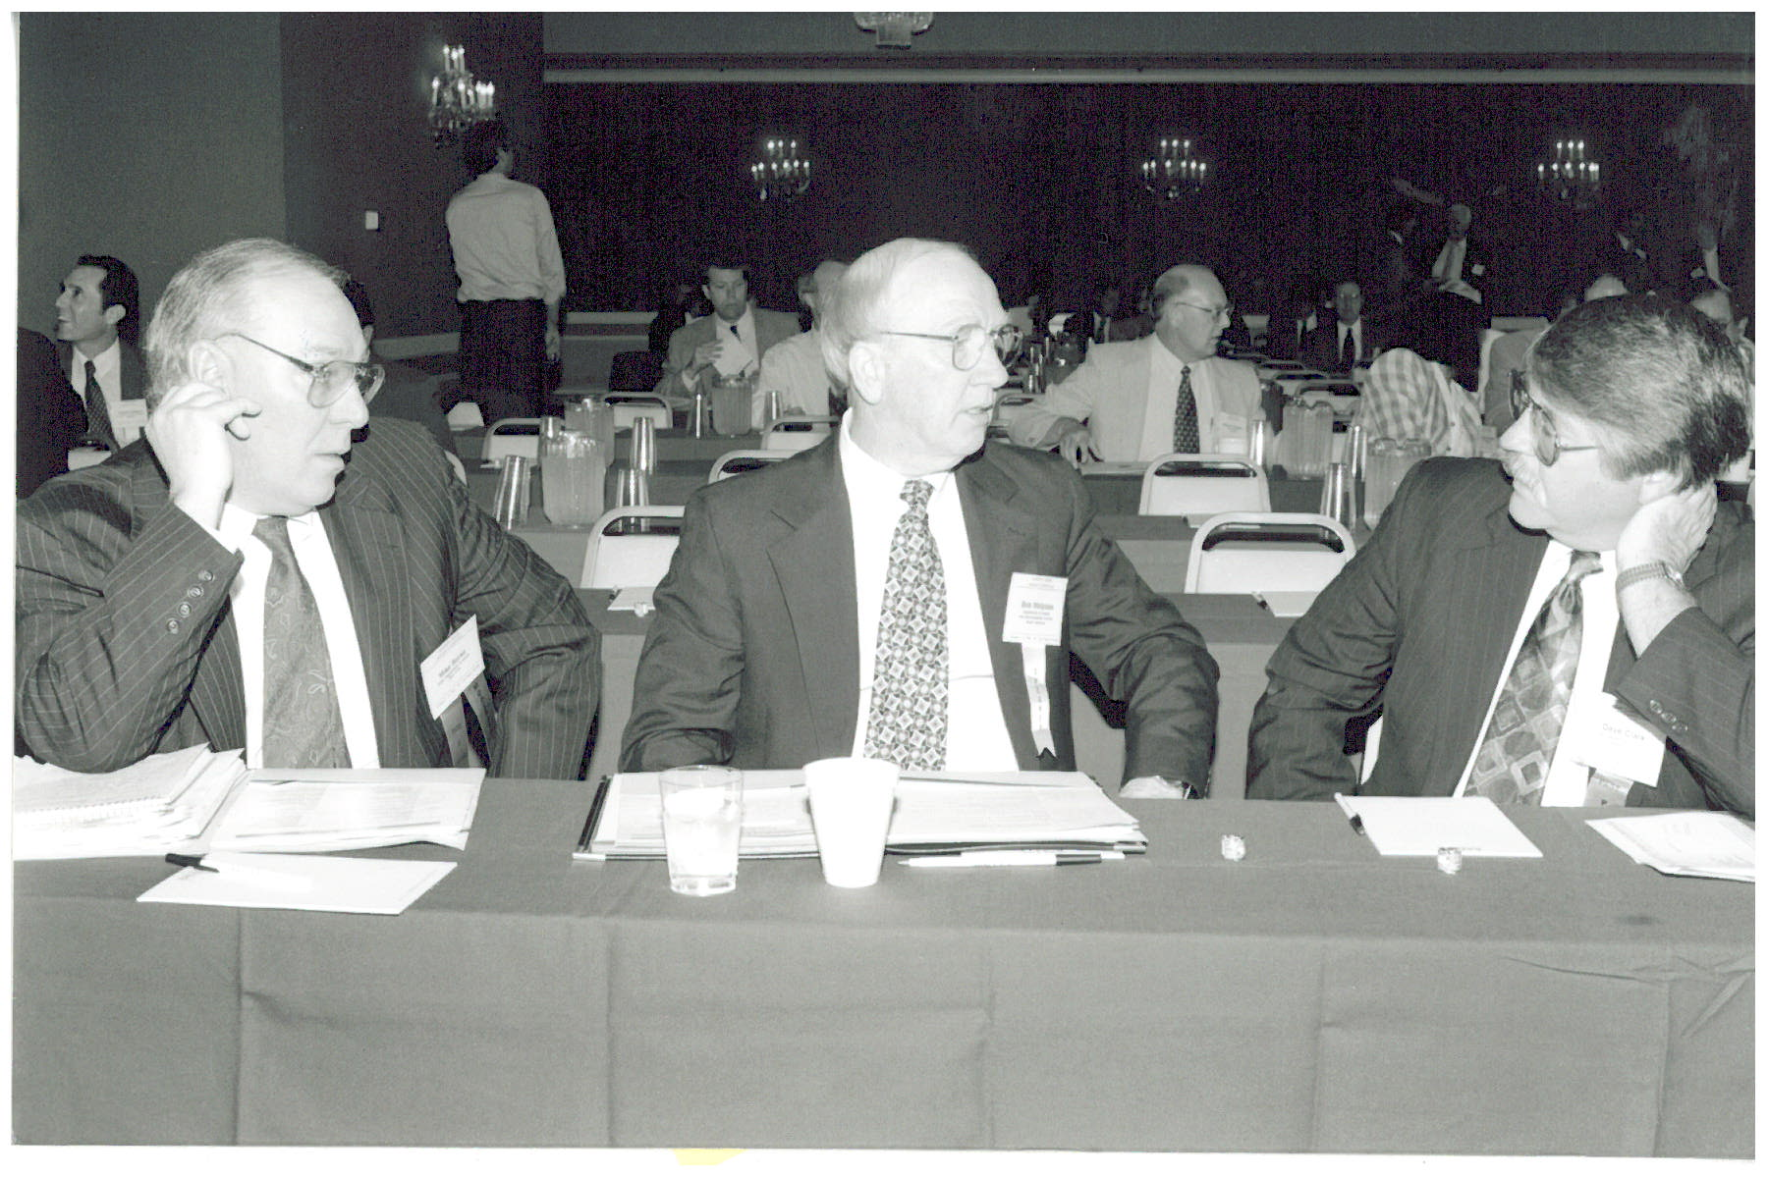
Mike Burke (NY), Bob Malpass (SC), Dave Clark (WA)
“Yeh, sure the Red Sox are a good team, but they’ve never won a World Series and never will…”

Slide 25
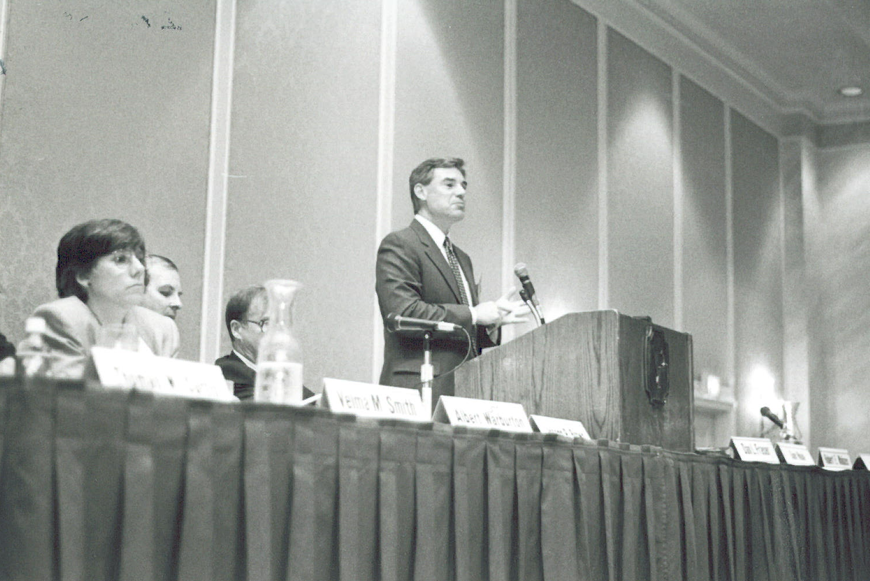
Jim Elder (OGWDW)
“Let the message go forth, from this time and this place, that we will bear any burden in the defense of safe drinking water…”

Slide 26
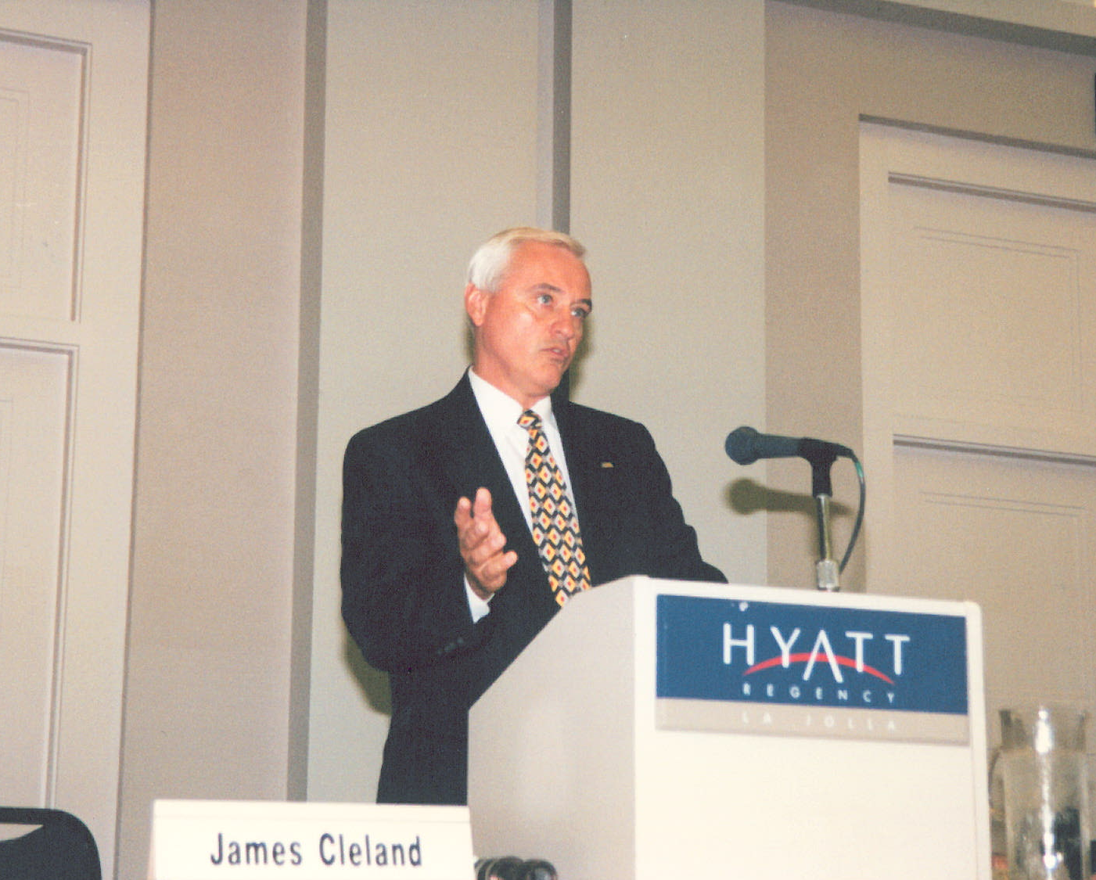
Jim Cleland (MI) – ASDWA President 1996

Slide 27
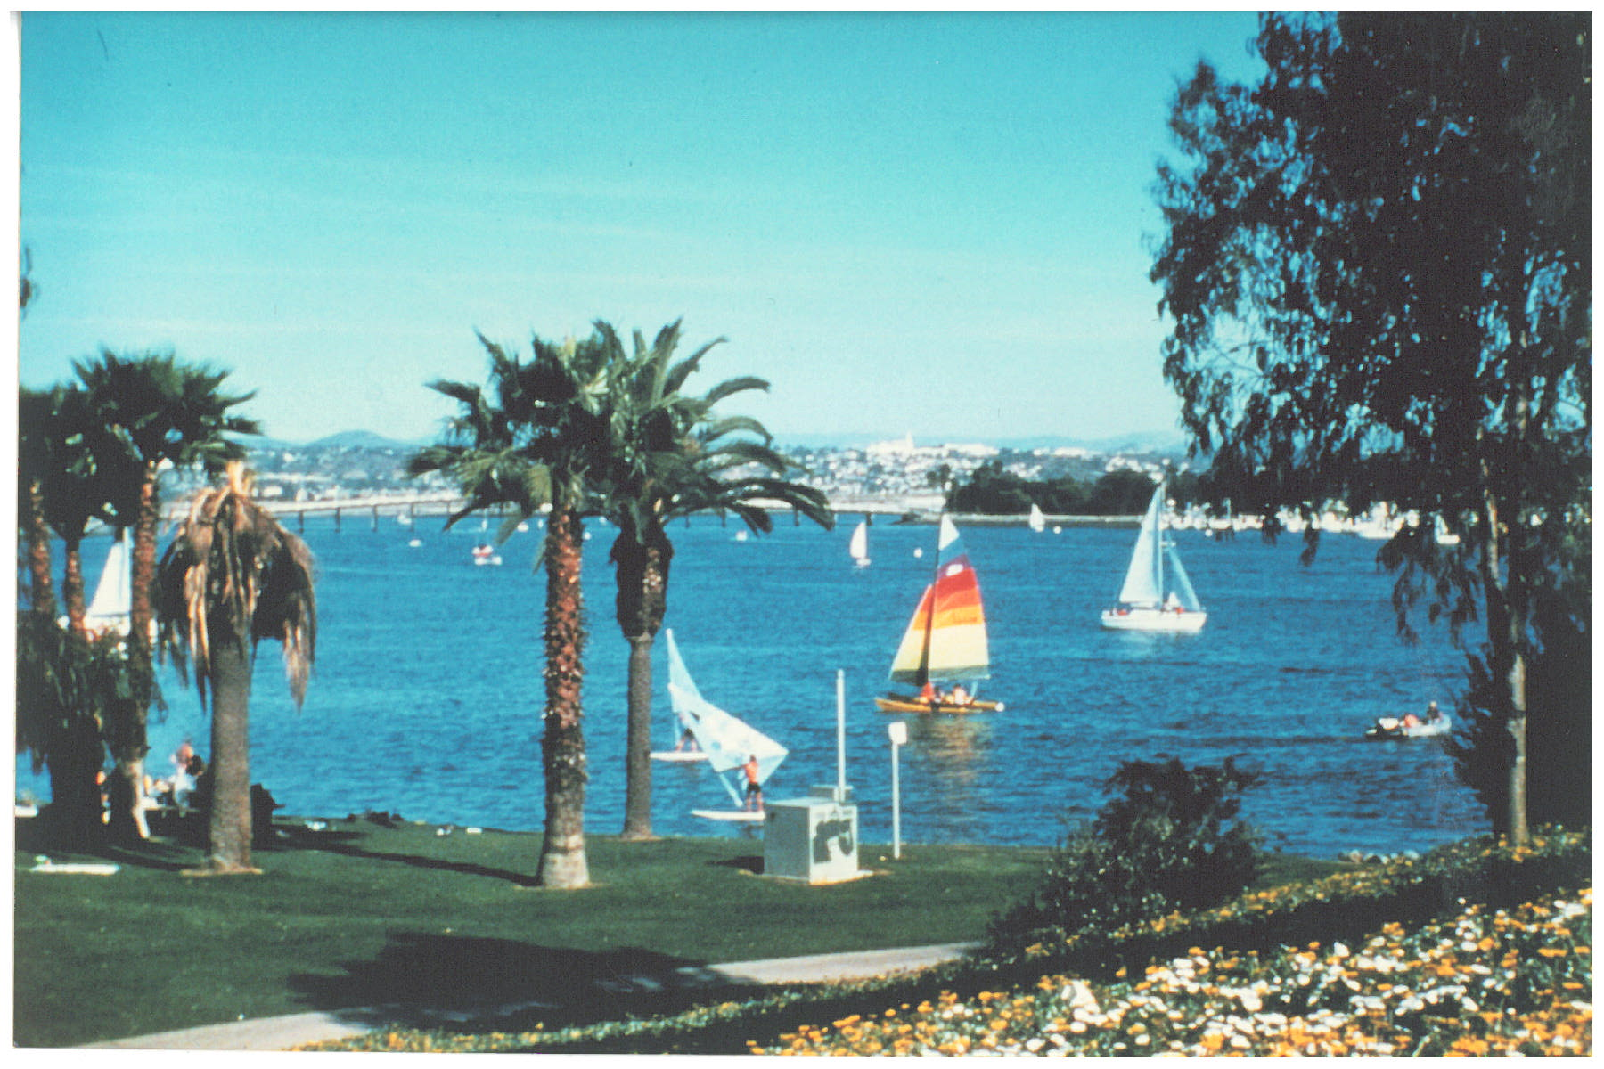
San Diego 1996 ASDWA Annual Conference

Slide 28
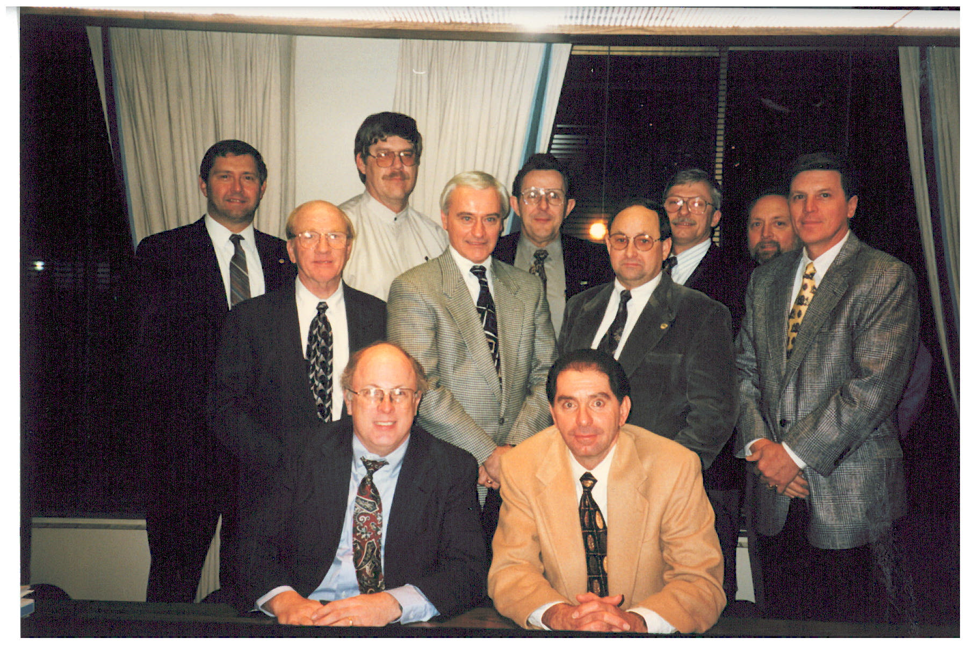
1996 Board: [missing Rene Pelletier (NH)] Front – Barker Hamill (NJ), Dave Spath (CA); Middle – Bob Malpass (SC), Jim Cleland (MI), Jon Craig (OK), Joe Power (AL); Back – Jack Daniel (NE), Ed Hallock (DE), John Sadzewicz (OH), Dave Leland (OR), Jerry Biberstine (CO)

Slide 29
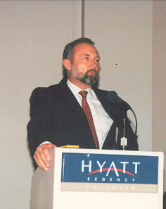
Jerry Biberstine (CO) – ASDWA President 1997

Slide 30
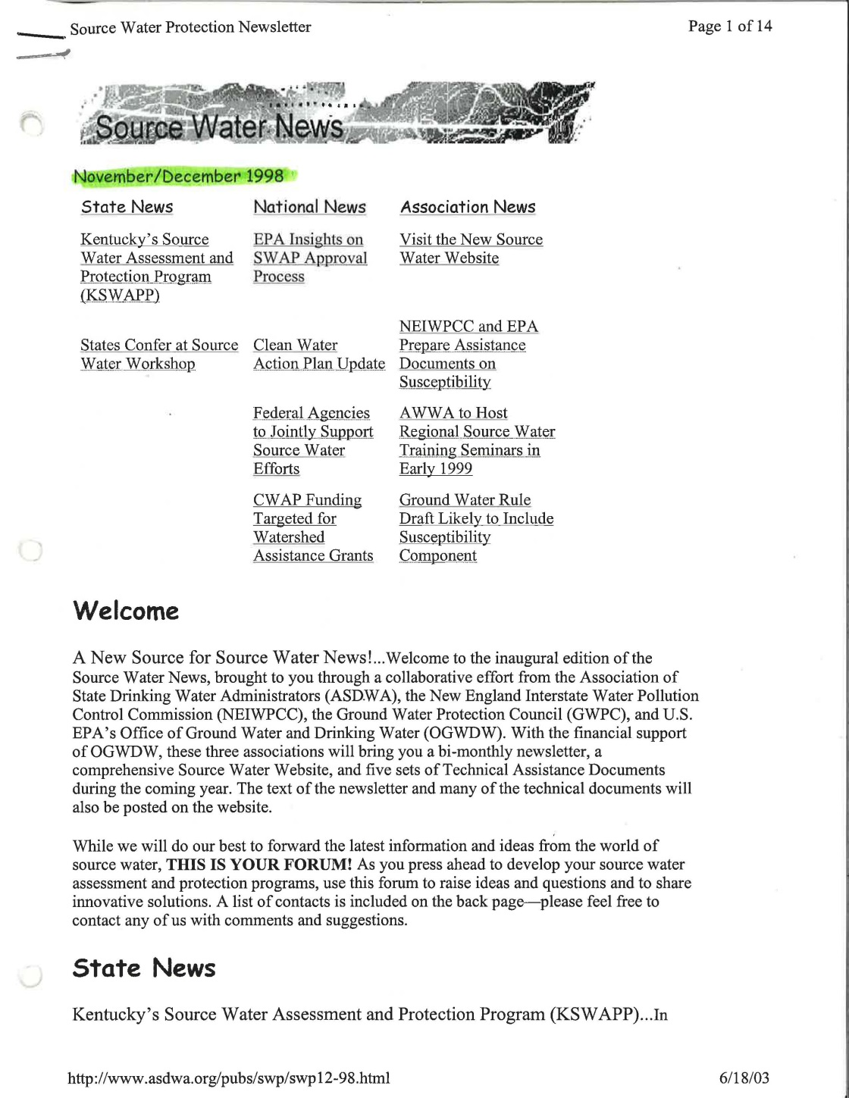

Slide 31
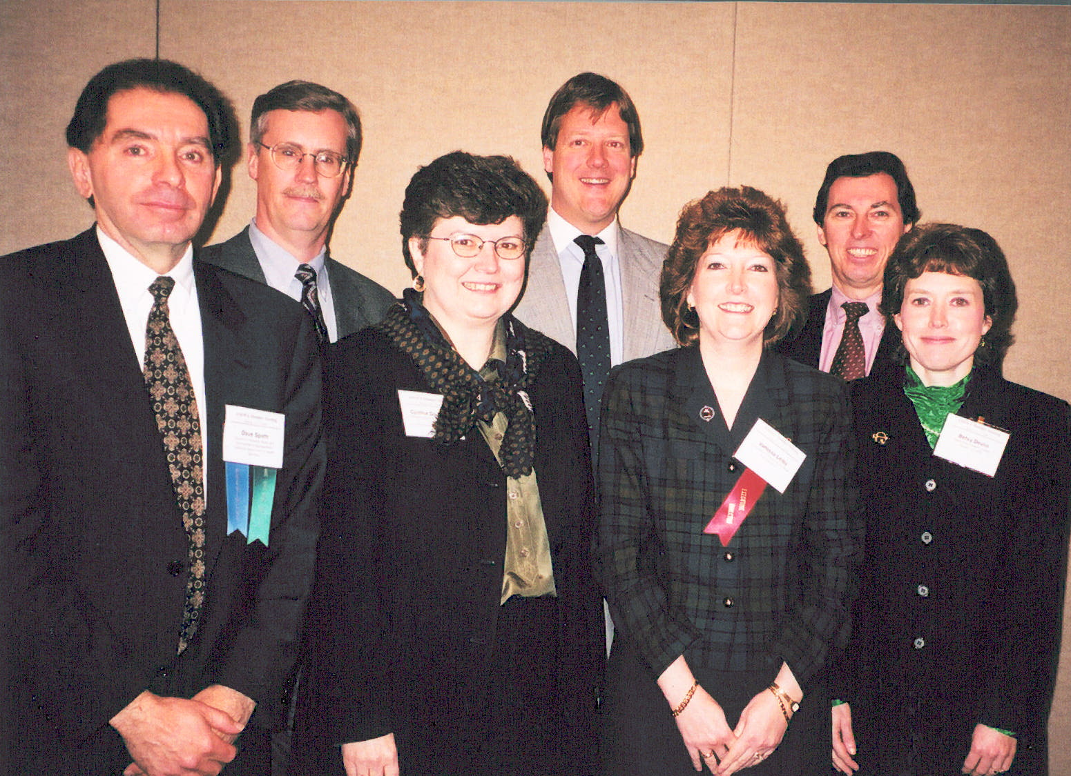
Dave Spath (CA), Jim Taft (EPA), Cynthia Dougherty & Jamie Bourne (OGWDW), Vanessa Leiby (ASDWA), Bill Diamond (OGWDW) & Betsy Devlin (OECA)

Slide 32
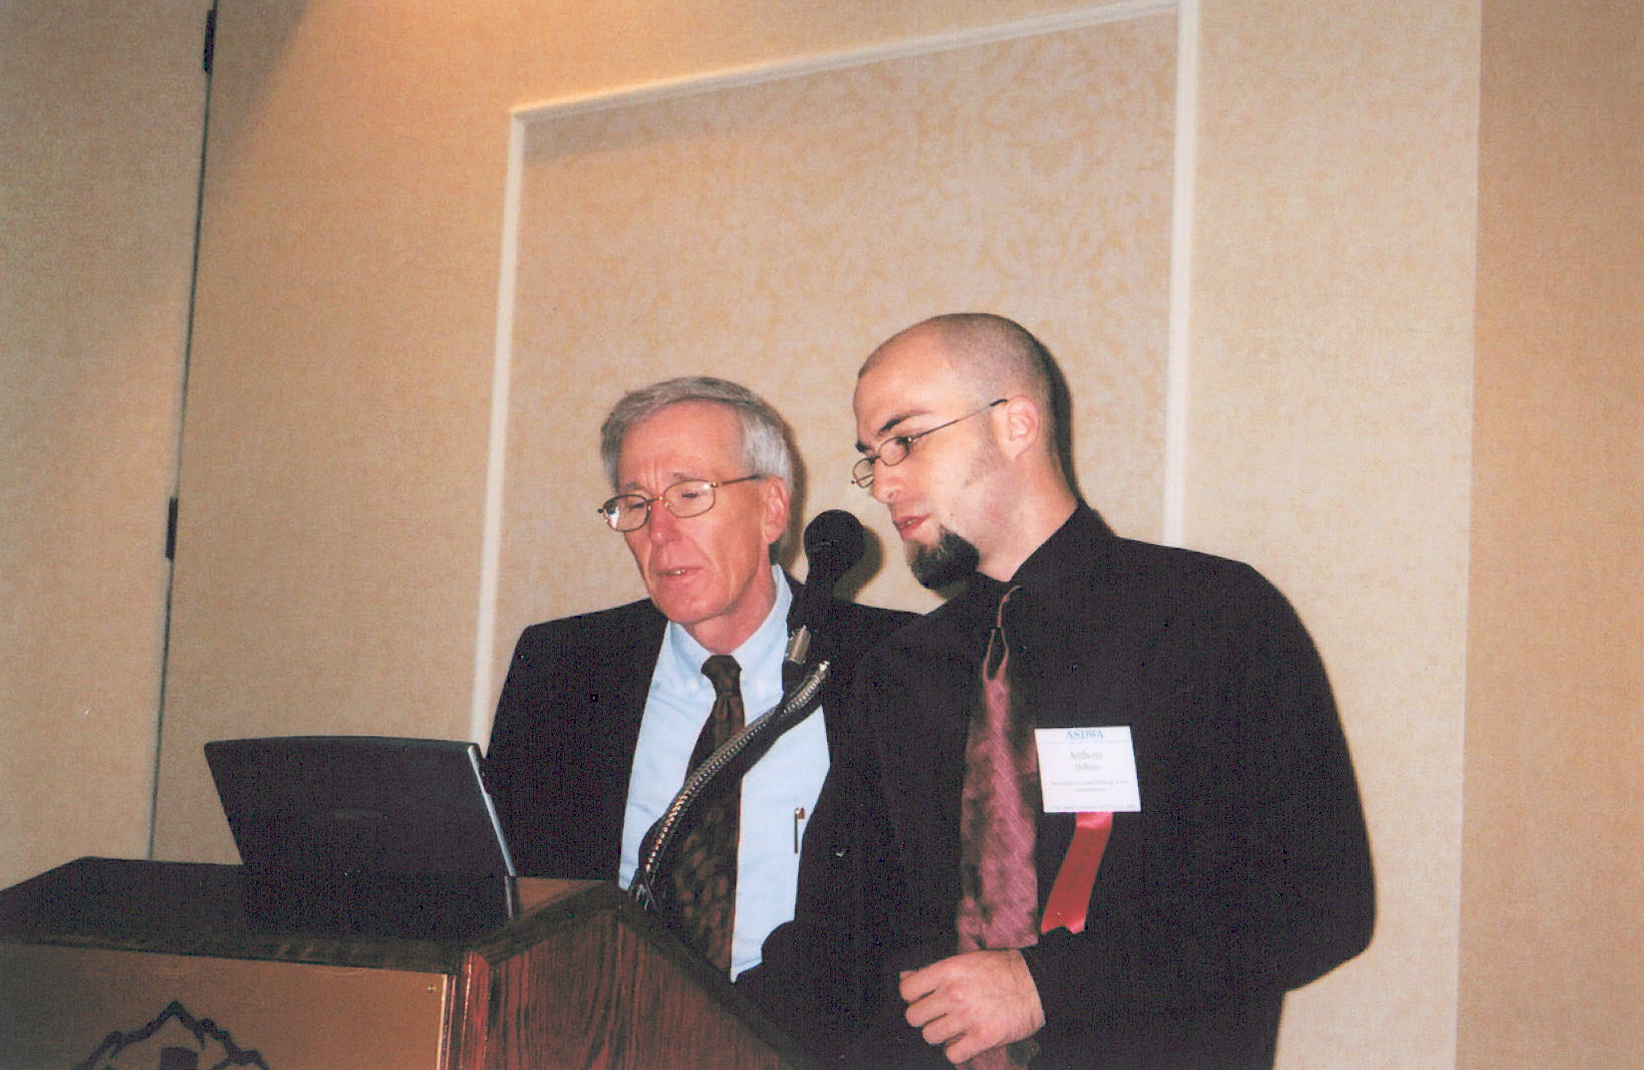
Chet Pauls (CO), Anthony DeRosa (ASDWA)
“Now, if you push this one you’ll be able to see the Matrix”

Slide 33
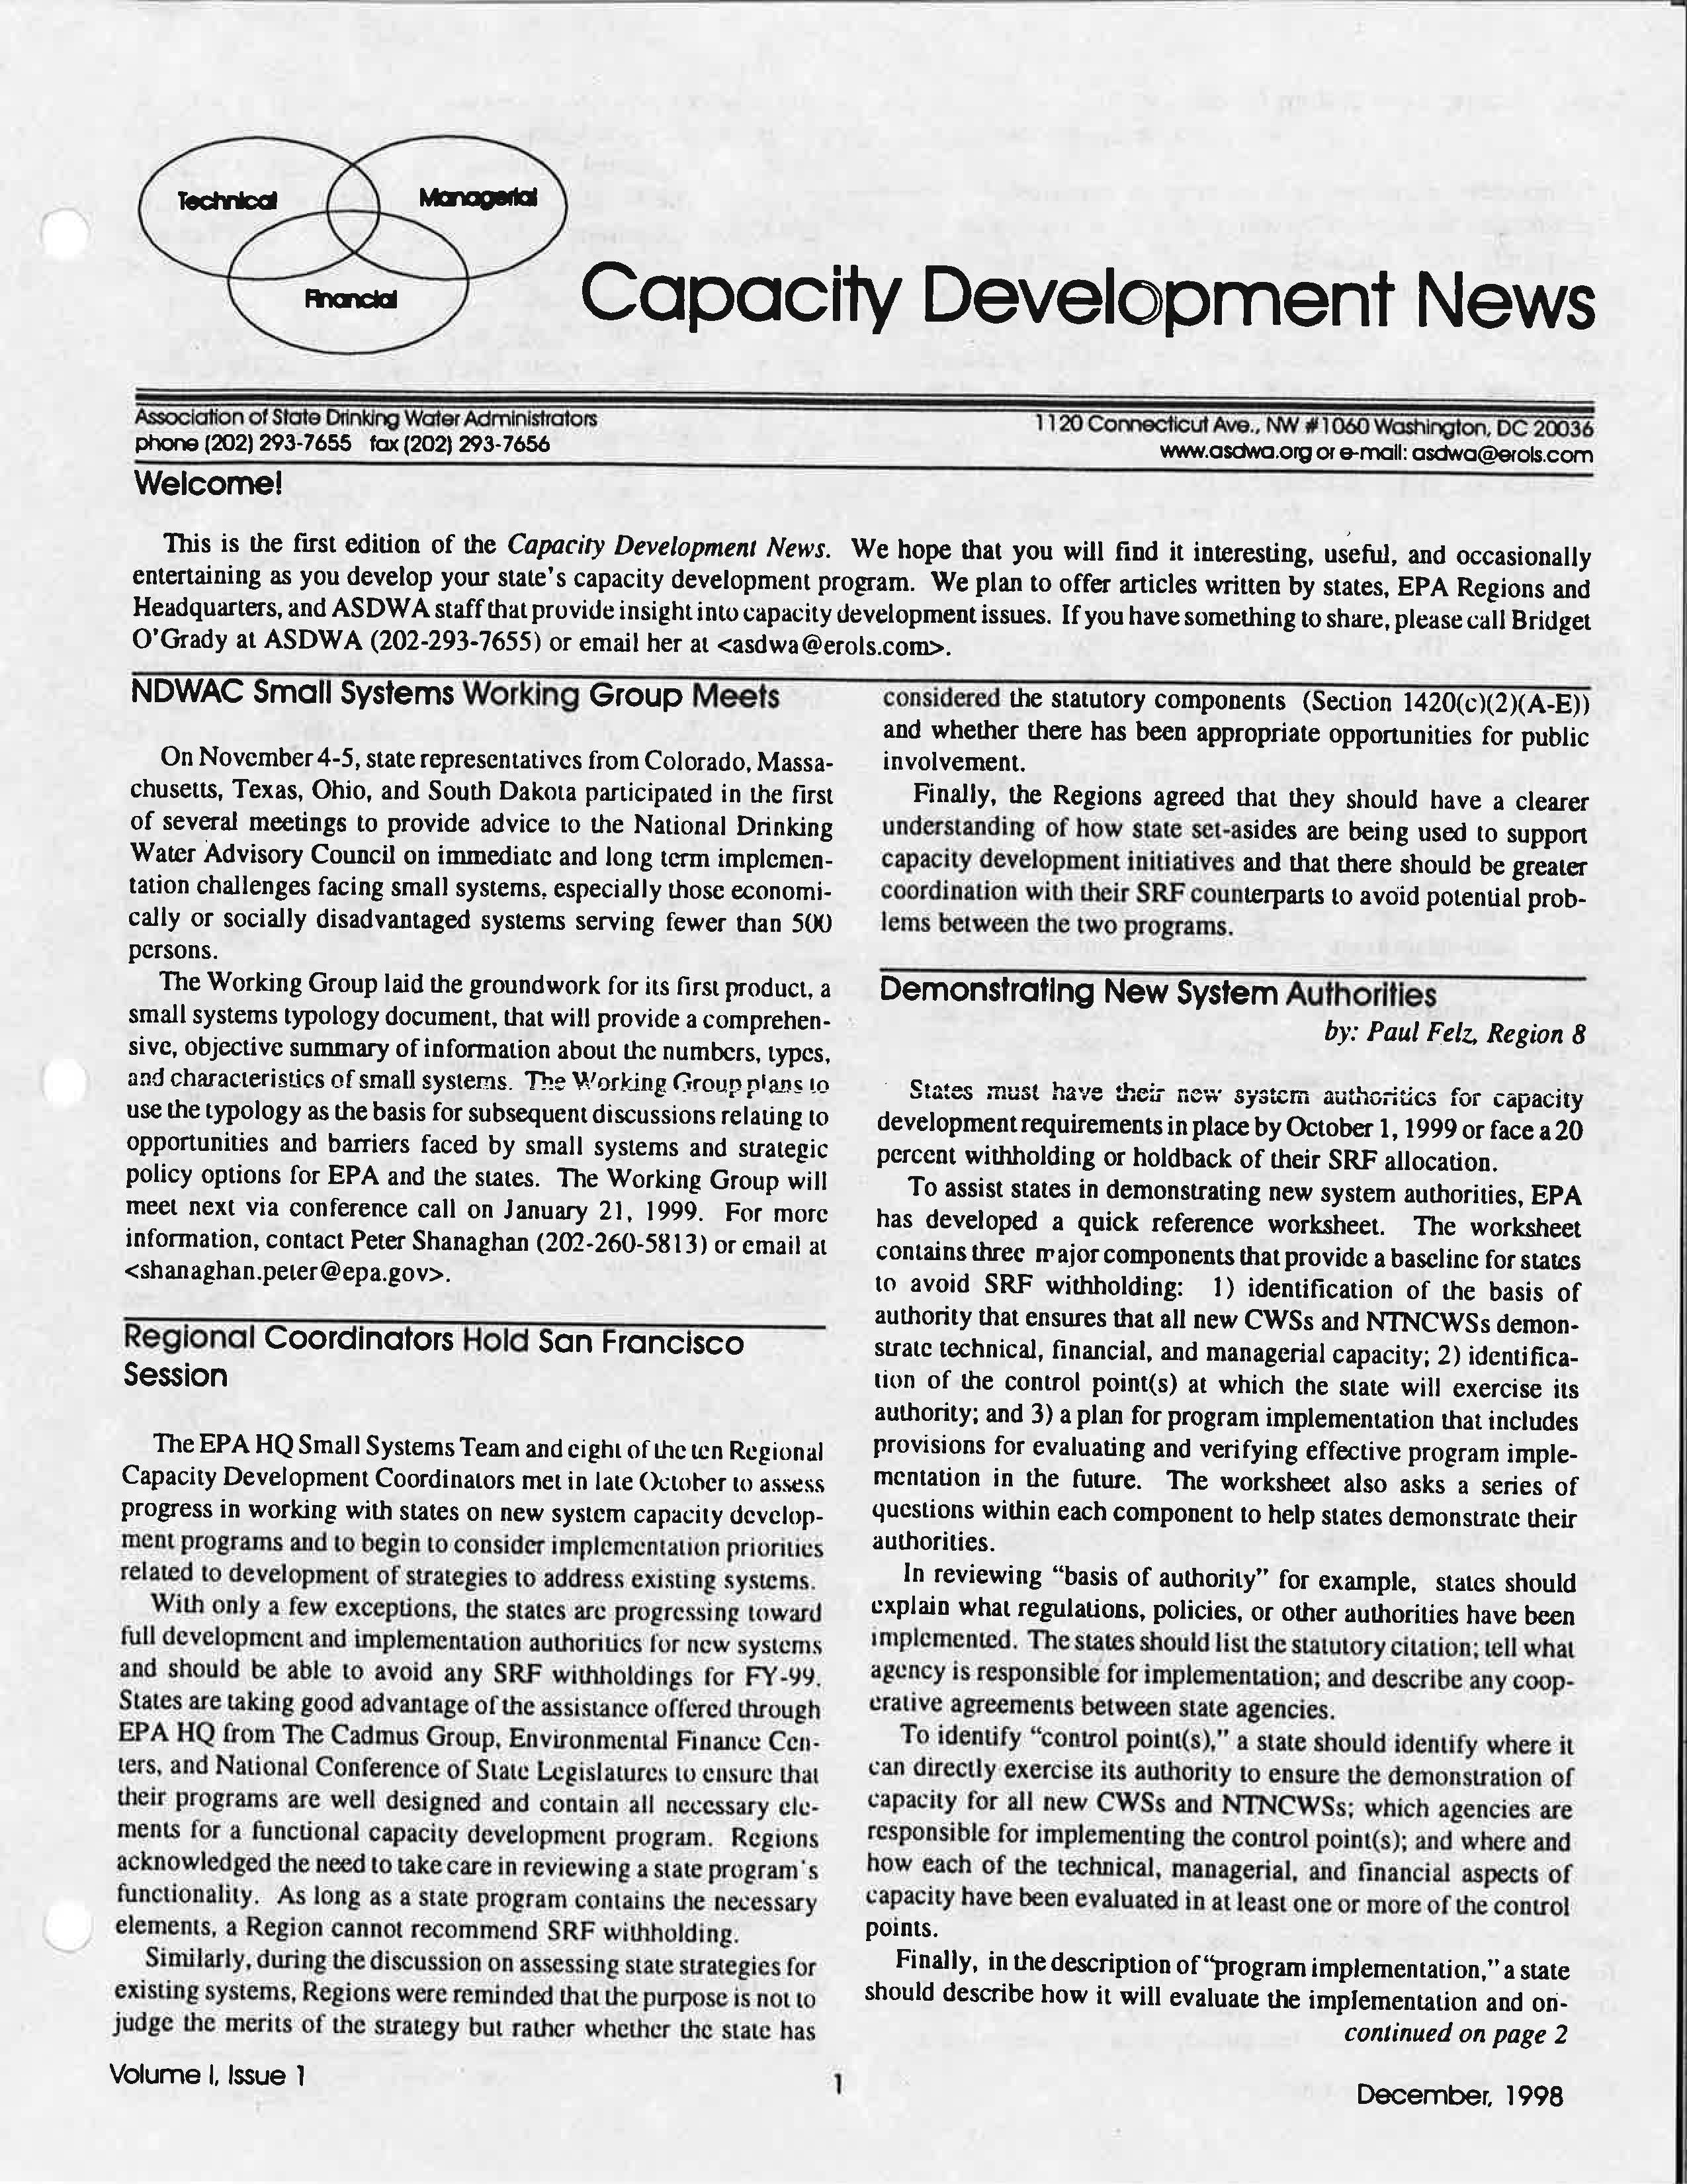

Slide 34
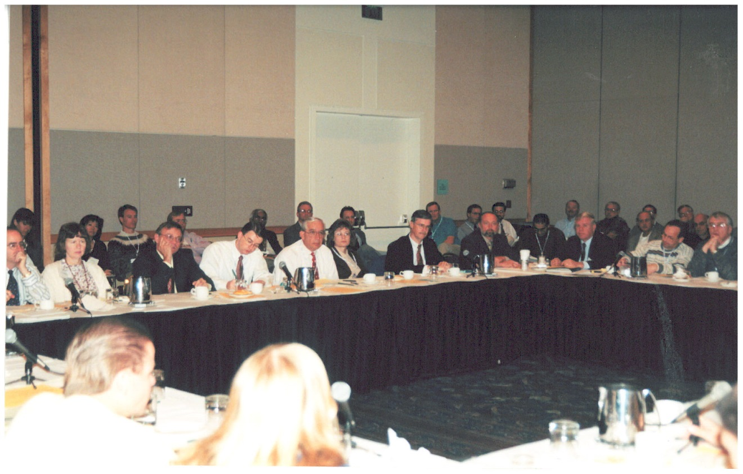
State/EPA Roundtable
“Zzzzzzzzzzzzzz…”

Slide 35
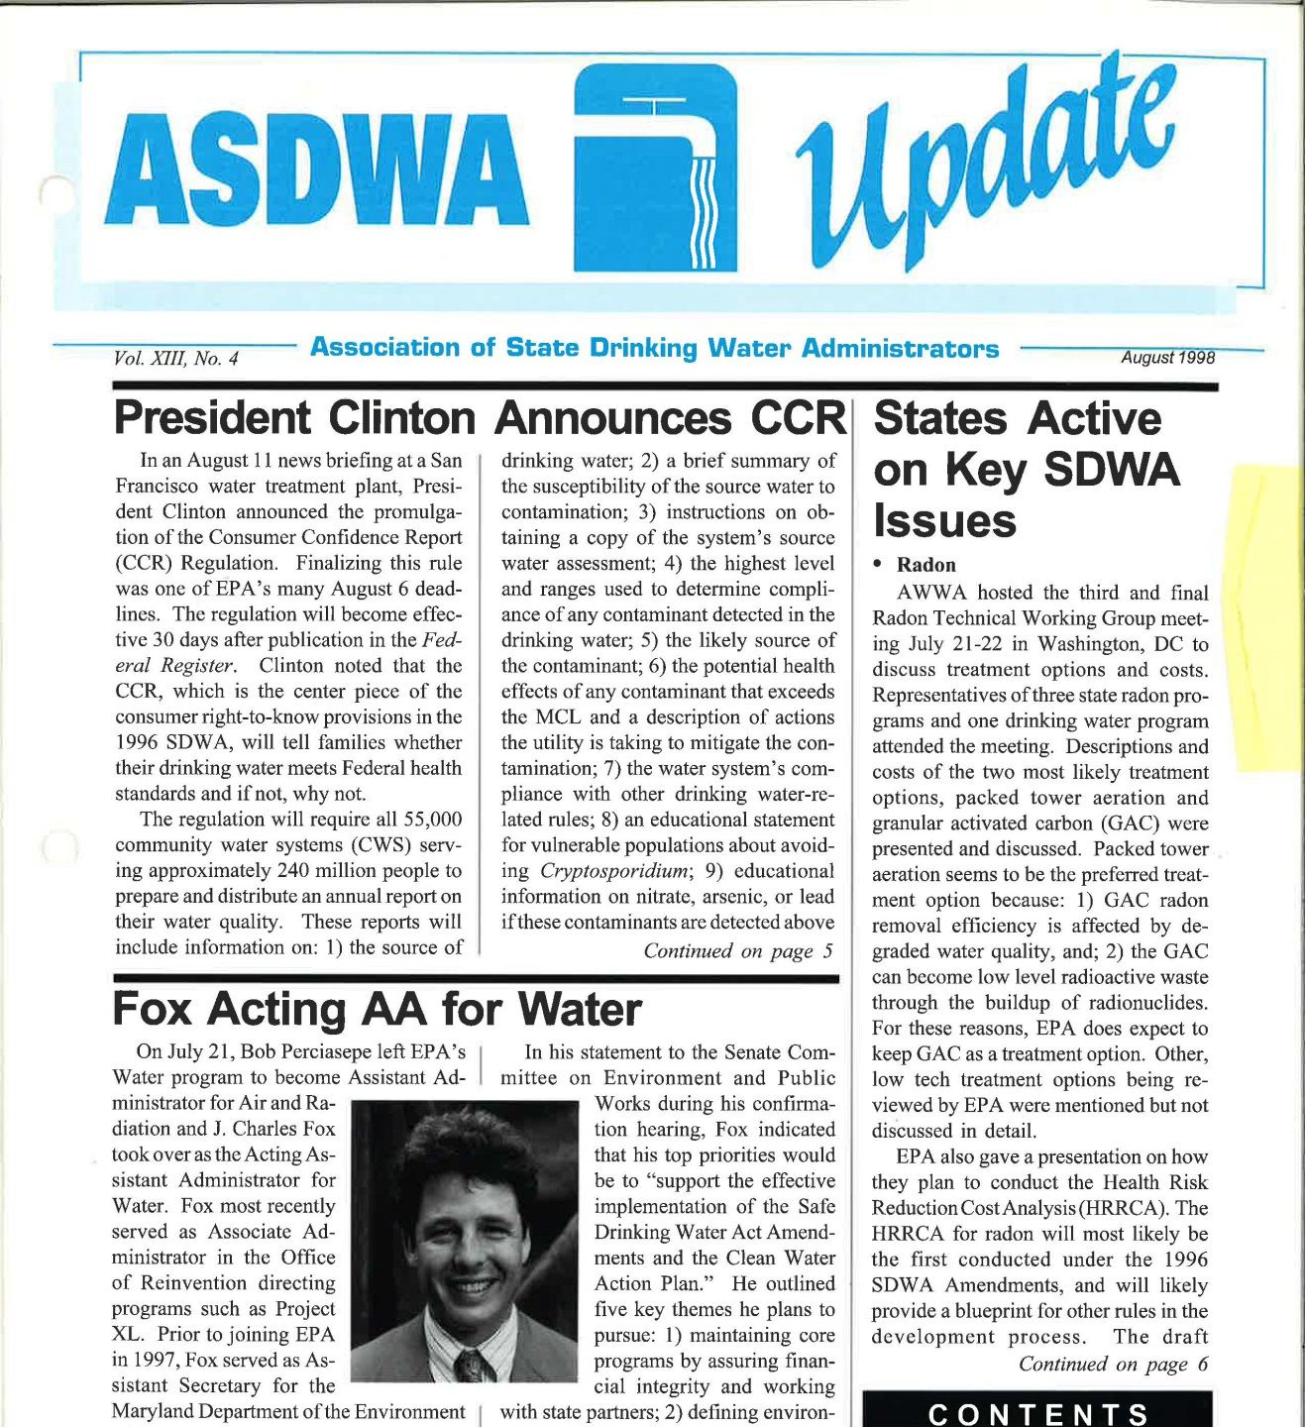

Slide 36
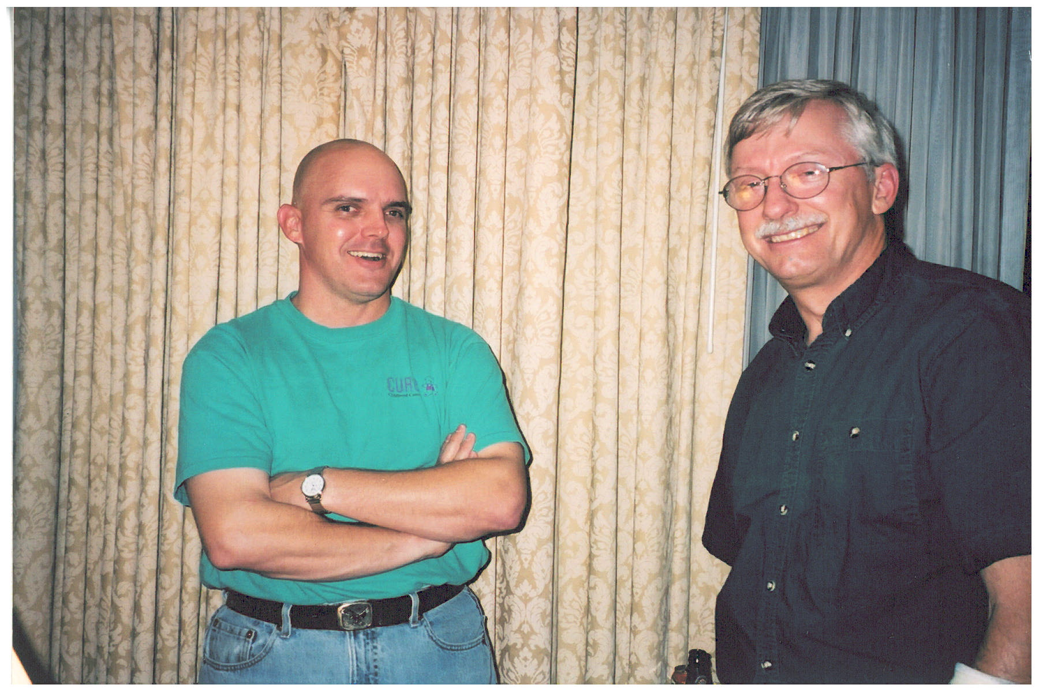
Dave Leland (OR) – ASDWA President 1998

Slide 37
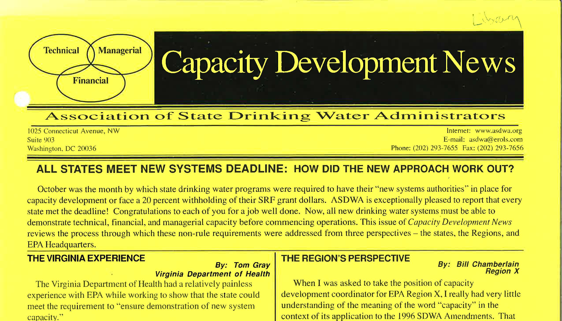

Slide 38
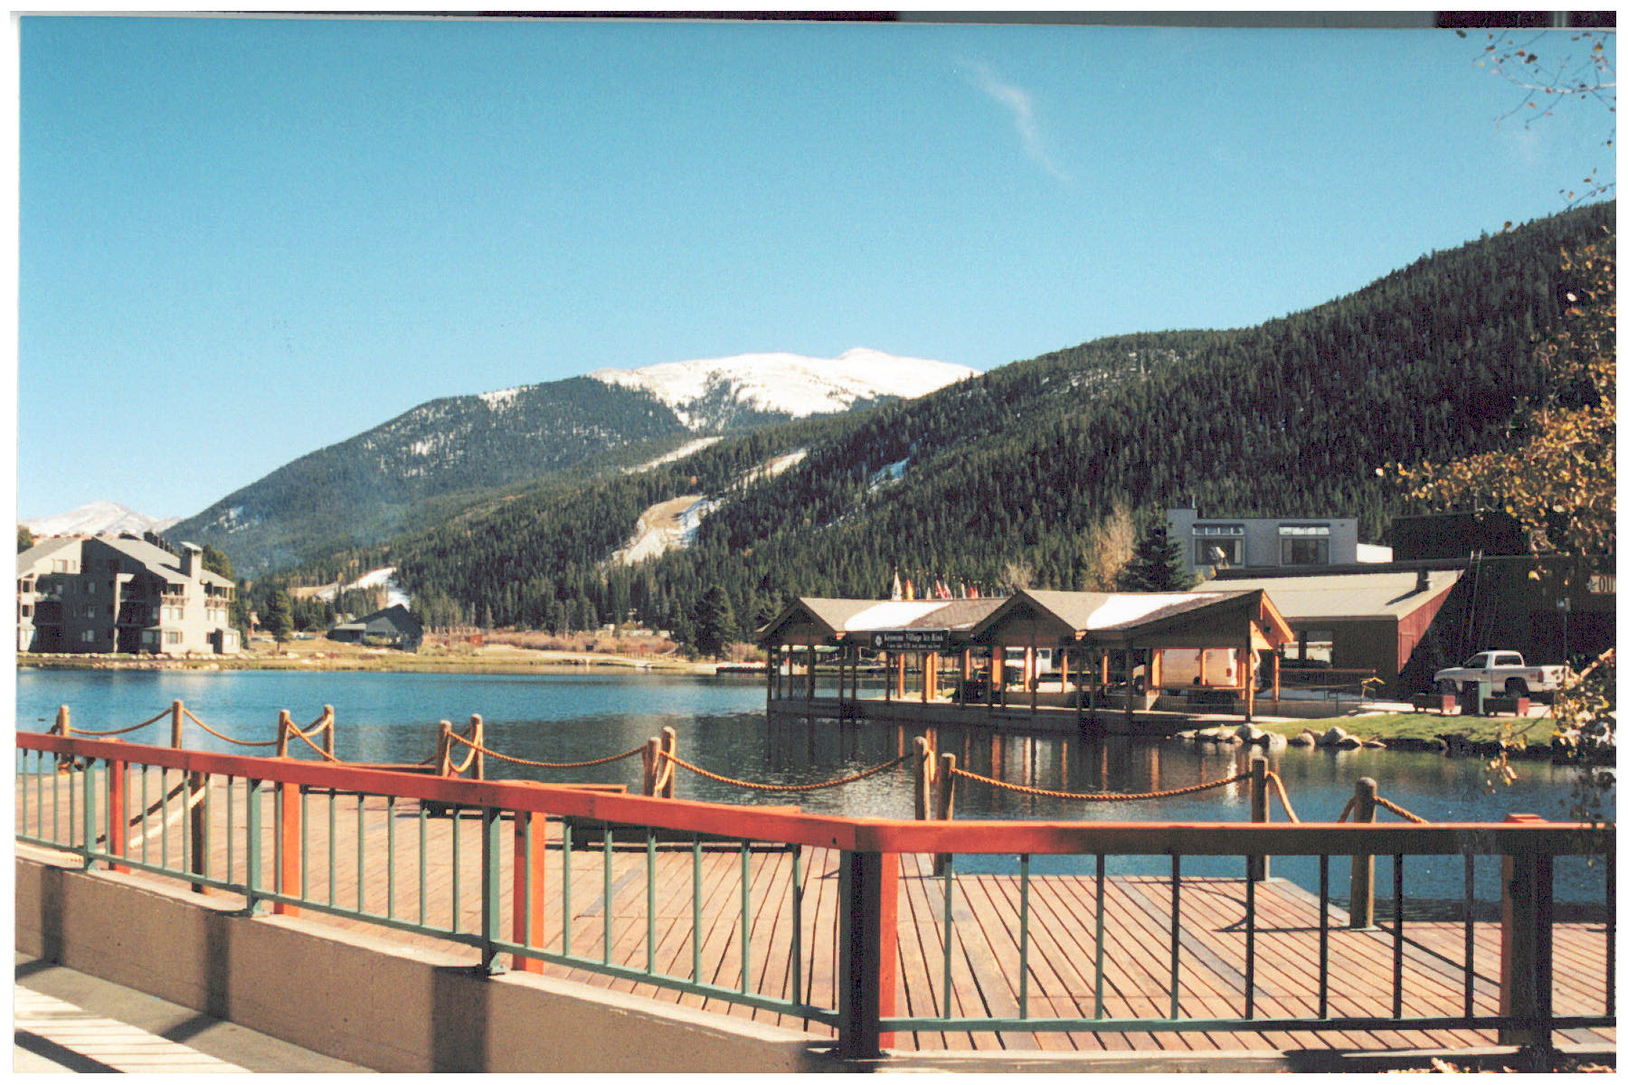
Keystone, Colorado
1998 ASDWA Annual Conference

Slide 39
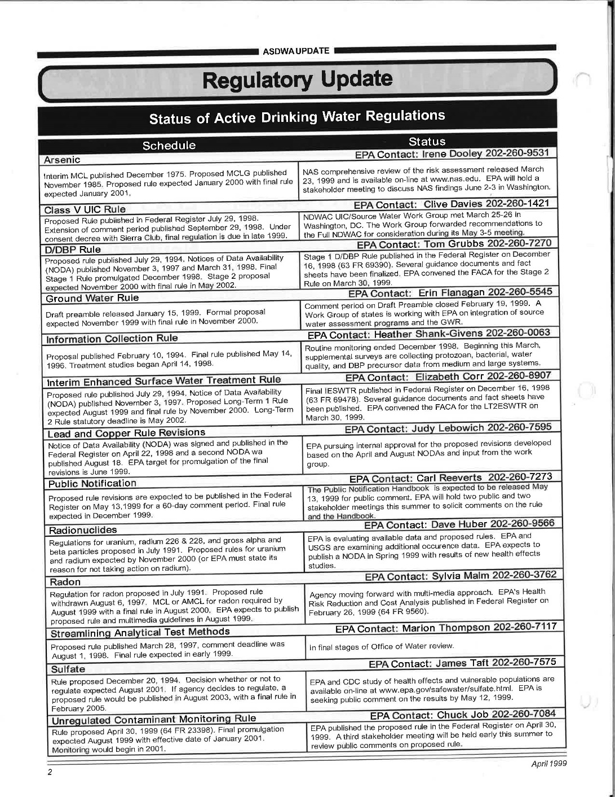

Slide 40
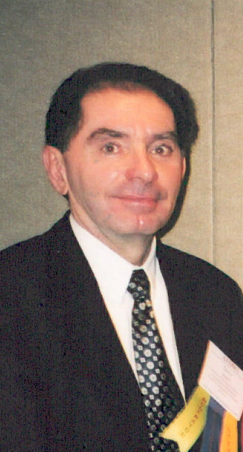
Dave Spath (CA) – ASDWA President 1999 and 2000!!

Slide 41
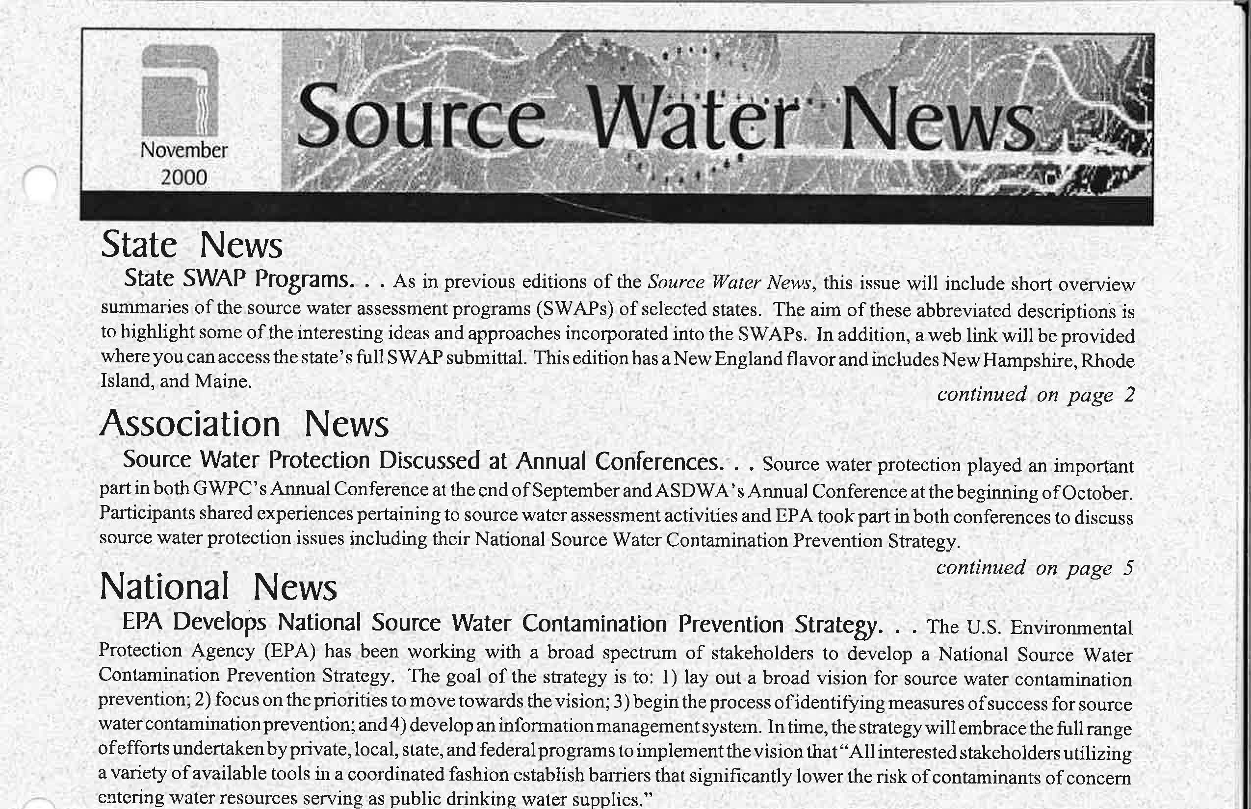

Slide 42
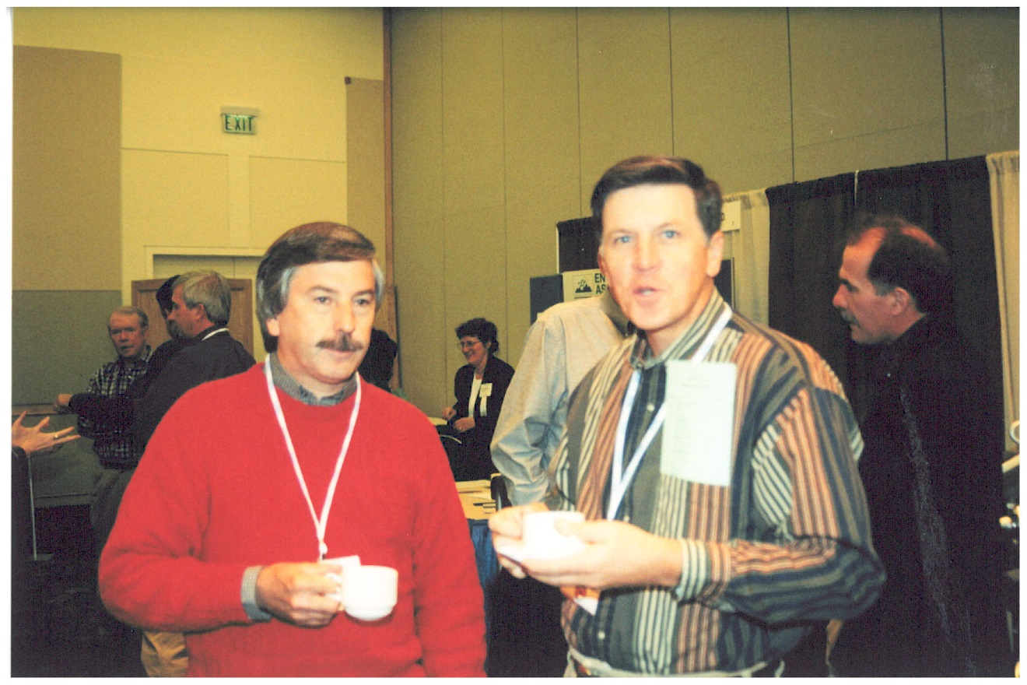
Alton Boozer (SC), Joe Power (AL)
Caffeine and Cookies – Keys to Success!

Slide 43
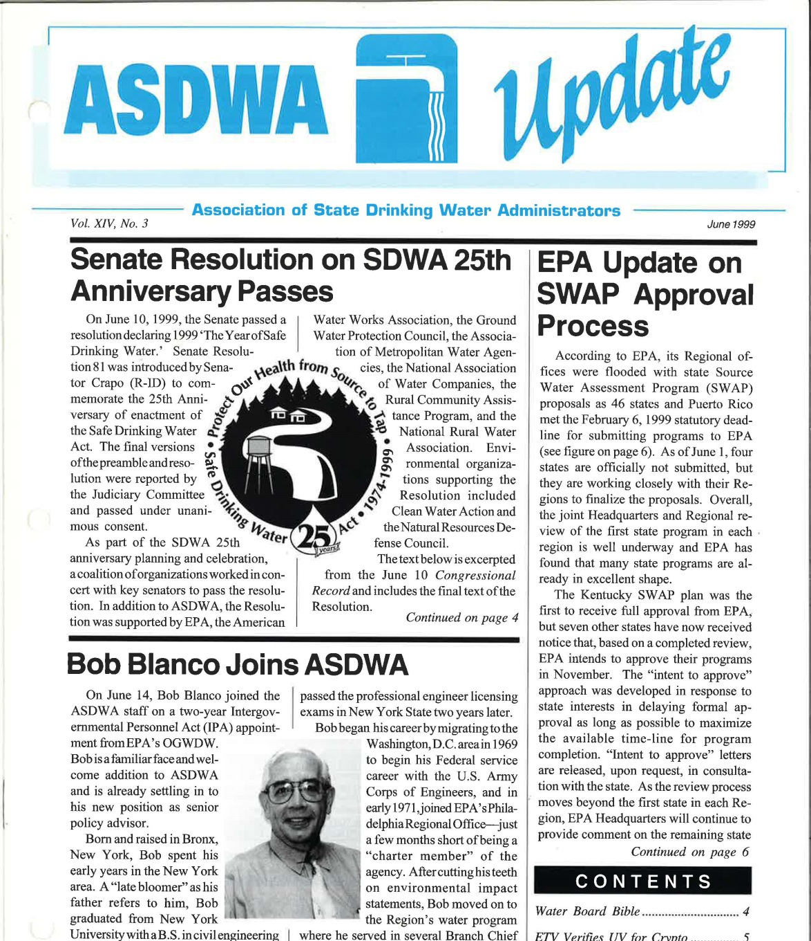

Slide 44
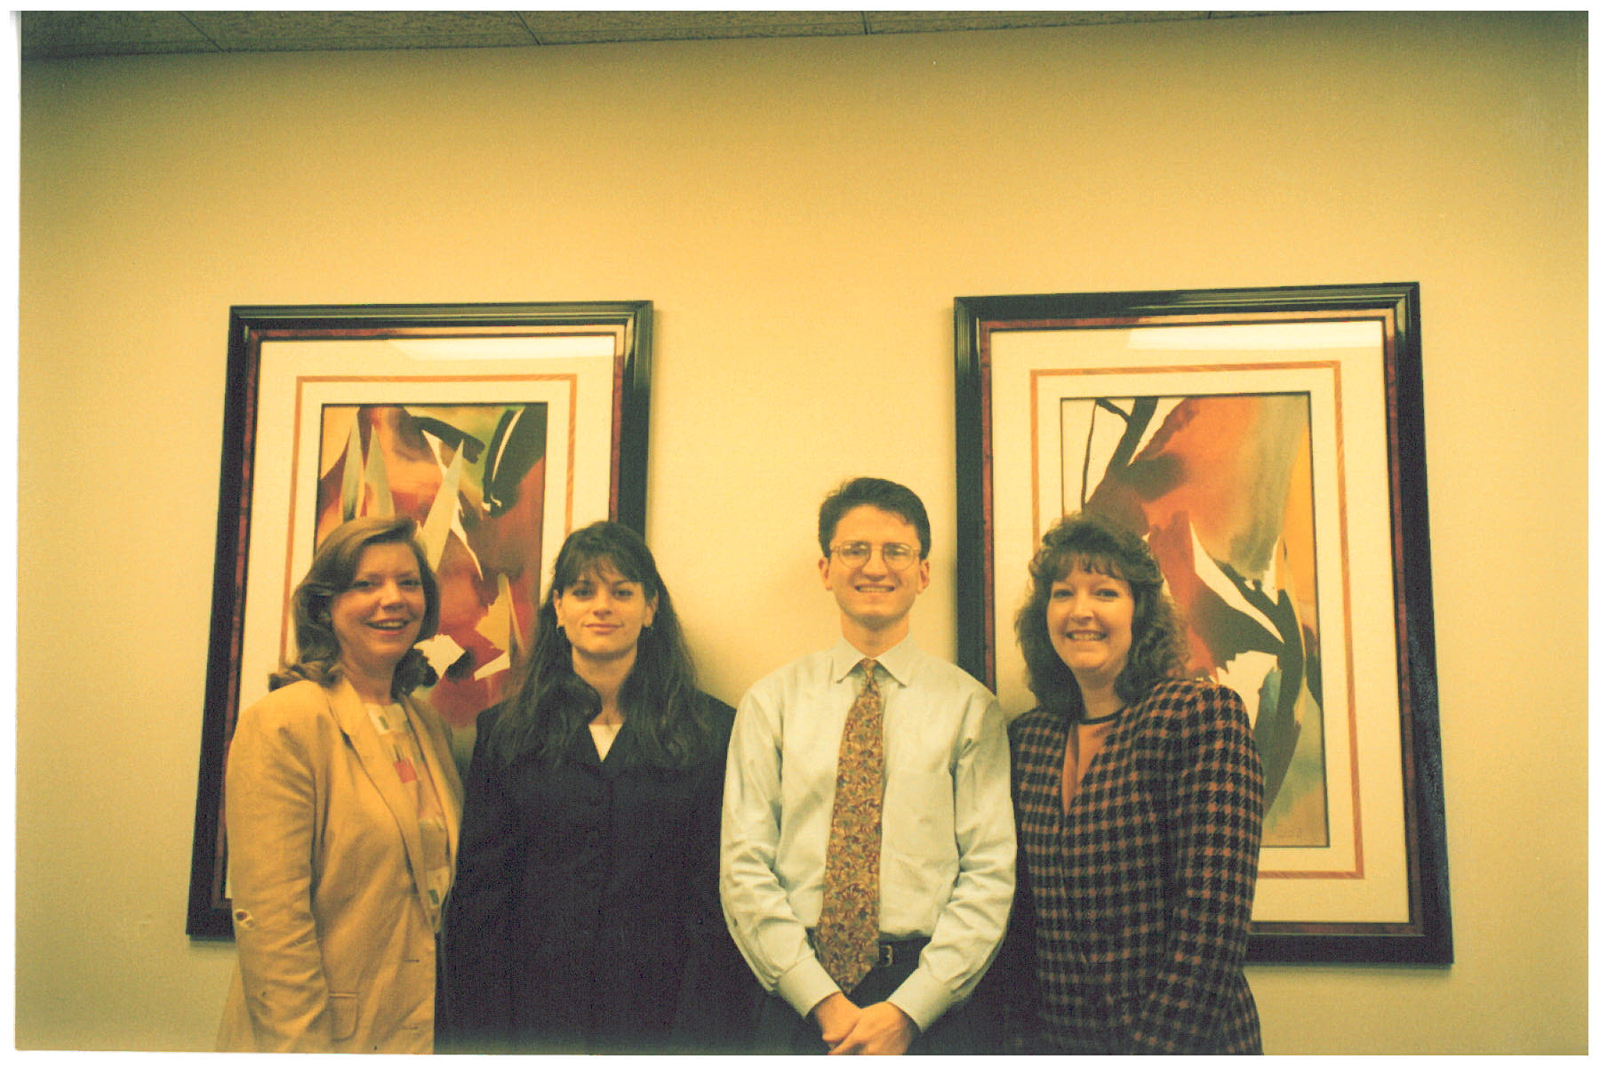
ASDWA Staff: Bridget O’Grady, Deirdre Mason, Tom Outlaw, Vanessa Leiby

Slide 45
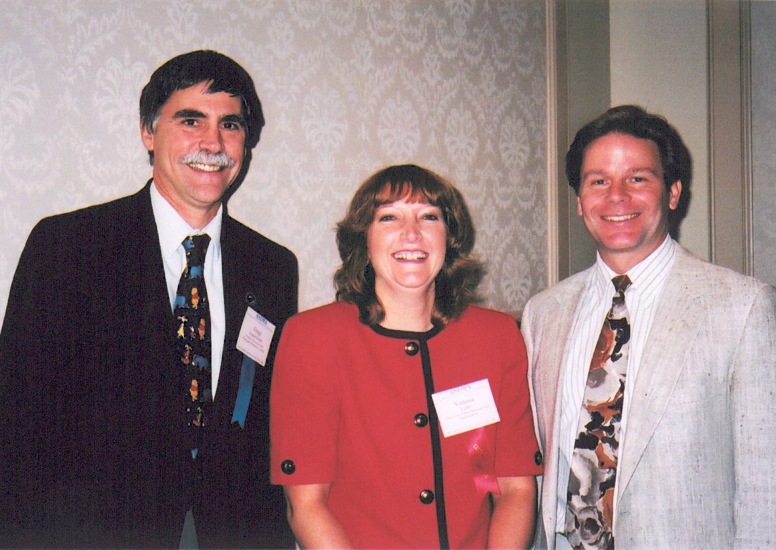
Gregg Grunenfelder (WA) – ASDWA President 2001
Vanessa Leiby (ASDWA), Kevin Brown (UT)

Slide 46
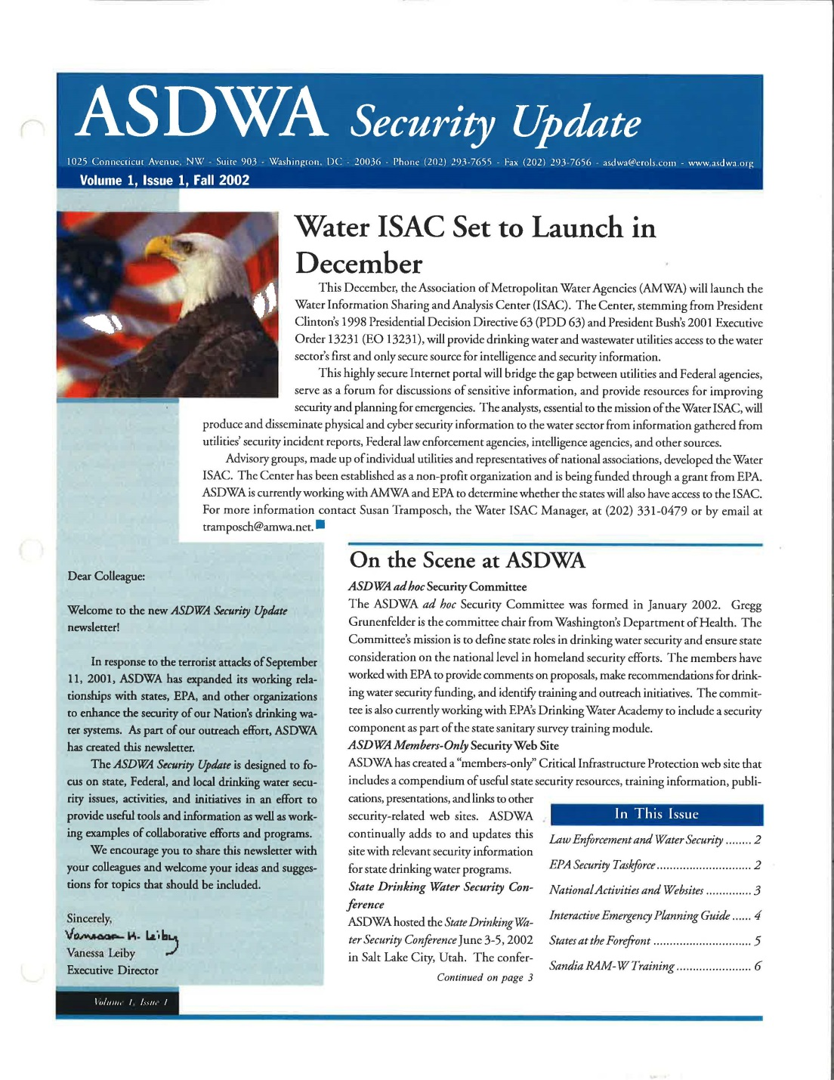

Slide 47
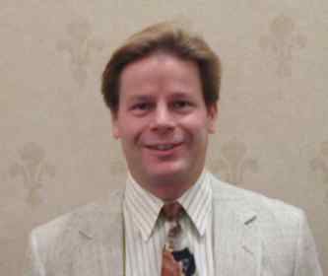
Kevin Brown, ASDWA President 2002

Slide 48
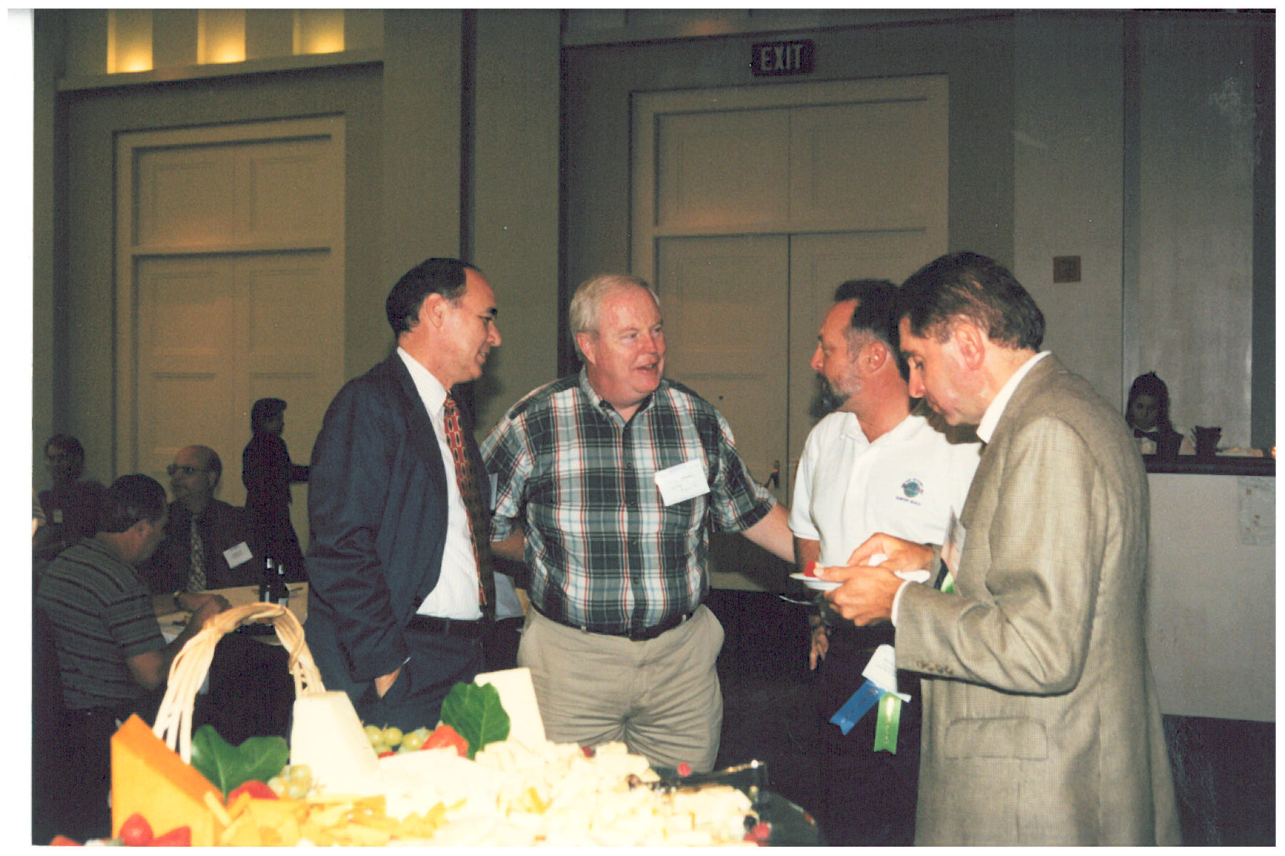
Wade Miller , Jerry Biberstine (CO), Dave Spath (CA)
Notes:
What’s the name of Wade’s organization now? I think it used to be WMA but changed in more recent times.

Slide 49
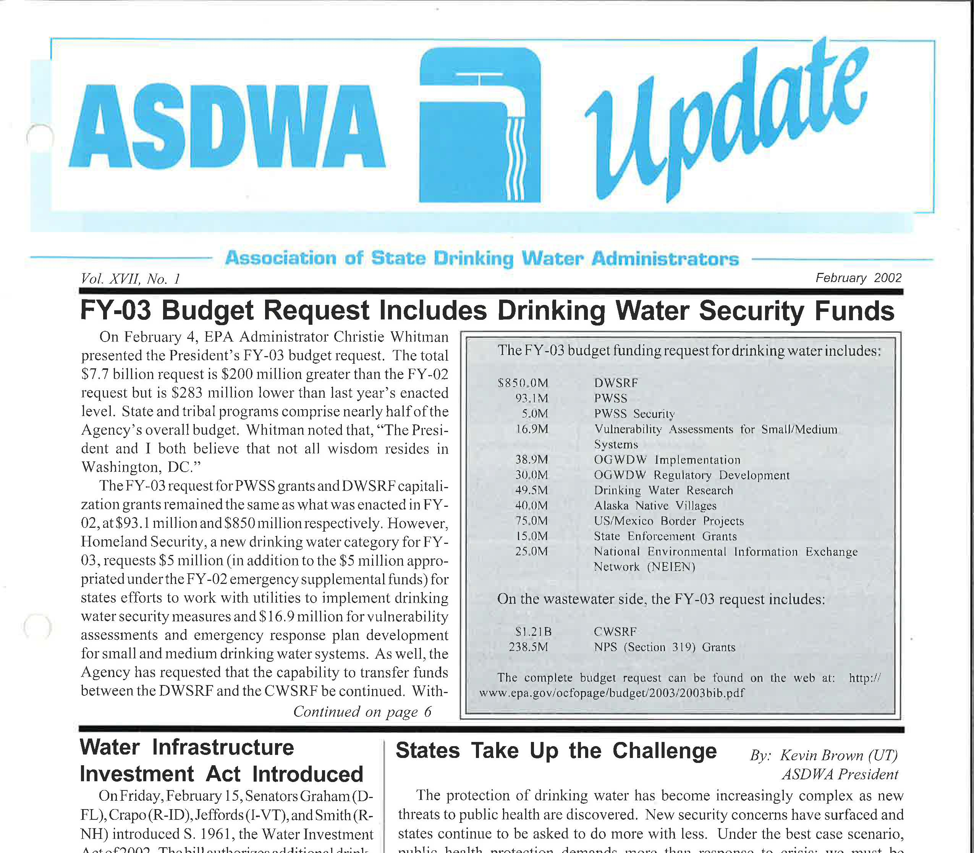

Slide 50
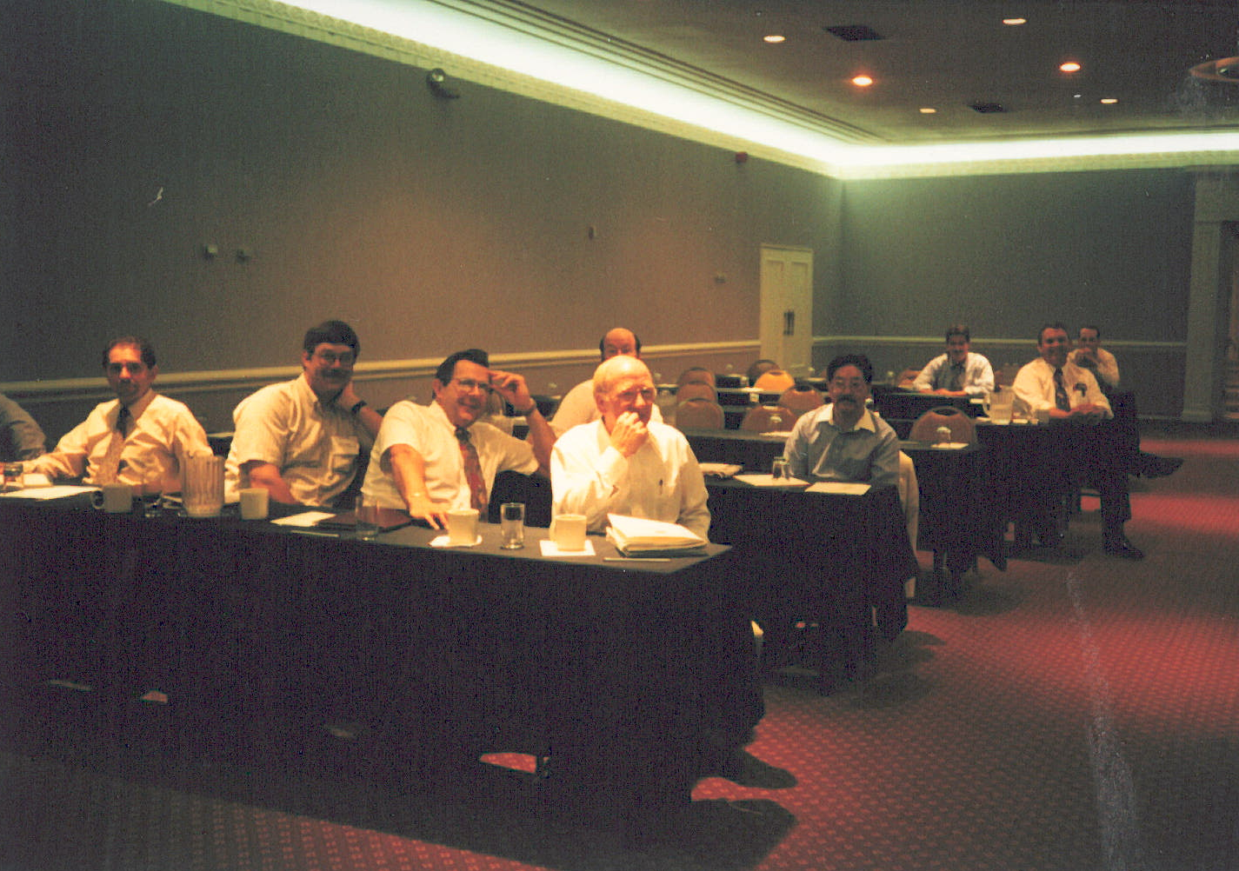
Dave Spath (CA), Ed Hallock (DE), John Sadzewicz (OH), Bob Malpass (SC)
Anchoring the Front Row…Left-Hand Side

Slide 51
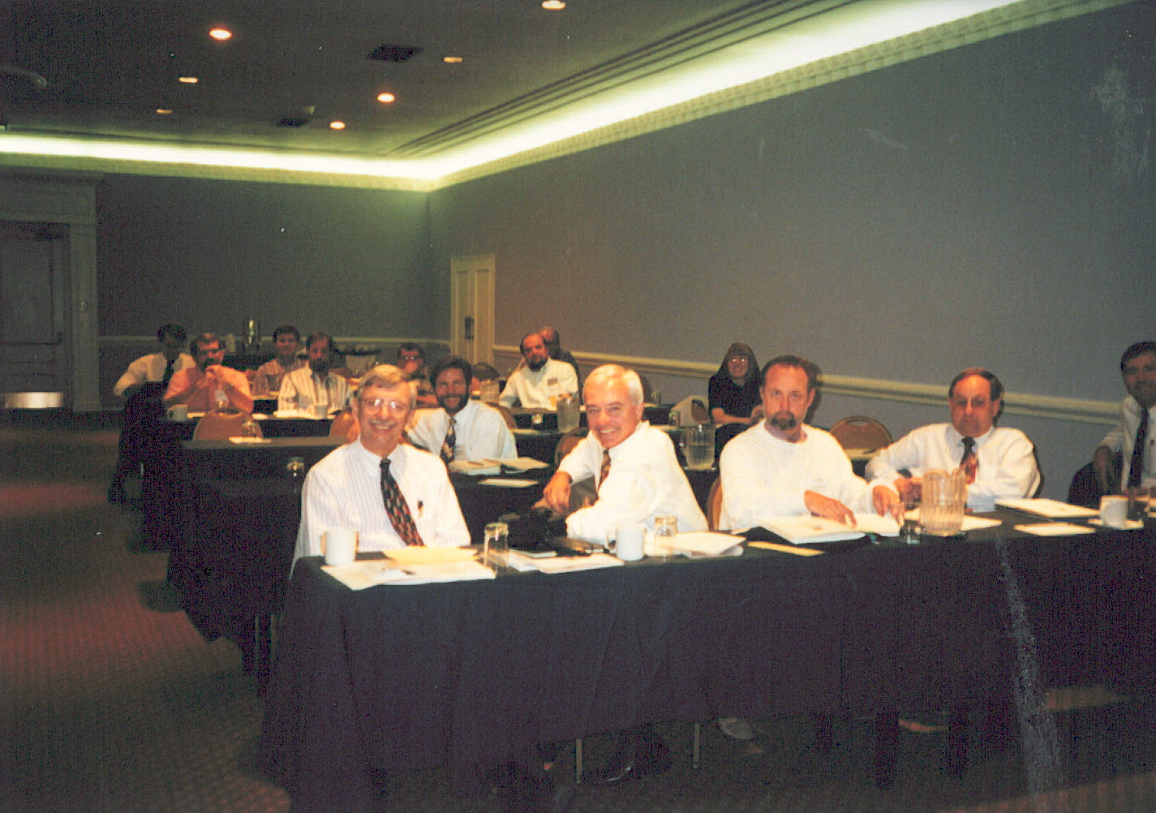
Dave Leland (OR), Jim Cleland (MI), Jerry Biberstine (CO), Jon Craig (OK)
Anchoring the Front Row…Right-Hand Side

Slide 52
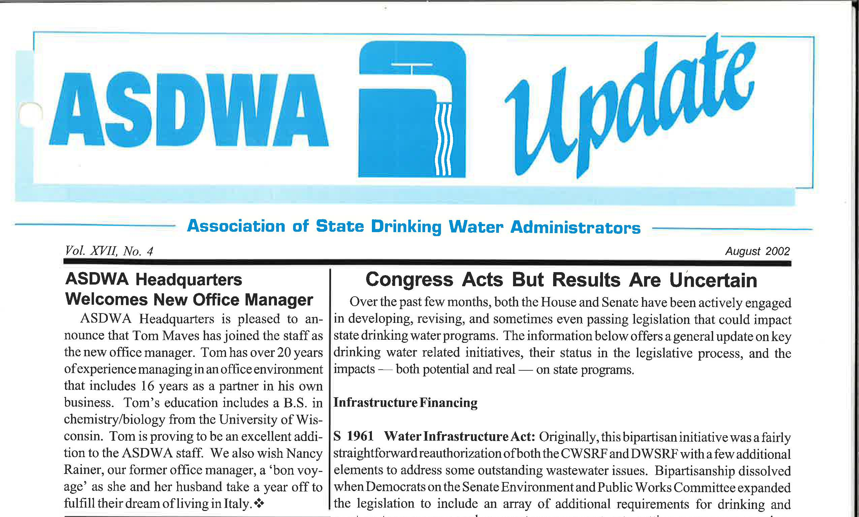

Slide 53
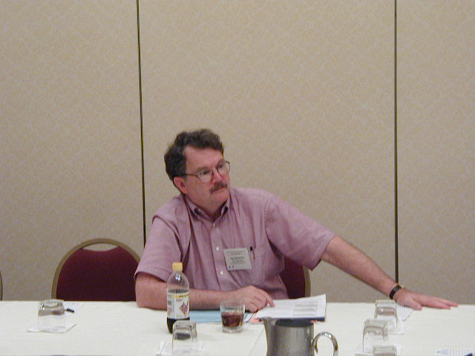
Jay Rutherford (VT) -- ASDWA President 2003
“This Presidency stuff can be a lonely business sometimes….”

Slide 54
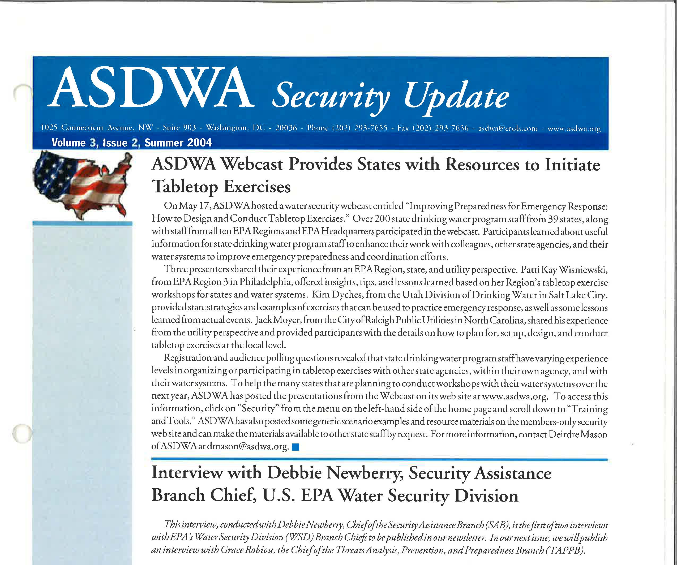

Slide 55

Jeff Sexton (EPA), Barry Greenawald (PA), Doug Davenport (GA), Deirdre Mason (ASDWA), and others
State, EPA, and ASDWA Personnel “Immersing” Themselves in Key Issues

Slide 56

Charlie Maddox (TX), Vanessa Leiby (ASDWA),
& Gayle Smith (UT):
Tanned, Rested, and Ready

Slide 57


Slide 58

Jeff Stuck (AZ), ASDWA President 2004

Slide 59

Left to Right – Van Hoofnagle (FL), Robert Gallegos (NM), John Sadzewicz (OH), Jerry Biberstine (CO), Kevin Brown (UT), Jack Daniel (NE), Rene Pelletier (NH), Ed Hallock (DE), Dave Leland (OR), Jim Cleland (MI)

Slide 60


Slide 61

Jim Taft (ASDWA), Jeff Stuck (AZ)
Van Hoofnagle (FL) -- ASDWA President 2005

Slide 62

Cynthia Dougherty and Bob Blanco (OGWDW), Jim Cleland (MI), Vanessa Leiby (ASDWA)
“I’m going to keep my head down, pretend I’m writing, and hope that Cynthia and Bob don’t come up with any new….‘initiatives’!”

Slide 63

Bob Perciasepe (AA for Water)
“Sure, it may look easy to you, but keeping this moustache groomed is a full time job….”

Slide 64

Darron Busch (SD), Jerry Biberstine (CO)
O.K., I’ll try some of your Colorado beer if you’ll try some of my South Dakota steak.”

Slide 65

Darrell Osterhoudt (MO), Bill Wong (HI)
“Hey Bill, I can’t imagine ever working for these ASDWA guys – there’s way too many details…”

Slide 66

Bob Perciasepe (AA for Water), Cynthia Dougherty (OGWDW), Jim Cleland (MI), Jerry Biberstine (CO)
You’ve got to be kidding!”

Slide 67

Vanessa Leiby (ASDWA), John Sadzewicz (OH), Dave Leland (OR), Kevin Brown (UT)
Enjoying the Rockies….

Slide 68

Vanessa Leiby (ASDWA), Dave Leland (OR), John Sadzewicz (OH)
“If you push this button, the disco ball in the ceiling starts to rotate….”

Slide 69


Slide 70

2000 Board Left to Right – Barker Hamill (NJ), Gregg Grunenfelder (WA), Jerry Lane (MO), Gary Englund (MN), Ed Urheim (GA), Kevin Brown (UT), Jon Palm (NV), Jay Rutherford (VT), Dave Spath (CA), Saeid Kasraei (MD), Dave Leland (OR)

Slide 71

Anthony DeRosa (ASDWA), Brendan Murphy (NRWA), Matt Corson (ASDWA), Jay Rutherford (VT), Nancy Hannan (ASDWA)
“FOJs”: Friends of Jay

Slide 72

Nancy Beardsley (ME), Jay Rutherford (VT), Elizabeth Corr (OGWDW)
More FOJs

Slide 73

Barker Hamill (NJ), Vanessa Leiby (ASDWA), Mike Burke (NY)
The Region II States Brain Trust

Slide 74

Carl Reeverts (OGWDW), Jerry Iwan (CT), Mike Burke (NY), Roger Selburg (IL)
State-EPA…uh...”Partnerships”
Notes:
That’s Ed Hallock giving Carl the “devil horns”

Slide 75

Denise Clifford (WA), Dave Leland (OR)
A Region 10 State Administrators’ “Consultation”

Slide 76

Matt Corson (ASDWA), Rene Pelletier (NH), Anthony DeRosa (ASDWA)
Time to Paaarrrrtttty!

Slide 77

Jay Rutherford (VT), Vanessa Leiby (ASDWA), Jane Downing (EPA Region 1)
“If Pedro Martinez had only been taken out of the game after the 6th inning….”

Slide 78

Roger Selburg (IL), Darrel Plummer (KS), Dave Waldo (KS), Harold Seifert (AR)
“I thought you were going to do
‘see no evil’!”

Slide 79

Jerry Iwan (CT)
“I have a question”

Slide 80

Nancy Hannan (ASDWA)

Slide 81

Cynthia Dougherty (OGWDW) and
Flying Pink Elephant
No Comment!

Slide 82

Bob Blanco (RCAC), Vanessa Leiby (ASDWA)
Bob Blanco sporting a California tan and smile

Slide 83

Brad Addison and Onder Serefli (GA), Alton Boozer (SC)
Stocking up on goodies from the exhibitors

Slide 84

Van Hoofnagle (FL)
“So, before I sign up, are you from a blue state or a red state?”

Slide 85

Vicky Binetti (EPA Region 3), Barker, Doug McKenna (Region 2)
Way too happy for a states-EPA Roundtable…..

Slide 86

“40 CRF 141.82………zzzzz”
Names withheld

Slide 87

Jim Cleland (MI), Jack Daniel (NE)

Slide 88

Abe Siegel (EPA)
“By the time you replace SDWIS, technology will have advanced and the new software will be built in 6 months - a year at the most”

Slide 89

The California contingent (2001)
Cindy Forbes, Rick Sakaji

Slide 90

G Tracy Mehan – EPA AA for Water (2001)

Slide 91

2002 Annual Conference –
Salt Lake City, UT

Slide 92

Van Hoofnagle (FL)
“Now, I’m really getting steamed!
(..and another thing -- who let in Lech Walesa of Poland to my right?”)

Slide 93

Cynthia Dougherty (EPA)
“That state goes on the bad list”

Slide 94

Jim Taft (ASDWA)
“Once I’m settled at ASDWA and see what the administrators are really like, I can always get rid of this moustache”

Slide 95

Matt Corson (ASDWA)
He looks so happy, we won’t upset him with some snarky comment

Slide 96

2004 Annual Conference – Austin, TX

Slide 97

Tom Maves (ASDWA): Urban Cowboy

Slide 98

Buck Henderson (TX), Matt Corson (ASDWA)
“Is the ‘Texas Two-Step’ anything like the ‘Hokey Pokey’?”

Slide 99

2002 Board – Jim Cleland (MI), Jeff Stuck (AZ), Mike Burke (NY), Jay Rutherford (VT), Kevin Brown (UT), Gregg Grunenfelder (WA), Lance Nielsen (ID), Ed Hallock (DE), Vicki Ray (KY), Buck Henderson (TX), Dennis Alt (IA), Jim Melstad (MT)

Slide 100

Ben Grumbles – EPA AA for Water

Slide 101

Anthony DeRosa (ASDWA)
The best laid plans of mice and men oft go astray…..

Slide 102

Steve Heare (DWPD), Janet Pawlukiewicz (WSD), Ephraim King (SRMD)

Slide 103

Joy Barrett (RCAP) & Bridget O’Grady (ASDWA)
Chillin’ at the Conference reception

Slide 104

Harold Seifert (AR), Tony Bennett (TX), Dave Leland (OR), Ed Hallock (DE)

Slide 105

Cynthia Dougherty (OGWDW), Mike Shapiro (OW), Jim Taft (ASDWA), Van Hoofnagle (FL)

Slide 106

Gregg Grunenfelder (WA) – Boston 2003
Auditioning for a spot on
“America’s Funniest Home Videos”

Slide 107

Anthony DeRosa (ASDWA)
“If I look really serious, they’ll all think I know what I’m doing up here….”

Slide 108

2005 Annual Conference – St Louis, MO

Slide 109

Chet Pauls (CO), Mark Mayer (SD), Larry Thelen (ND)
None of them named Tom Sawyer

Slide 110

Nancy Beardsley (ME) – ASDWA President 2006

Slide 111

ASDWA New Logo - 2006

Slide 112


Slide 113

Brad Addison (GA)
ASDWA President 2007

Slide 114

Yu-Ting Guilaran (OGWDW), Ed Hallock (DE)
“The problem with being Regulatory Committee chair is that you always have to sit through the boring regulatory sessions”

Slide 115

Bridget O’Grady (ASDWA), Chi Ho Sham (Cadmus), Melissa Parker (MS)
“And the winner is…”

Slide 116

Lance Nielsen (ID) – ASDWA President 2008

Slide 117

Mike Baker (OH), ASDWA President Introduces EPA Administrator Lisa Jackson at the 2009 Member Meeting

Slide 118

2009 Summer Board Meeting
Leaving for a 3 hour tour, a 3 hour tour…..

Slide 119

Darrell Osterhoudt (ASDWA)
“their tiny ship was tossed….”

Slide 120

Jill Jonas (WI) – ASDWA President 2011

Slide 121

Wes Kleene (VA)

Slide 122

Denise Clifford (WA), Lance Nielsen (ID), John Calkins (AZ), Mike Baker (OH)
“Then the police told me to face left, like this”

Slide 123

Denise Clifford (WA), Lance Nielsen (ID), John Calkins (AZ)
“No matter how funny you think it is, being seasick is no joke”

Slide 124

Karen Irion (LA)
“ Don’t ask what I had to do to get all these”

Slide 125

Peter Silva – EPA AA for Water (2009)
Seriously – does anyone really remember him?

Slide 126

Chuck Job (EPA), Jon Dilliard (MT)

Slide 127

Denise Clifford (WA) –
ASDWA President Queen 2010

Slide 128

Ed Hallock (DE) –
ASDWA President 2012

Slide 129


Slide 130

Sarah Pillsbury –
ASDWA President 2013

Slide 131

Dorothy Taft (musical spouse)
“Hummmm………..”

Slide 132

John Calkins (AZ) –
ASDWA President 2014

Slide 133

SDWIS Pool Championship!

Slide 134


Slide 135

Steve Sturgess (MO) –
ASDWA President 2015

Slide 136


Slide 137


Slide 138

ASDWA Board of Directors 2017

Slide 139


Slide 140

Team ASDWA (2023) at Bealeton

Slide 141

ASDWA’s Executive Directors

Slide 142


Slide 143


Welcome Carsen and Holly! (2024)

