Slide 1
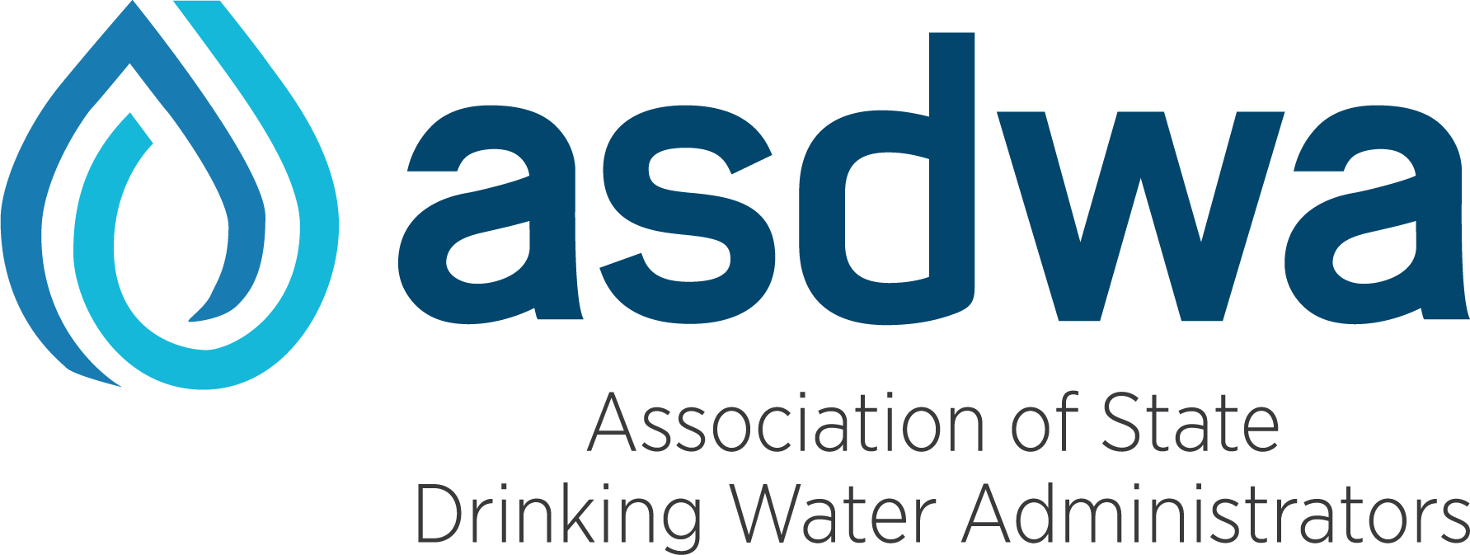
9th Biennial AWOP National Meeting
Status
Targeted Performance Improvement
Maintenance
July 19-21

Slide 2
ASDWA Introduction
July 19th
Alan Roberson – ASDWA Executive Director (aroberson@asdwa.org)
Kevin Letterly – ASDWA Policy Analyst (kletterly@asdwa.org)

Slide 3
Who is Asdwa?
The Association of State Drinking Water Administrators (ASDWA) is the professional Association serving state drinking water programs. Formed in 1984 to address a growing need for state administrators to have national representation.
ASDWA members are the drinking water program administrators in the 50 states, the five territories, the Navajo Nation, and the District of Columbia. (15 of the 50 state drinking water programs are located in state departments of health, 32 are located in state departments of the environment or natural resources, and 3 are in mixed departments of health and environment.)

Slide 4
AWOP and ASDWA History
ASDWA’s AWOP involvement began around 2003 and 2004
Briefing with former ASDWA Executive Director Jim Taft on AWOP expansion and use by state drinking water programs
Briefing points that aligned with ASDWA’s Mission:
AWOP developed in cooperation with Region 4 and 6 states
States have documented water system performance improvements
OGWDW requested ASDWA’s assistance to expand the use of AWOP by states

Slide 5
ASDWA’s Involvement Now
Providing travel support
Assisting in hosting and facilitating meetings
Providing online opportunities for collaboration among states
Forums and UserVoice
Including AWOP in various ASDWA meetings and discussions
Recent AWOP Everything But the Bagel

Slide 6
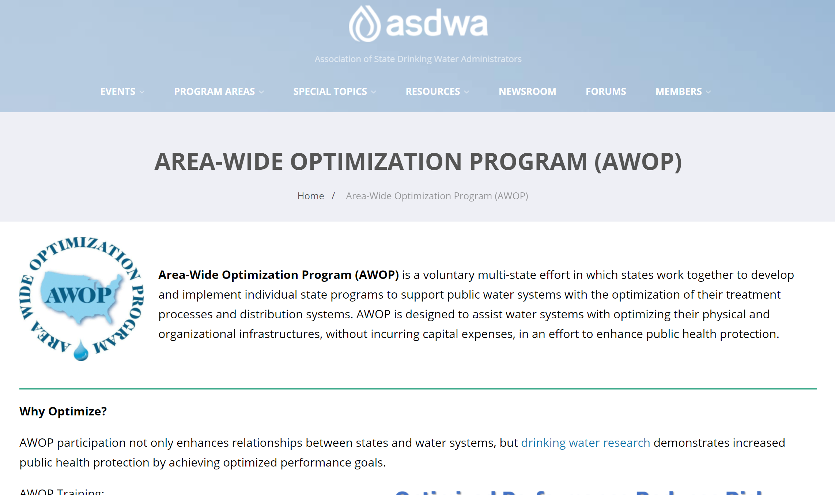
ASDWA’s Involvement Now
Recently completed ASDWA AWOP webpage (https://www.asdwa.org/awop/)
Visit the page and give us feedback!
More to come on the webpage (new state tools and information, etc.)

Slide 7
Why ASDWA Supports AWOP
The benefits of AWOP align with ASDWA’s mission
AWOP network provides links to expertise and resources nationally, including a long list of technical tools and resources
AWOP fosters a state-to-state relationship that encourages sharing information and implementing technical approaches and promoting improved public health as a state community

Slide 8
Clear examples of Success

Slide 9
Clear examples of Success

Slide 10
ASDWA Support of AWOP will Continue
Although some of the successes of AWOP can be shown graphically – DBPs and turbidity, there are many more that cannot.
The teamwork and relationships the Program has built are an invaluable benefit and tool that cannot be measured but can be directly tied to the continual and evident improvement in the nation’s drinking water.
AWOP transcends geographic and federal boundaries and acts as a bridge to state and regional collaboration in improving public health across the country. The Program’s success is the direct result of the hard work and perseverance that you all, the states and EPA, have shown in the support of a voluntary program in the name of protecting public health.
These countless benefits reinforce ASDWA’s mission, and we look forward to continuing to support AWOP in any way we can.

Slide 11
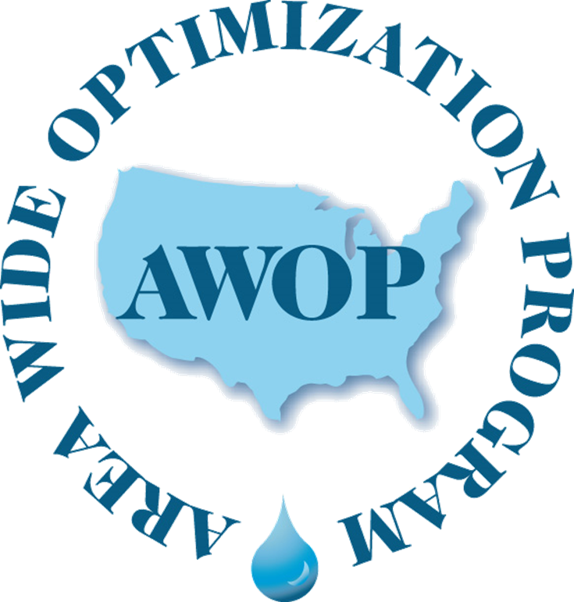
AWOP: Current Status & Vision for the Future
Rick Lieberman
Office of Ground Water and Drinking Water
Standards and Risk Management Division
Technical Support Center
Cincinnati, OH

Slide 12
Disclaimer
The information in this presentation has been reviewed and approved for public dissemination in accordance with U.S. Environmental Protection Agency (EPA). The views expressed in this presentation are those of the author and do not necessarily represent the views or policies of the Agency. Any mention of trade names or commercial products does not constitute EPA endorsement or recommendation for use.

Slide 13
Presentation Overview
Status of AWOP network
Recap of Activities since 2019
AWOP Impacts
Future AWOP Vision
Focus Areas
Implementation Strategies
Notes:
This presentation will describe the current status of the Area-Wide Optimization Program by a review of activities since our last biennial meeting and sharing some examples of AWOP impacts on water quality using AWOP M/DBP data. Note that most of this occurred while we were all dealing with the pandemic.
Examples of AWOP impacts will draw upon data collected by the AWOP network and shared during AWOP multistate meetings. These are only a few examples of AWOP impacts that have been reported.
Data will reveal AWOP impacts for an example water system, an example of state-wide impacts and also the national AWOP graphs.
I will then talk about the future of the program and how the pandemic has resulted in challenges and potential opportunities for AWOP going forward.

Slide 14
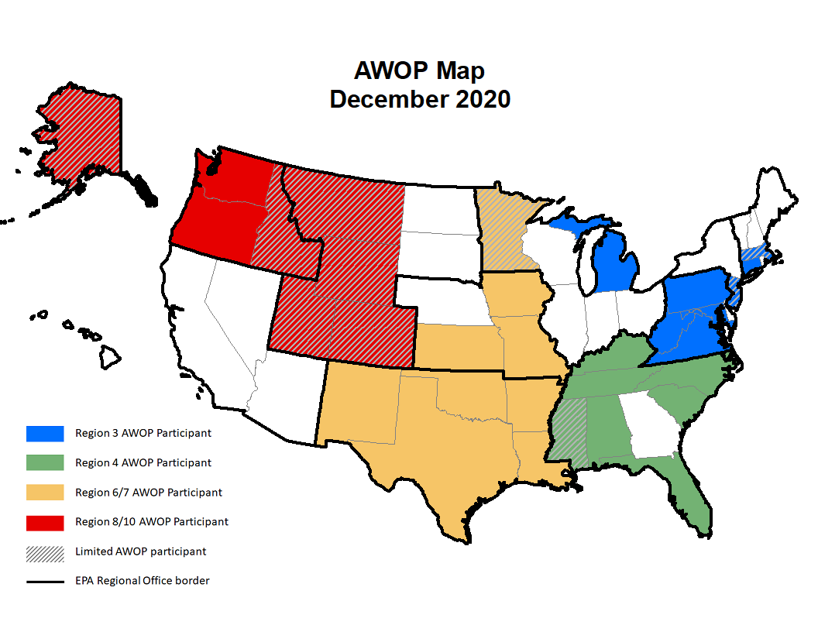
AWOP Network Status:
ASDWA: https://www.asdwa.org/awop/
Notes:
This map depicts states that are participating in AWOP. It doesn’t reflect all the states hosting AWOP tools and training events, but the coloration on the map recognizes the states that routinely participate in AWOP events. Those exhibit solid colors have committed to implementation of AWOP in their respective states. Implementation begins with state administrators & staff adopting optimized performance goals and emphasizing the importance of meeting those goals
I encourage you to visit the ASDWA AWOP web pages (see link on slide) and utilize the interactive AWOP map which links to state AWOP web pages.
Since the 2019 biennial meeting, six states have changed their status on this AWOP map. Four (MA, MN, MS & NJ)have been routinely participating in AWOP events without fully committing to program implementation, as indicated by the hash marks. One has fully committed to AWOP implementation (TN) and one has dropped out of the network (GA) for now.
Changes in state AWOP programs are a direct result of the impact of “Champions of Optimization” in state drinking water programs. Staff turnover in PWSS programs (EPA Regions and States) impact the focus on optimization – both positively and negatively. Overall, the program has experienced growth in the last 24 years, with indications that it will continue on that trajectory.
James Nusrala, Regional Engineer with the OREGON HEALTH AUTHORITY announced his retirement during last week’s R10 AWOP mtg. James provided the following via email during the meeting: This is a quick note to a few of you in our region 8/10 AWOP group to thank you for sharing your time, knowledge, and experience in this exciting and important work of assisting our drinking water community and advancing public health in Oregon and throughout the country. I personally, have learned and gained so much through informal networking with other states and EPA, and the hands-on and innovate approaches of the optimization program. Our collaborations have improved the capacity of not only the operators of water systems, but also our state program. Thanks to Evan, Jay, and Rebecca, for partnering in our state activities and trainings.

Slide 15
AWOP Network Status: National AWOP Activities since July 2019
Multi-state AWOP Meetings & Technical Workshops: 23 total
Five on-site
Eighteen remote, using online platforms (~60% increase in participation)
Additional AWOP Activities (mostly remote via online platforms)
DBP compliance assistance & training focused on water systems in KS, KY, OK & TN
DBP training focused on state staff during an EPA Region 9/CA hosted event.
Distribution System Optimization CPE for the Pittsburgh W&S Authority
AWOP training via contract support of 4 states and 2 EPA Regional Tribal programs
EPA monochloramine method approval
AWOP updated documents and tools posted to the EPA Website: https://www.epa.gov/sdwa/optimization-program-drinking-water-systems
Notes:
Onsite AWOP events occurred from summer 2019 to early March 2020. From that time on, most work was conducted remotely. Average attendance (across all multi-state groups) for on-site events is roughly 31; for online events it is ~50
DBP optimization activities included training focused directly with water system staff in KS & OK and via the PBT format led by KY with water systems in KY & TN
DBP training in R9 relied heavily on AWOP, including TSC DBP webinars hosted by ASDWA in early 2019, additional presentations by TSC staff and a panel of representatives from four AWOP states.
In addition, TSC responded to international interest in AWOP – El Salvador had requested technical assistance of TSC for HAB issues in February 2020.
During this time, the National Optimization Leadership team also continued its strategic planning process.
A new support contract was awarded in May 2021.
A national AWOP Meeting Planning Committee was chaired by ASDWA and included participation from AL, KY, OK, VA & R4.
In spite of COVID, the AWOP community showed up in force for online training and strategic implementation meetings. Implementing the AWOP concepts with PWSs that were demonstrated during AWOP meetings were difficult during COVID, but some of you even came up with online approaches.

Slide 16
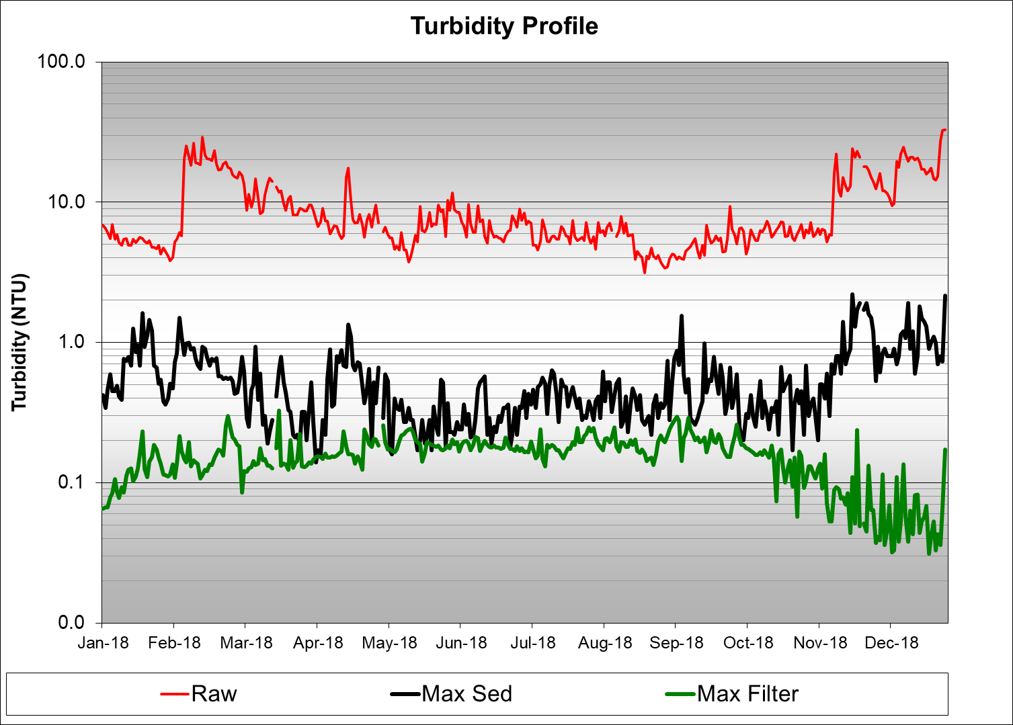
AWOP Impacts: Performance-Based Training in AL
M-PBT Session 1
Filtered turbidity issues were mainly at WTP startup each day
Notes:
AWOP continued to impact water quality, even during the pandemic. The proactive focus of the program to build long-term capability with water system personnel helped water systems weather the stress of the pandemic.
This example of AWOP impacts results from implementation of an AWOP Targeted Performance Improvement tool known as Performance-Based Training. The graph reveals filter performance that does not meet the AWOP filtered water turbidity goal (green line). Also noted is the location of the filtered water sampling tap on top of the filter effluent line. Operators thought that a quill was present at the sampling location to pull water from the center of the pipe.
This PBT project began in late 2018 and continued through 2019, so was conducted onsite prior to the pandemic.

Slide 17
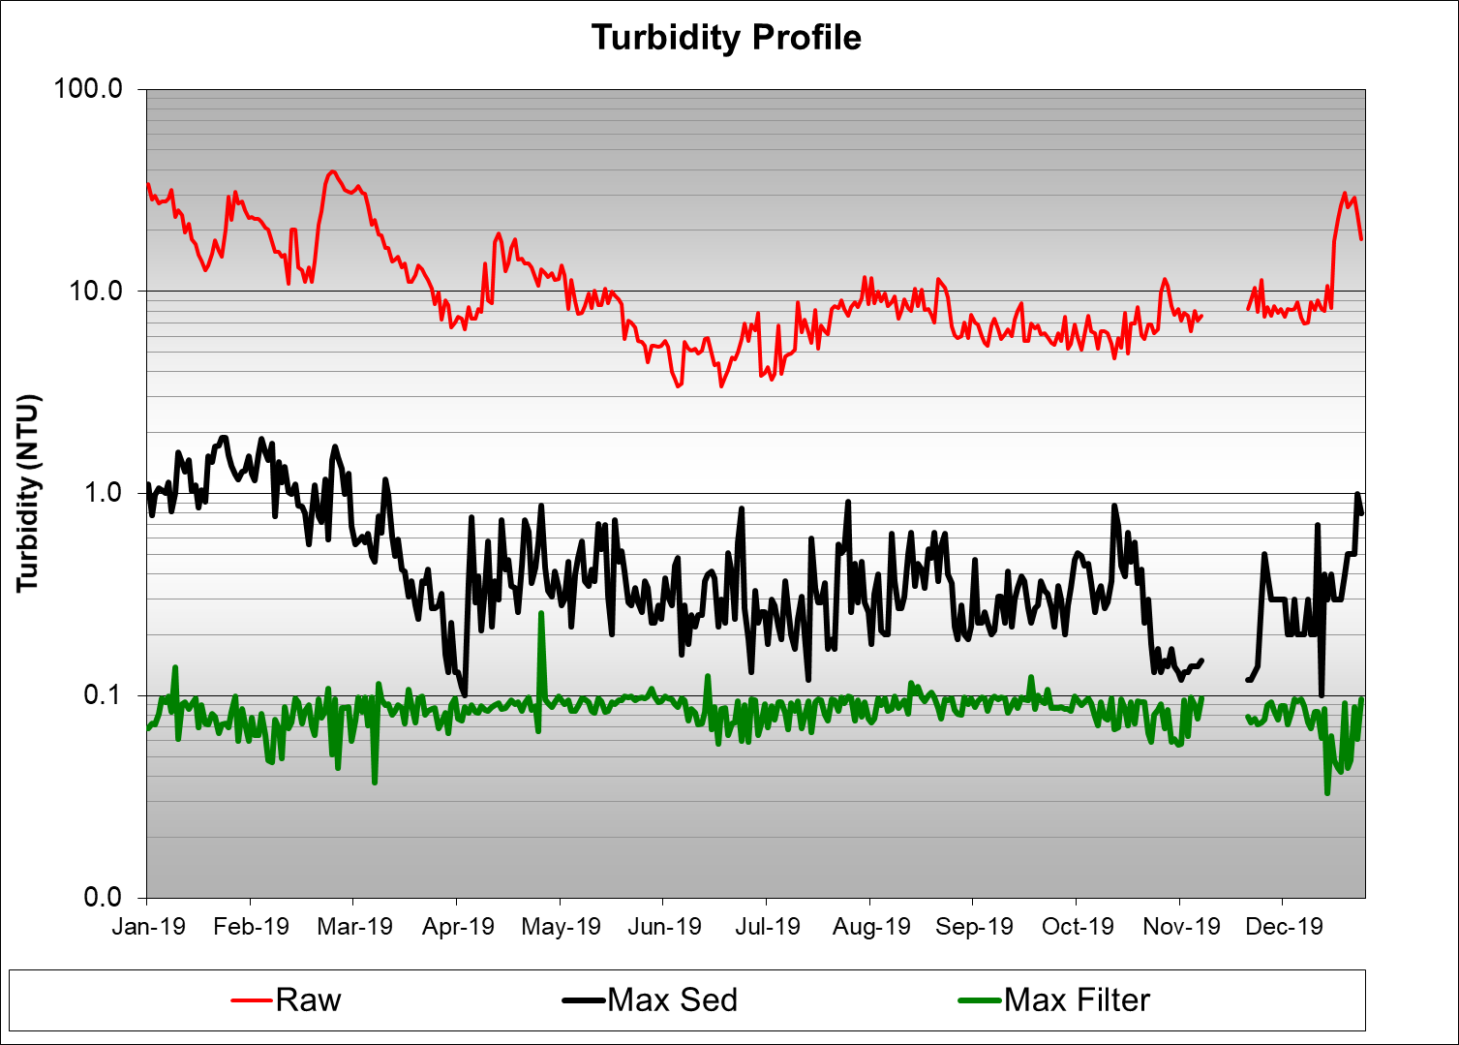
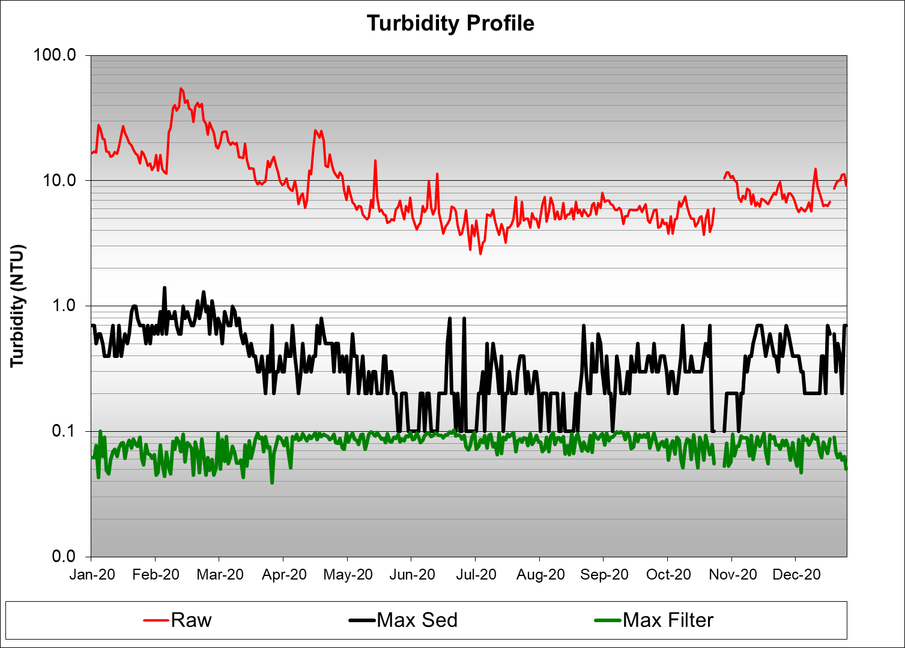
AWOP Impacts: Performance-Based Training in AL
Notes:
While completing their PBT homework, water system staff identified several potential data integrity issues. Some of the identified issues were long sample lines, large diameter sample lines (1/2‐inch copper), numerous bends in sample lines and the quill for top mount sample taps were missing. After replacing the sample lines with small diameter and short length lines, installing the quill and other items, the filter performance dramatically improved. This improvement is demonstrated in the performance graph for 2019 (top left) and through continued participation in PBT, was maintained in 2020. This WTP was able to achieve optimized performance for the first‐time during calendar year 2019 and maintained that performance during calendar year 2020. Optimized performance continued during the pandemic.
The same type of performance data obtained used for these individual water system graphs can be used to assess state-wide performance, as shown on the next slide.

Slide 18
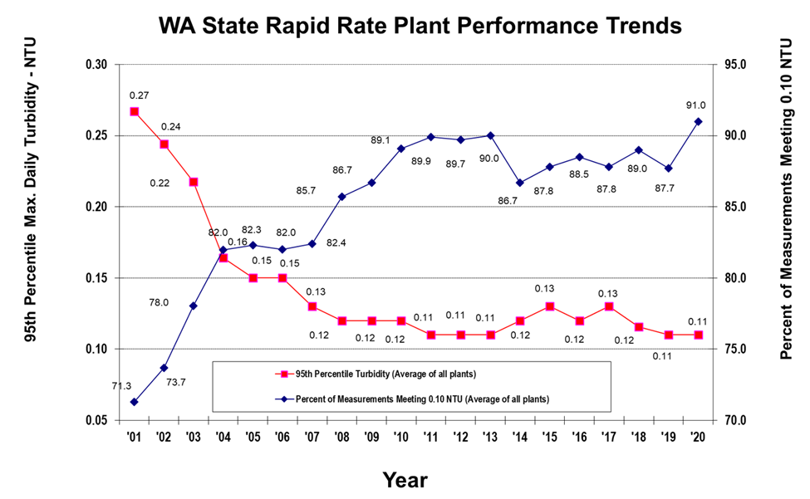
AWOP Impacts: State-Wide Example – Tracking Turbidity in WA
Notes:
Jumping from the southeast to the other corner of the country, here is an example of state-wide performance from the state of WA:
This graphical method has been fondly dubbed as the “X-graph” although it is apprearing less like an “X” over time. It is developed from WA DOH performance data, as measured by CFE turbidity for surface water treatment plants over the past 20 years. The source of data used to produce this graph are the daily maximum CFE values that DOH obtains from monthly operating reports (MORs).
The blue line (trending up) signifies the percent of daily maximum turbidity measurements meeting the goal of ≤0.10 NTU or less. In 2020, this percentage reached 91%. The red line (trending down) signifies the average 95th percentile value state-wide. In 2020, it maintained the value of 0.11 NTU.
AWOP discussions often center around reasons for changes in the trajectory of these graphs to better understand how the program can be more effective.
This is but one example of AWOP impacts. We have similar graphs for many of the participating AWOP agencies. We also track performance across the entire national AWOP network.

Slide 19
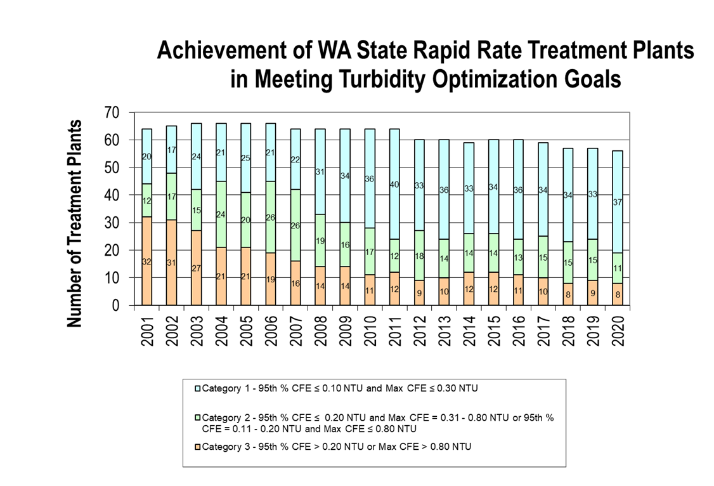
AWOP Impacts: State-Wide Example – Tracking Turbidity in WA
Notes:
AWOP multi-state meetings are structured strategic implementation meetings and focus on assessing methods to make the program more effective.
Data used for the WA “X-graph” in the previous slide can also be used to develop a graph such as the one depicted here.
This graph supports the development of a strategy to apply different approaches to the plants in the different performance categories. The light blue stacked bars show the number of WTPs meeting optimization goals, the green portion of each bar represents the number of WTPs close to meeting the goals and the orange portion of each bar represents WTPs with poor performance. Different strategies are used with the different categories of WTPs to ultimately maintain the optimized Cat 1 WTPs, move the Cat 2 plants to achieve optimized performance and reduce the numbers of Cat 3 plants.
The OR Health Authority used this approach with its systems and found that 40% of its Cat 3 WTPs had no auto-shutdown set point for high turbidity resulting in the plants continuing to run unattended during those times.

Slide 20
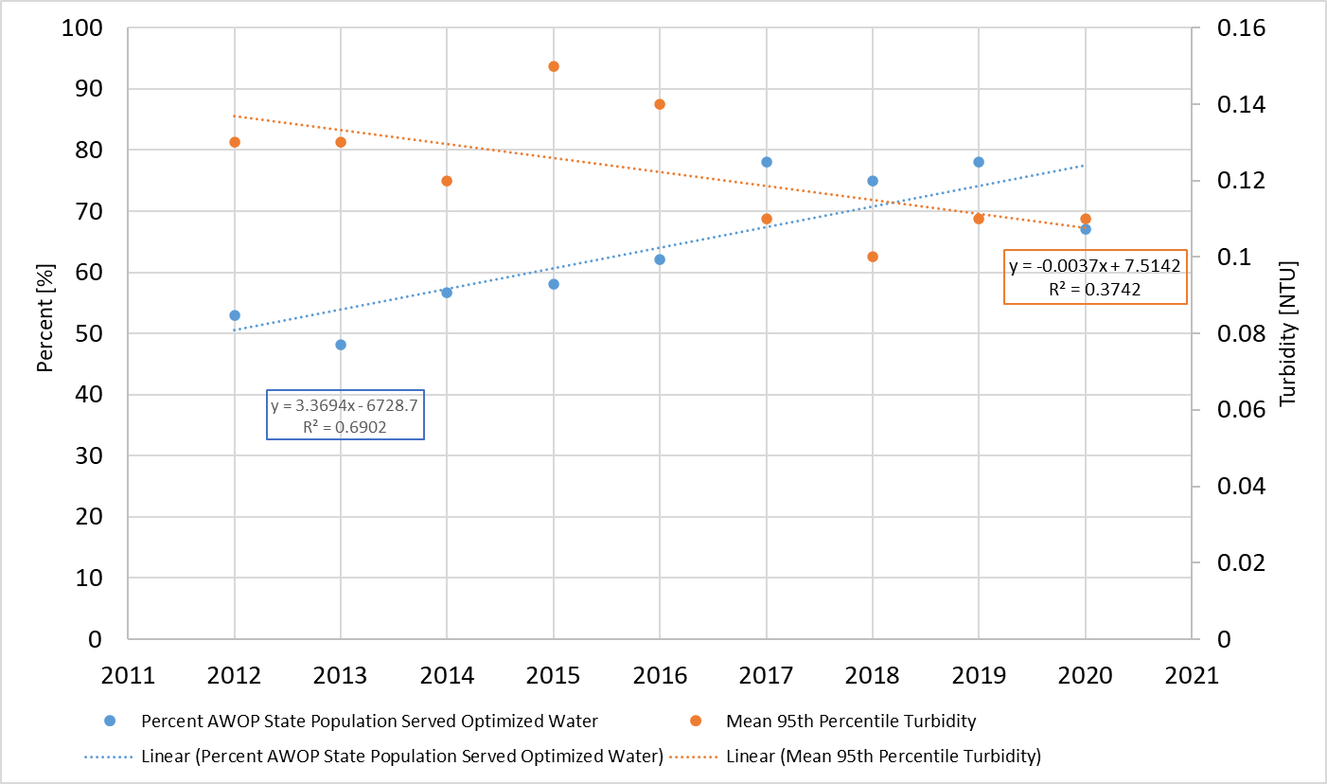
AWOP Impacts: Tracking Turbidity Across the AWOP Network
Notes:
TSC tracks performance across the entire national AWOP network.
We also develop an “X-Graph” similar to the WA DOH, but instead of plotting the average NTU of all measurements, we plot the percentage of the population that is served by water that has met the CFE optimization goal for turbidity. This is signified by the blue line and is trending up. The 2020 data point reveals a value of 77% of the population – down slightly from the 2019 value of 81%.
The orange line (trending downward) depicts the meant 95th percentile of CFE turbidity values, just like the WA DOH “X-graph.” The 2019 and 2020 values were 0.11 NTU each year, which was slightly elevated from the 2018 value of 0.10.
These trends continue to show the positive impact of the program on the microbial quality of the water being served to the public over the areas represented by these data. It will be more effective to analyze the network-wide data once we achieve consistent contributions from our network of AWOP agencies.

Slide 21
AWOP Impacts: State-Wide DBP Performance Using LRAA Goals in KY
Notes:
Switching from turbidity to DBP performance, this slide shows state-wide performance in the state of KY over the past three years.
The bars represent the population served by systems in KY that meet the DBP optimization goals. The line represents the number of water systems meeting those goals.
The number of water systems and associated population served, in relation to DBPs, were first calculated in 2018. Due to data tracking limitations, the Individual Site LRAA goals were the only goals used for this determination. Since the development of the DBP Ranking Tool in 2019, the Individual Site LRAA goals and Long-Term distribution system goals are now tracked; the expanded data capabilities resulted in a decrease in the number of systems and population served between 2018 and 2019. Between 2019 and 2020, the performance data is trending up again.
Goals:
Individual site goals: Quarterly maximum LRAA TTHM/HAA5 values not to exceed 70/50 ppb.
Long-Term System Goal: Average of maximum LRAA TTHM/HAA5 values not to exceed 60/40 ppb (the average of the last 8 quarters cannot exceed 60/40 ppb).

Slide 22
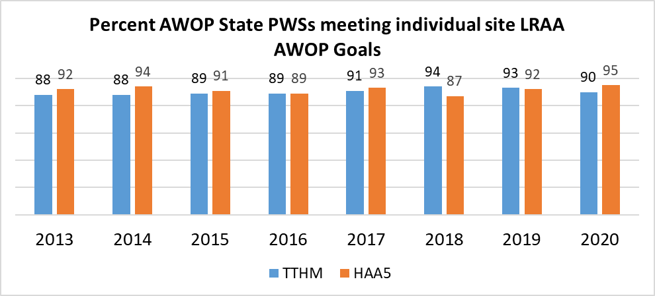
AWOP Impacts: Tracking DBPs Across the AWOP Network
Notes:
TSC tracks DBP performance across the entire national AWOP network.
This reveals that the % of PWSs meeting AWOP goals for individual site LRAA over the past 7 years have hovered around 90% for both TTHM and HAA5 values.
TSC also tracks these data against population served by water meeting the individual site LRAA DBP goals. The trend is very similar to the graph shown above.
It is difficult to make too many conclusions regarding these data due to the low number and intermittent contributions of AWOP state data to this graph.

Slide 23
AWOP Vision for the Future
“Drawing the Graph”
Increase our focus on documenting performance, on a state-specific and national basis, as it is assessed against the AWOP microbial and DBP goals
Overcome obstacles to AWOP performance data management and agree upon a set of baseline metrics to be gathered/shared by all states.
Increase Participation by Representatives of PWSS programs
Enhance Collaboration with Other Optimization Programs
Incorporate new technical areas and public health concerns while maintaining effectiveness in current areas.
Notes:
AWOP is a data-driven program that is based on data-based decision-making.
Performance data showing the results of program activities is fundamental to a fully functional AWOP. The vision is maintained that AWOP impacts such as the graphs shown previously will be developed by each participating agency AWOP.
Several PWSS programs continue to face significant obstacles when attempting to collect performance data for AWOP. Creative solutions are needed to overcome these obstacles.
AWOP participation by all PWSS agencies continues to trend upward. Resources needed to accommodate increased participation continue to be assessed.
Optimization program collaboration has many potential benefits and has been trending upward. This meeting is testament to that effort as we are benefitting from participation by representatives of the PSW, PCW and the wastewater optimization community.
Documented AWOP impacts have focused on M/DBP water quality. New technical areas should also involve development of approaches to document impacts and performance improvements. Resource availability will need to be considered when expanding the technical scope of AWOP.

Slide 24
AWOP Vision for the Future
“A crisis is a terrible thing to waste; let’s hope we don’t waste this one.” Quote by Scott Galloway, author of Post Corona: From Crisis to Opportunity
1993: Milwaukee’s waterborne disease crisis: Optimization efforts gained momentum and new regulations were promulgated
2019 - 2021: SARS-CoV-2/COVID-19 resulted in enhanced on-line platforms to support remote work approaches
Develop/Demonstrate/Implement
Optimizing program effectiveness utilizing all available approaches
Notes:
I have been using this quote as we look to the future when we can safely work together in the same space again. The drinking water agencies and industry didn’t waste the 1993 crisis; they initiated actions to improve public health protection.
The virus and associated illness of the pandemic created an instant demand for enhanced virtual work platforms. We adjusted our Implementation approach to take advantage of the online technology advancements.
As we look to envision AWOP in the future, approach to develop, demonstrate and implement optimization tools can be maintained and the moto of “Making a Difference at the Water System Level” will be preserved.
We will strive to optimize our use of online and in-person AWOP events to improve access to AWOP events, enhance flexibility for addressing the needs of the Agency, the program and the participants. The National Optimization Leadership Team has already initiated discussion on how best to proceed and will be continually soliciting feedback from the AWOP network participants as we implement new ideas. AWOP started from the ideas and efforts of a few visionaries, but the passion and commitment of many were required to build the value-added program that exists today. We will move forward together as we adapt the program to new opportunities, as we always have. We will not waste this current tragedy.

Slide 25
EPA Headquarters Report
Crystal Rodgers-Jenkins

