Slide 1
National Optimization Goals
Cincinnati, OH
August 7, 2019

Slide 2
Background
Measuring performance against optimization goals is basic AWOP activity. In this session we will summarize the goals and summarize the basis for each.
Meeting optimization goals is a proactive approach to regulatory compliance
Optimization goals are not required but encouraging optimization has the following benefits
Additional public health protection in some cases
Additional operational safety factor to assure water quality objectives are met

Slide 3
Goal Development Process
Develop proposed goal based on experiences and research
Demonstrate the effectiveness and implementation of the proposed goal at plants/utilities
Finalize the goal

Slide 4
For a Comprehensive Table of Optimization Goals, See the Resource Table
Resource Table

Slide 5
We have monitoring & Operating goals as well as performance goals for each category. The monitoring goals for conventional SWT establish a multiple barrier approach to optimizing the reduction of pathogens.

Slide 6
Water Quality Objective: Reduce Risk from Pathogens Through Conventional Surface Water Treatment
Coagulant Addition
Turbidity Goal
Variable Quality Source Water
Turbidity Goal
Disinfectant Addition
Disinfection Goal
Coagulation Flocculation
Sedimentation Barrier
Filtration Barrier
High Quality Finished Water
Disinfection Barrier
The conventional plant is separated into barriers and each barrier has monitoring and performance goals.

Slide 7
One minute intervals are necessary to provide sufficient data resolution during critical periods, e.g. backwash recovery.

Slide 8
Additional monitoring supports the establishing multiple barriers.
Raw water turbidity monitoring
Settling basin monitoring
1- minute IFE or CFE monitoring

Slide 9
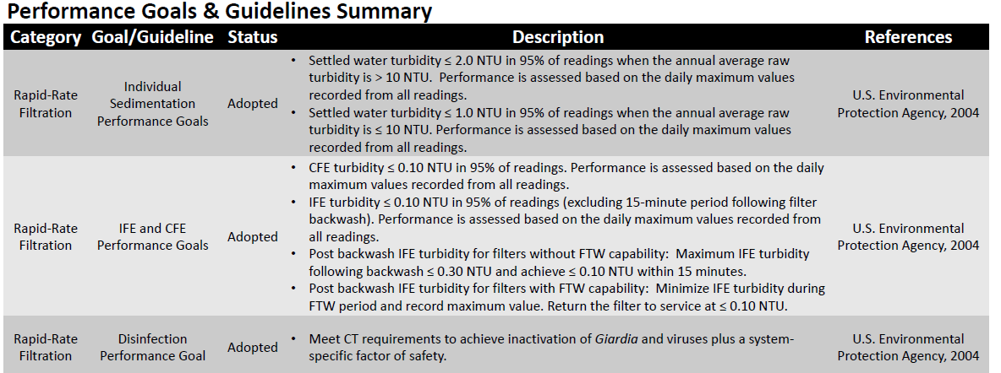
These goals are achievable and have been in place for at least 35 years.
There was some resistance at first but field experience found them to be achievable.
Meeting guidelines is strategic for meeting goals but not essential.

Slide 10
We have proposed goals for a number of non-conventional technologies, some of which have been proposed by AWOP network partners.
These proposed goals are still being field tested.
AWOP Goal proposal Process
Propose Goal
Field Test
Finalize Goal
Notes:
The membrane monitoring goals for turbidity/LRV were unintentionally omitted from are still “proposed” so were not included on the poster/list so I am going to summarize them here. They are included
Monitoring requirements for turbidity (or particle counts) are the same as conventional filters: Measure at each rack (analogous to IFE) continuously and save data in one-minute intervals to insure enough resolution during critical times. Measure CFE and store 1-minute data. Also run a direct integrity test on all active membranes (sometimes membranes are taken out of service while they are waiting to be pinned and do not need to be tested).

Slide 11
The list shows the proposed monitoring goals for slow sand and membranes. We should add that the conventional monitoring goals would also apply to membranes (1-minute turbidity data, measure at each rack and at CFE location). Also should add in a proposed goal to run a direct integrity test at least daily on each active rack.
There are also some guidelines that have been proposed for non-conventional technologies.
Notes:
The membrane monitoring goals for turbidity/LRV were unintentionally omitted from the poster/list so I am going to summarize them here. (They are included)
Monitoring requirements for turbidity (or particle counts) are the same as conventional filters: Measure at each rack (analogous to IFE) continuously and save data in one-minute intervals to insure enough resolution during critical times. Measure CFE and store 1-minute data. Also run a direct integrity test on all active membranes (sometimes membranes are taken out of service while they are waiting to be pinned and do not need to be tested).

Slide 12
Treatment technology limits are set by primacy agencies for these technologies when the treatment is approved. Meeting the proposed goals should assure compliance with State requirements.

Slide 13
The monitoring goals for DBP related treatment have been in place for about 15 years now.
This monitoring would parallel the regulatory requirements except the plant effluent monitoring goal would generally be additional.
AWOP monitoring goals generally increase routine monitoring for PWSs. Additional cost of monitoring has always been considered. DBP analyses are costly as compared to many other parameters and AWOP tries to leverage compliance monitoring costs whenever possible.

Slide 14
Some performance goals are plant specific.
These TTHM/HAA5 goals basically provide a safety factor between the regulatory requirement and plant performance but an individual plant could set much lower goals.

Slide 15
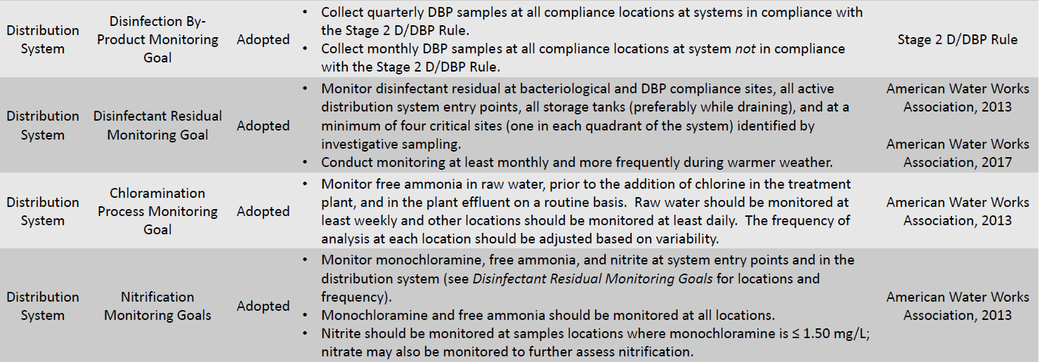
The DSO monitoring goal encourages additional monitoring (over and above regulatory), focused on “finding bad water.” The additional monitoring relatively inexpensive (disinfectant residual).
The chloramine monitoring goals would require additional analyses (ammonia, monochloramine and nitrite) that are considered strategic and are required in some states.

Slide 16
Guidelines are considered “strategic” but not “essential”. For example, you could have a storage tank turnover time >5 days and still meet the distribution system performance goals for disinfectant residual and DBPs, but it would be difficult and unlikely.

Slide 17
Summary
Optimization goals were established to enhance public health protection using the multiple barrier approach.
Adoption of AWOP goals by the National Optimization Leadership Team has always involved input from, and field testing by the AWOP network.
Measuring performance against the goals helps PWSS programs assess relative risks associated with specific water quality objectives.
Adoption of optimization goals by water utilities helps establish a culture of continuous improvement and data-based decision making.

