Slide 1
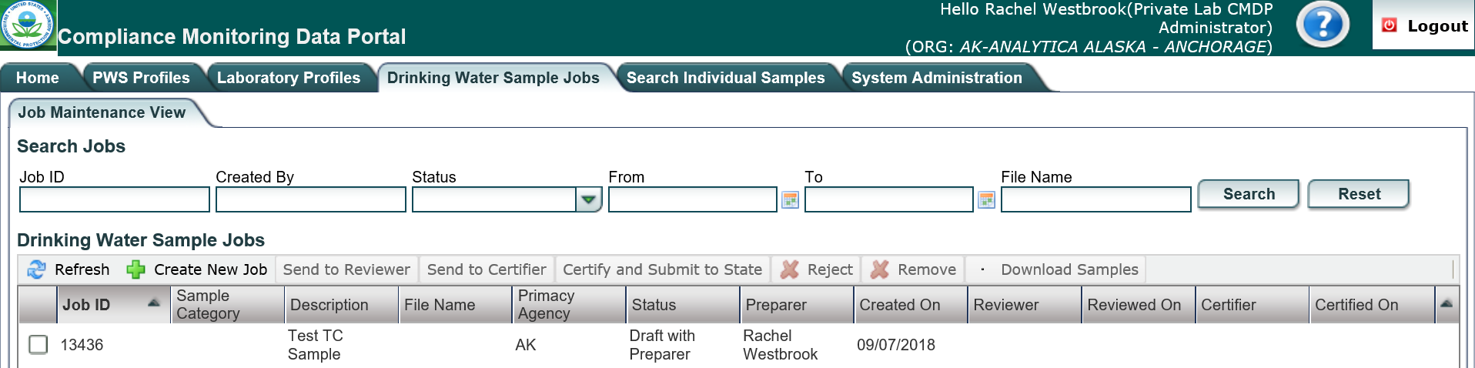
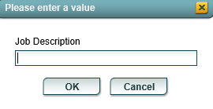
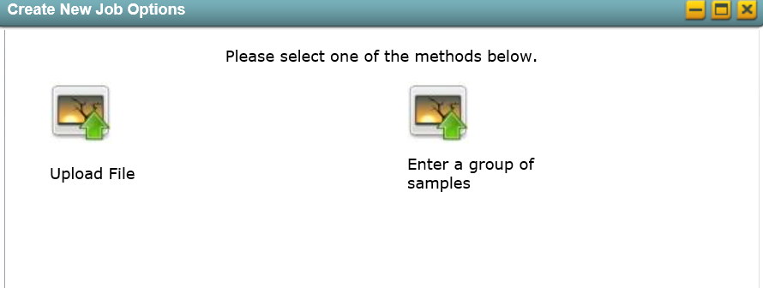
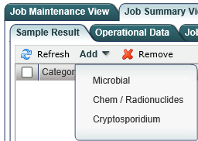
Sample Validation & Submission Process (WEB ENTRY)
This document is divided into five separate parts (as shown below) and provides instruction for how to create a Sample Job in CMDP, items to consider when addressing validation errors within CMDP and highlights the most common reasons why samples are rejected from the State in CMDP.
Part 2: Review Validations Tab
Part 3: Submit Sample Job
Part 4: Validation Errors from the State
Part 1: Create a Sample Job
Part 5: Example Scenario of Sample Rejection
Part 1: Create a Sample Job
Step 1: To create a new Sample Job, go to the Drinking Water Sample Jobs tab and select Create New Job.
Step 2: From the pop-up window, select the Enter a group of samples option.
Then, enter the sample name into the
Job Description field. Then, click the OK button.
NOTE: Consider using a consistent naming
convention for your organization which will
promote data consistency and regularly track
samples/results entered.
Step 3: To enter a new sample submission, click on the Sample Result sub-tab and click the
Add drop down menu. Users have the option to select three different types of sample submissions including Microbial, Chem/Radionuclides and Cryptosporidium.
Step 4: After selecting the submission type (as appropriate), you are now ready to enter the sample/result information into CMDP.
As a reminder, use the DEC Lab Data Submission Guides to help ensure the data is complete.
NOTE: Confirm the appropriate analysis Method is reported (as outlined on the DEC Lab Data Submission Guides) and a Sampling Location is entered prior to uploading the data into CMDP as these are state required fields.
Step 5: After entering the appropriate information, be sure to click the Save button located in the upper left corner of the web entry form.
A blue bar with the wording of Information saved successfully will appear along the top of the web entry form if the federally required information is entered appropriately (screen shot below).
Fields denoted with an asterisk (*) located to the right of the field name are considered federally required. If one of these fields are left blank and missing data, CMDP will notify the user with a warning icon and will highlight the field(s) in blue (screen shot below). Then, the user will need to fix the federal error.
NOTE: If the Sample Category column (located on the Job Maintenance View tab) is blank, this also indicates that data was unsuccessfully uploaded.
In either case, the user will need to check the Validations tab to confirm the sample submission is free from all errors.
For guidance on reviewing the Validations tab, proceed to Part 2.
Submission Entered Successfully
Submission Entered Unsuccessfully

Slide 2
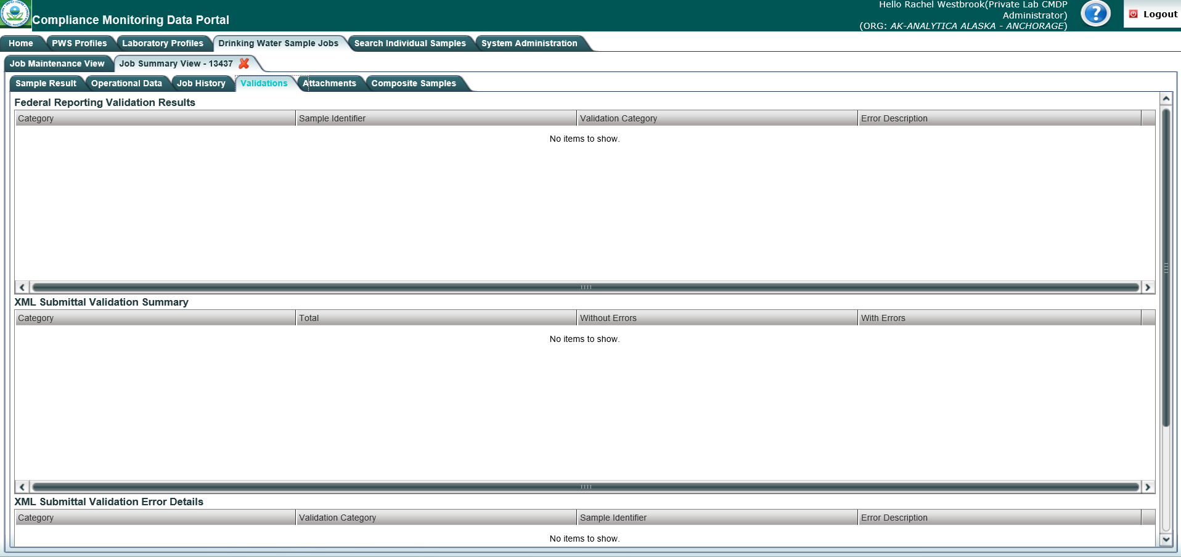
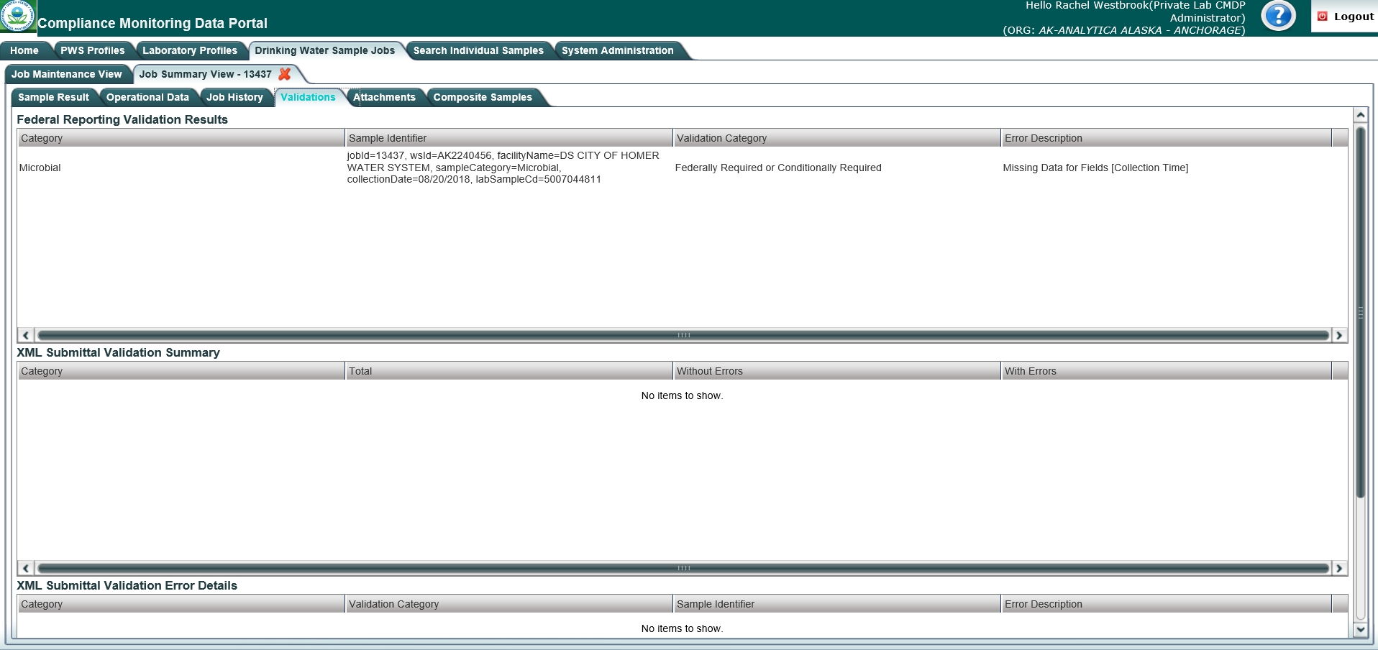
VALIDATION & SUBMISSION PROCESS (WEB ENTRY)
Part 2: Review Validations Tab
Step 1: After the user has entered the appropriate sample/result into CMDP successfully, as part of the review process be sure to check for validation errors under the Validations tab. This is a very important step because addressing errors listed here will reduce the number of submission rejections issued by the State.
NOTE: The “No items to show” notification will be displayed under the XML Submittal Validation section when submitting information from a web entry form.
If the “No items to show” notification is displayed in Section A, this indicates that no validation errors were identified within the entered web entry form (see screen shot below).
If no validation errors are listed under this tab, the user can submit the sample/results to the State.
For guidance on how to submit this information to the state, proceed to Part 3 of this document.
If one or more messages are displayed within Section A, this indicates that validation errors were identified within the web entry form (see screen shot below).
If any validation errors are listed under this tab, the user must make the appropriate corrections prior to submitting the sample/results to the State.
For guidance on how to address the information within Section A refer to page 3.
Section A
Section A

Slide 3
VALIDATION & SUBMISSION PROCESS (WEB ENTRY)
Section A: Federal Reporting Validation Results Table
Step 2: This table contains results of validations checked against fields that are federally required/conditionally required to see if there is a value. If fields are left blank or information is entered incorrectly, they will be listed as errors in this table. If the user double clicks on an individual row in this table, they will be brought to the specific sample submission.
The information below provides a brief description of each column within Federal Reporting Validation Results table and how users can navigate through the information.
Category: This column lists the type of sample group as it relates to the specific sample with an error. The categories listed can include Microbial, Chem/Radionuclides or Cryptosporidium.
Sample Identifier: This column provides details on the sample that contains the Federal reporting error(s). The information merely identifies the sample, it does not describe the error. For instance, the screen shot above (highlighted text under column 2) identifies that an error occurred with the sample job 13437 and this sample job is from AK2240456 with a facility name of DS CITY OF HOMER WATER SYSTEM. It is a Microbial sample with a collocation date of 08/20/2018, assigned a lab sample identification number of 500704481. Specifically, the type of information displayed within this section includes the following:
Validation Category: This column identifies the severity level for the type of error identified (e.g., federally required/conditionally required).
Error Description: This column describes the specific error that has occurred with the sample submission.
The table below highlights the various CMDP error messages as displayed within Error Description column along with an explanation of the error. This table also highlights the specific fields within the Excel template that could generate the error.
NOTE: This is not an all-inclusive list of every error that can occur and only identifies the most common errors. If you run into an error message that is not listed in the table below, please contact the CMDP Transition Team and we will add it to the list.
Step 3: Once the user has reviewed the all validation errors listed within this section, make note of all errors, and then double click on the individual row within the Validations tab and edit the web entry form. After the appropriate edits are made, be sure to review the Validations tab again to confirm that no additional errors have occurred.
If no additional errors appear on the Validations tab, proceed to Part 3.
1
2
3
4
1
2
jobId: Job sample identification code assigned by CMDP
wsId: Public Water System identification number
facilityName: Water system facility name entered in CMDP
sampleCategory: Type of sample classification (i.e., Microbial, Chem/Radionuclides, Cryptosporidium)
collectionDate: Date sample collected (MM/DD/YY)
labSampleCd: Lab sample identification number
3
4
CMDP Error Message | Explanation of Error | Fields for Labs to Review
Missing Data for Fields [sampleRecievedDt] | No data entered in Sample Received Date field. | Add data into Sample Received Date field.
Missing Data for Fields [sampleVolume] | No data entered in Sample Volume (ML) field. NOTE: Only required for Microbial Samples. | Add data into Sample Volume (ML) field.
Missing Data for Fields [Collection Time] | No data entered in Collection Time field. | Add data into Collection Time field.
Missing Data for Fields [Missing Sample Result for E.coli Given Reported TC+ Sample Result] | E.coli sample result was not submitted with TC+ sample result. | Add E.coli sample result to sample submission.
Missing Data for Fields [Volume Assayed] | No data entered in Volume Assayed (ML) field. | Add data into Volume Assayed (ML) field.
Missing Data for Fields [Method] | No data entered in Method field. | Add data into Method field.
Missing Data for Fields [Analysis Start Date] | No data entered in Analysis Start Date field. | Add data into Analysis Start Date field.
Missing Data for Fields [analysis StartTime] | No data entered in Analysis Start Time field. | Add data into Analysis Start Time field.

Slide 4
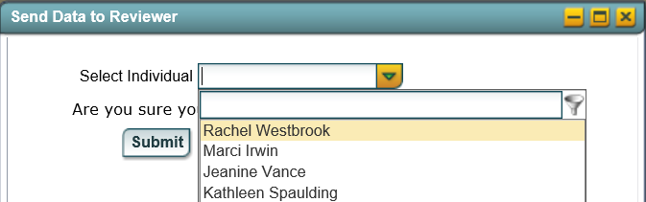
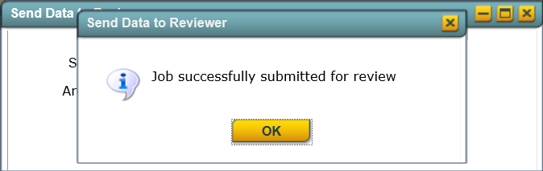
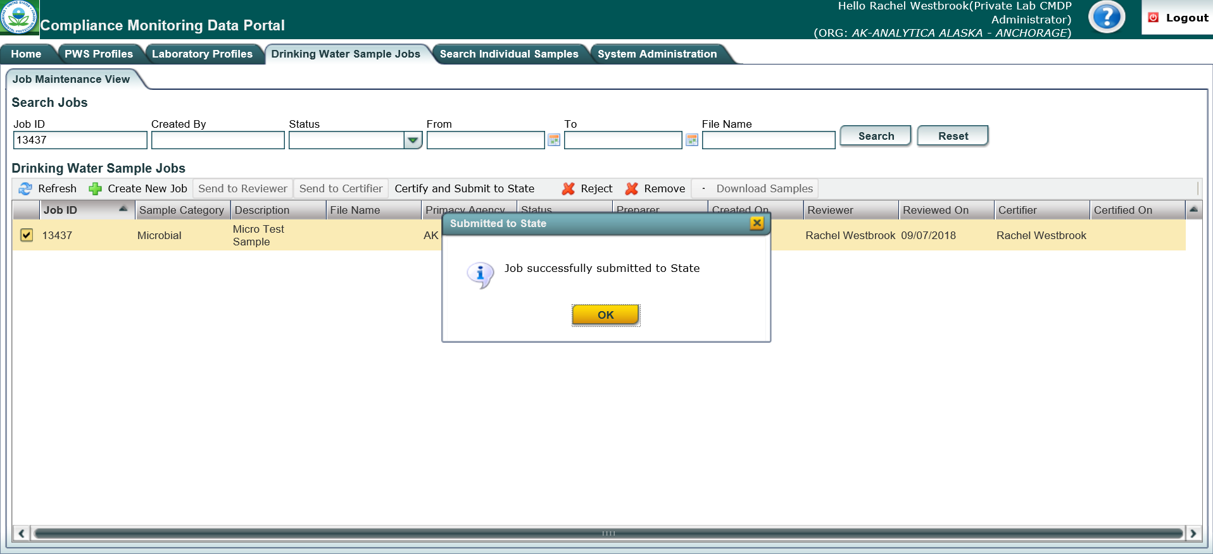
VALIDATION & SUBMISSION PROCESS (WEB ENTRY)
Part 3: Submit Sample Job
Step 1: Once the user has confirmed that no errors exist from the Validations tab, the Sample Job can be submitted to the State. To submit a sample, go to the Job Maintenance View tab, enter the Job ID into the search bar and click on the check box to select the appropriate job.
Step 2: Click the Send to Reviewer button on the Drinking Water Sample Jobs menu.
A pop-up will ask you to select the
appropriate individual. After the user has selected the reviewer, click the Submit button.
Then, a confirmation window will pop-up stating the job was successfully submitted for review. Click OK.
An email will be sent to the assigned reviewer’s email indicating that a job is ready for review (example screen shot to the right). The email is simply an instant notification. The user does not have do anything with the email or even exit out of CMDP. This convince feature was integrated into CMDP in case there are multiple individuals in different roles within a single organization.
Step 3: Then, the Sample Job should be sent to the certifier by clicking the Send to Certifier button.
Again, a pop-up will ask the user to select the appropriate certifier.
Step 4: When the certifier or Lab System Administrator is prepared to submit the Sample Job, click the Certify and Submit to State button.
A final confirmation window will pop-up. Then, click the OK button to complete the submission process.
The user will be able to see exactly when the data was submitted to the State and who the preparer, reviewer and certifier were and when the certification steps were completed as displayed in the job details row. This row will update automatically once the user clicks OK on the pop-up window.
Then, a confirmation window will pop-up stating the job was successfully submitted to the certifier.
An email will be sent to the assigned certifier’s email indicating that a job is ready for the final evaluation.
Then, enter your user name and password.
The user will be asked a security question (highlighted by red box in screen shot to the right) and must click the check box (indicated by red arrow in screen shot to the right) to certify the information provided was true and accurate.
To move forward, click the Submit button.

Slide 5
VALIDATION & SUBMISSION PROCESS (WEB ENTRY)
Part 4: Validation Errors from the State
After the Sample Job is submitted to the State there is still a possibility the sample may be rejected during the state validation process (meaning the errors will not necessarily be listed on the Validations tab in CMDP). The following steps outline how to deal with rejected sample submissions.
Step 1: If a data error was identified in a sample submission AFTER it was accepted by the State, the State will notify laboratory staff via email explaining the sample has been rejected along with the reason for the rejection (example screen shot to the right).
In order to understand the type of error that occurred, refer to the table below. This table highlights the rejection message as displayed on the email along with an explanation of the rejection, and the specific fields within the web entry form that could generate the error.
NOTE: The (xxxx) denoted in the Rejection Message column acts as a placeholder indicating unique information related to the sample submission will be displayed here (e.g., analyte code, method code).
Rejection Message | Explanation of Rejection | Fields for Labs to Review
Invalid data: Lab sample ID is too long. Maximum allowed length: 20 characters | Sample ID field exceeds the maximum allowed 20 character limit. | Enter Sample ID that is within 20 character limit.
Lab is not certified for this method (xxxx) and analyte (xxxx) for the given analysis date | Method field contains method code that Analyzing Lab is not certified for. | Confirm Method field contains method code that Analyzing Lab is certified for. Refer to DEC Lab Data Submission Guides for additional information.
Sample age for Sample Result (xxxx) is beyond the allowed limit | Sample result exceeds hold time. Analysis Start Date value entered is more than 30 hrs. from Collection Date. | Confirm Analysis Start Date value and Collection Date value are correct.
Required field: Sample collection date is missing | Collection Date field is blank. | Add data to Collection Date field.
Required field: Sample collection time is missing | Collection Time field is blank. | Add data to Collection Time.
Required field: Lab receipt date is missing | Lab Sample Received Date field is blank. | Add data to Sample Received Date field.
Required field: Sample collection location is missing | Sampling Location field is blank | Add data to Sampling Location field.
Required field for Sample Result (xxxx) Analysis start date is missing | Analysis Start Date field is blank. | Add data to Analysis Start Date field.
Required field for Sample Result (xxxx) Analysis start time is missing | Analysis Start Time field is blank. | Add data to Analysis Start Time field.
REJECT: Inconsistent result data: Review rules for populating Presence Indicator (ResultMeasurementQualifier), Count (ResultMeasurementValue), and/or Interference. (SAMPLE RESULT) | (e.g. A/P field listed as Present but Count field does not have value.) NOTE: Only required for Microbial Samples. | If contaminant is Present in sample, Count field may need data (determined by method used).
REJECT: Inconsistent result data: Presence Indicator is "A" (absent) and Count Value is not "0". (SAMPLE RESULT) | (e.g. A/P field listed as Absent but Count field has value.) NOTE: Only required for Microbial Samples. | If contaminant is Absent in sample, Count field should not have data entered.
REJECT: Laboratory Received Date supplied was prior to Sample Collection Date. (SAMPLE) | The sample has to be collected before it is received by the laboratory. | Confirm the Sample Received Date is before in time of the Collection Date.
REJECT: Sample Result failed duplicate by data check. A sample result for the same analyte is already present for this sample (SAMPLE RESULT) | A sample result with the same information in the Analyte (as it relates to the sample) has already been submitted to the State. | Review previous sample result(s) submitted and if indeed information is correct, confirm the Sample ID field is different compared to the previous sample submitted. Contact the CMDP Helpdesk if issue persists.
Step 2: Once the user understands the issue, you will need to re-submit the sample/results through CMDP. However, be aware this process is different than any errors corrected PRIOR to the sample submission to the State (i.e., errors list on the Validations tab).
To correct errors AFTER the sample has been submitted to the State (as identified in the Validation Error email) the user must create a new web entry form with the appropriate edits.
Before creating a new web entry form, it is recommended to rename the Job Description with a naming convention that indicates the sample/result is a resubmission.
NOTE: CMDP will not allow for the same Sample ID number to be used twice. After the validation errors are corrected within the originally submitted Excel template, please add an "X" to the beginning of the Sample ID # (e.g., Field name changed from 11844070 to X11844070 highlighted in screen shot below.)
Step 3: Once the new sample submission is created through a web entry form in CMDP, review the Validations tab for any inconsistencies and submit the sample/result to the State (following the process outlined on pages 1-4 of this document) .
Congratulations! This completes the process for addressing rejected sample submissions using the Web Entry form.
See pages 6-7 for a full example scenario on correcting validation errors.

Slide 6
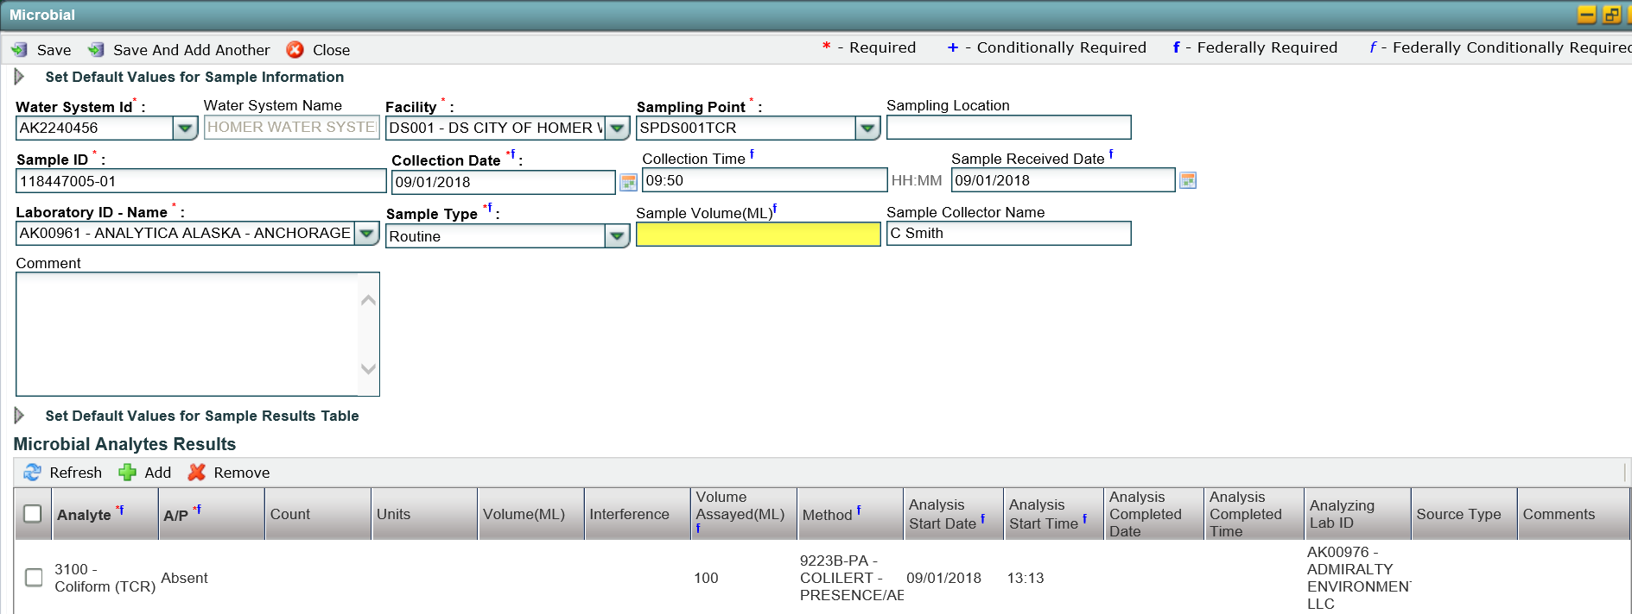
VALIDATION & SUBMISSION PROCESS (WEB ENTRY)
Part 5: Example Scenario of Sample Rejection
EXAMPLE: The scenario below outlines how Ms. Heather Olson, who is enrolled as a CMDP Lab System Administrator working for LabTech, identifies/corrects a federal reporting error with an initial sample submission and how she addresses a second error identified by the State.
Step 1: After Heather creates a new web entry form, containing sample data, into CMDP she confirms that all sample submittals are listed on the Sample Results sub-tab (refer to page 1 for the screenshot of a Submission Entered Successfully example).
Then, Heather reviews the Validations tab. During her review, she notices one validation error listed under the Federal Reporting Validations Results table. The CMDP error message (highlighted text noted in the Error Description column) indicates the Sample Volume (ML) field is either blank or the information is entered incorrectly. Before clicking on this row for additional information, Heather reviews the rest of the Validations tab to confirm no additional errors are listed under the Federal Reporting Validations Results table.
After confirming that only one validation error occurred, Heather double clicks on the error message located under the Error Description column and is brought to the specific sample submission. From this web view, she can see that she accidently left the Sample Volume (ML) field blank (highlighted field in screen shot below). Now, with an understanding of the error Heather knows exactly what should be corrected within the web entry form.
Step 2: Now, Heather can edit the web entry form of the sample submission that had the error by adding the appropriate data into the Collection Time field (highlighted field in screen shot below). Once the form is updated appropriately, she selects the Save button and receives the Information saved successfully notification.

Slide 7
VALIDATION & SUBMISSION PROCESS (WEB ENTRY)
EXAMPLE CONTINUED: The scenario below outlines how Ms. Heather Olson, who is enrolled as a CMDP Lab System Administrator working for LabTech, identifies/corrects a federal reporting error with an initial sample submission and how she addresses a second error identified by the State.
Step 3: Once she reviews the Validations tab again to confirm no validation errors exist (screenshot below), she submits the sample/results to the State by following the process outlined in Part 3.
Step 4: After the Sample Job is submitted to the State, the next day Heather receives an email indicating that the submission was rejected because it did not have a Sampling Location listed (highlighted field in screen shot below). REMEMBER! The Sample Location and Method fields are state required and errors within these fields will not be identified within the Validations tab.
To correct this error, she then creates a new web entry form with the appropriate information entered into the Sample Location field AND adds an "X" to the beginning of the Sample ID # (highlighted fields in screen shot below). Since this error was identified AFTER the submission was sent to the State, she will not be able to delete the Sample Job from CMDP and must re-submit it as a new Sample Job (which is why she changed the Sample ID field).
Once the web entry form is updated with the appropriate information, Heather reviews the Validations tab, and submits the Sample Job to the State (following the process outlined in Part 1- Part 3).
She did it! Heather successfully submits the sample to the State and no further validation errors are identified.
REJECTED: Submission with missing Sampling Location
CORRECTED: New submission with Sampling Location entered

