Slide 1
SDWIS 101 – Fundamental Operation
US EPA, Infrastructure Branch
6/19/2018

Slide 2
Topics
SDWIS Background
SDWIS State
SDWIS Fed

Slide 3
Objective
To refresh current SDWIS operation knowledge , especially Federal reporting process with new production control.

Slide 4
SDWIS BACKGROUND

Slide 5
What is SDWIS?
An EPA data system supports Safe Drinking Water Act (SDWA) implementation & Public Water System Supervision (PWSS) program
PWSS Program is delegated to states/tribe as Primacy Agencies
Jurisdictions without primacy are managed by EPA regional offices thru Direct Implementation (DI) Programs

Slide 6
SDWIS Dataset
Basic water system: name, ID number, city, county, number of people served, type of system (residential, transient, non-transient), year-round or seasonal operation, water source characteristics, latitude/longitude of source water
Violation: monitoring and reporting schedules, treatment technique compliance, Maximum Contaminant Levels (MCLs), communicated vital information to their customers
Enforcement: actions taken violated water systems return to compliance
Sampling results (for contaminants): when the monitoring results exceed the MCL.

Slide 7
Drinking Water Primacy Agency
67 Primacy Agencies nationwide:
State: 51 programs
49 Community Water Systems
2 Non-Community Water Systems
U.S. Territories: 5 programs
American Samoa, Commonwealth of the Northern Marianas Islands, Guam, Puerto Rico, U.S. Virgin Islands
Tribe: 1 program -- Navajo Nation
EPA Region: 10 DI programs
Region 1, 2, 4-7, 9-10: Tribal program
Region 3: DC
Region 8: Tribe and WY

Slide 8
SDWIS Stakeholders
Drinking Water Primacy Agencies
Public Water System Owners/Operators
EPA:
Regions
Office of Water (OW)
Office of Enforcement and Compliance Assurance (OECA)
Public

Slide 9
SDWIS Reporting Overall
Primacy Agency
(SDWIS State or Non SDWIS State)
EPA
(SDWIS Fed)
PWS Owner/Operator
Notes:
As-IS dataflow using CDX
The 68 primacy agencies create at least 3 SDWA 3.5 XML files, one each for Inventory, Actions and Samples. If they use SDWIS State, FedRep will extract the necessary data and create the XML files.
Primacy agencies not using SDWIS State have to create the XML files some other way. They can use FedRep to validate their XML files
FedRep can route the XML files to the primacy agency’s EN Node/Node client for submission or the primacy agency can manually upload files to CDX.
Once the files are uploaded to the CDX SDWIS folder, a second round of FedRep validations is done and, if any errors are found, error reports generated and emailed to the primacy agency and processing stops.
The production control process takes over. Data are read from the XML files (inventory first, followed by actions and samples), checked, and loaded into SDWIS ODS. Along the way, error reports are generated and shared with the reporting primacy agencies via CDX emails.
If there are errors, the primacy agency will have to fix them in SDWIS State (or other system) and repeat the submission process.
There are really two data flows – a test flow and a production flow. Many states first submit to CDX test, then fix errors and then resubmit until they get it right. Then they submit again to CDX production.
The ETL, or Extract-Transform-Load process, copies data from ODS to the SDWIS Fed Data Warehouse (SFDW). Once in SFDW, the data is available to the public through the SDWIS Fed Reporting Services, ECHO and Envirofacts
EPA Regions manage federal actions using the ODS/Web tool. Since each primacy agency has its own database, they don’t see these federal actions. They can request a download from ODS to view the actions
In the last step, EPA staff use an ETL tool to copy the reporting data from ODS to the SDWIS Fed Data Warehouse. Additional transformations are applied to the data.
The data warehouse is used for GPRA measures, FOIA requests, the SDWIS Fed Reporting Services, ECHO, Envirofacts, DWMAPS, and other data products.

Slide 10
SDWIS Sub-systems
SDWIS has two sub-systems:
SDWIS/State:
State version of SDWIS, or primacy SDWIS system
Used by primacy agencies to manage the primacy drinking water (DW) program
Contains DW data reported from public water systems to primacy agencies
SDWIS/Fed:
Federal version of SDWIS, or national data system
Used by EPA to oversee national DW systems and ensure the compliance of DW regulation and protection of public health
Contains DW data reported from all primacy agencies to EPA

Slide 11
SDWIS Usage
3.33
3.33
3.21
3.33
3.21
3.32
2.3
3.32
3.22
3.33
3.32
3.31
3.32
3.32 c
3.21 n
3.32
3.32
3.33
3.33
3.32
3.22
3.32
3.32
3.32
3.32
3.33
3.21
3.32
3.33
3.32
3.3
3.32
3.3
3.3
3.32
3.22
3.33
2.3
3.31
3.21
American Samoa
Michigan NCWS
Navajo Nation
N. Mariana
R9 & R1 Tribal
3.33
67 Reporting Agencies
53 using SDWIS State
14 non-SDWIS State
Using SDWIS/State
Not Using SDWIS State
Notes:
54 of the 68 DWPAs use SDWIS State
Note that Michigan divides its PWSS program into transient and nontransient programs.
The nontransient program does not use SDWIS State. Illinois also has divided its program the same way and both use SDWIS State.

Slide 12
Reporting to EPA
Passed in 1974, Safe Drinking Water Act (SDWA) authorized EPA to set enforceable health standards for contaminants in drinking water
National Primary Drinking Water Regulations (NPDWRs)
Reporting Requirements are specified in the Regulations for each Rule
Primacy Agencies Report Quarterly
April (Quarter 1)
July (Quarter 2)
October(Quarter 3)
January (Quarter 4)
Annual Performance Measures are Reported in October

Slide 13
SDWIS STATE VERSION (SDWIS/State)

Slide 14
SDWIS State Data Needs
Primacy Agencies need much more data than EPA requires
Engineering Information
Sampling Results
Monitoring Schedules
Determine Rule Compliance
Track Site Visits
Primacy Activities

Slide 15
SDWIS State Components
SDWIS State – core, database application
SDWIS FedRep -- EPA’s XML-based reporting tool that drinking water primacy agencies use to report required data to EPA.
Lab-to-State – EPA CROMERR compliant web portal where labs submit sample/results data using Electronic Drinking Water Reports (eDWR) Data Exchange Template to generate Extensible Markup Language (XML) files for XML Sampling. [being replaced by CMDP]
XML Sampling – “reads” an eDWR XML file and loads sample/results into SDWIS State database
[Used with CMDP and the Data Synchronization Engine (DSE)]

Slide 16
SDWIS State Components (Cont’d)
Data Bridge – generates XML sampling files for Migration to State
Migration to State – lets primacy agencies migrate legacy drinking water data into SDWIS State database
Drinking Water Watch – displays SDWIS data on a web page
Example Drinking Water Watch State Interface

Slide 17
SDWIS State
Current version 3.33
Installed in and operated/maintained by the primacy agencies
Oracle or SQL Server database (most are Oracle)
Windows Server or Linux (most are Linux)
Java Enterprise Edition (EE) application developed by SAIC in the mid-2000’s using Computer Associate’s “Gen” development platform
Many primacy agency developed applications accessing SDWIS State data through Open Database Connectivity (ODBC)

Slide 18
SDWIS FEDERAL VERSION (SDWIS/Fed)

Slide 19
SDWIS Fed Data Flow
SDWA 3.5
XML
SDWIS State
OECA
FedRep
Production Control
(Production and Test)
ODS
(Prod and Test)
Error Reports
Validated XML file
CDX
Extract, Transform, Load
SFDW
Primacy Agency Compliance System
(X 68)
Production Control Actions
Reporting Services
SDWA 3.5
XML
Error Reports
Summary Reports
Non-SDWIS
Manage Federal Actions
Extract
FedRep
Validate
Error Reports
DW Reports
DW Maps
FOIA/Adhoc Requests
Notes:
As-IS dataflow using CDX
The 68 primacy agencies create at least 3 SDWA 3.5 XML files, one each for Inventory, Actions and Samples. If they use SDWIS State, FedRep will extract the necessary data and create the XML files.
Primacy agencies not using SDWIS State have to create the XML files some other way. They can use FedRep to validate their XML files
FedRep can route the XML files to the primacy agency’s EN Node/Node client for submission or the primacy agency can manually upload files to CDX.
Once the files are uploaded to the CDX SDWIS folder, a second round of FedRep validations is done and, if any errors are found, error reports generated and emailed to the primacy agency and processing stops.
The production control process takes over. Data are read from the XML files (inventory first, followed by actions and samples), checked, and loaded into SDWIS ODS. Along the way, error reports are generated and shared with the reporting primacy agencies via CDX emails.
If there are errors, the primacy agency will have to fix them in SDWIS State (or other system) and repeat the submission process.
There are really two data flows – a test flow and a production flow. Many states first submit to CDX test, then fix errors and then resubmit until they get it right. Then they submit again to CDX production.
The ETL, or Extract-Transform-Load process, copies data from ODS to the SDWIS Fed Data Warehouse (SFDW). Once in SFDW, the data is available to the public through the SDWIS Fed Reporting Services, ECHO and Envirofacts
EPA Regions manage federal actions using the ODS/Web tool. Since each primacy agency has its own database, they don’t see these federal actions. They can request a download from ODS to view the actions
In the last step, EPA staff use an ETL tool to copy the reporting data from ODS to the SDWIS Fed Data Warehouse. Additional transformations are applied to the data.
The data warehouse is used for GPRA measures, FOIA requests, the SDWIS Fed Reporting Services, ECHO, Envirofacts, DWMAPS, and other data products.

Slide 20
SDWIS Fed Components
Data Flow-in:
SDWIS/FedRep (current v3.51):
A software primacy agencies use to validate and submit federally required DW data to EPA
SDWA XML Schema (current v3.6):
XML document: a template housing reporting data for Federal submission
3 reporting XML templates: Inventory, Action, Sample
Operational Data Store (ODS):
Repository Only – stores raw data submission from primacy agencies.
Data Flow-out:
Data Warehouse: database of record
Reporting Services: all uses of SDWIS data

Slide 21
FedRep
-- Used by primacy agencies to prepare their quarterly reports to EPA
Extracts federally reported data from SDWIS State database and writes to SDWA 3.5 compliant XML files
Detects and records data inconsistencies in the XML files (SDWIS state and non-SDWIS systems)
Specifies objects, elements, and drinking water business rules for data reporting requirements to SDWIS Fed
Divides reporting into three domains: Inventory, Actions and Samples (lead and copper)
-- Installed at the primacy agency and at EPA NCC environment for Fed production control process

Slide 22
File Submission Steps
Prepare XML file
Validate the XML file using SDWIS FedRep
Performs field-level and cross-field validations based on EPA-defined business rules
Identifies data errors before submission to EPA
SDWIS FedRep validates XML documents for both SDWIS STATE and non-SDWIS STATE agencies
Certify the validated XML file using SDWIS FedRep
Allows the primacy agency to attest the accepted business objects in the XML document completely and accurately represent the data in its drinking water database of record
Captures when the XML document was certified and by whom
Data Submission
Transfer the certified XML document from the primacy agency to EPA HQ for processing using the Production Control Tool
Primacy agency user may “push” the XML document in a .zip format to EPA by logging into CDX and requesting a file upload; or
Primacy agency user may send the XML document in a .zip format to their state node from where CDX “pulls” it in to the Production Control Tool

Slide 23
CDX Log in https://cdx.epa.gov
6/19/2018

Slide 24
Primacy Agency New CDX Roles for Production Control
Primacy Agency Submitter -- Submit File Upload
View Submissions History, Regional Approval Status (NEW!)
Primacy Agency Requestor -- SDWIS ODS File Request (QA Extract)
View Submissions History, Regional Approval Status (NEW!)
4/26/2018

Slide 25
Regional Staff New CDX Roles for Production Control
Regional Submitter - Submit File Upload
View Submissions History, Regional Approval Status (NEW!)
Regional Requestor - SDWIS ODS File Request (QA Extract)
View Submissions History, Regional Approval Status (NEW!)
Regional Approver - Approve or Reject File and submit file for processing
View Submissions History, Regional Approval Status (NEW!)
Regional Actions - Report violations and Enforcement actions
View Submissions History, Regional Approval Status (NEW!)
Regional Administrator - All the above plus Primacy Agency Affiliation
4/26/2018

Slide 26
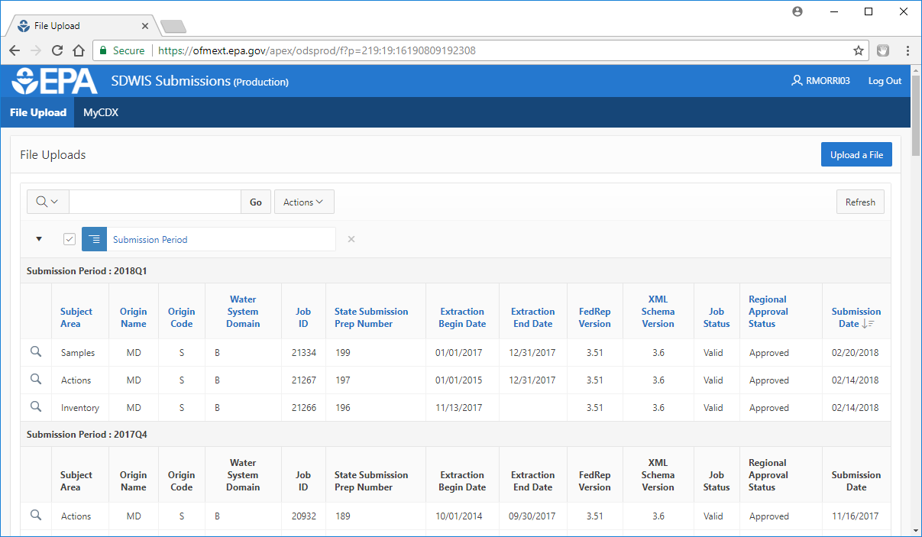
File Upload – Use Primacy Agency Submitter Role
Submission Year and Quarter files were submitted for (latest one listed first)
4/26/2018

Slide 27
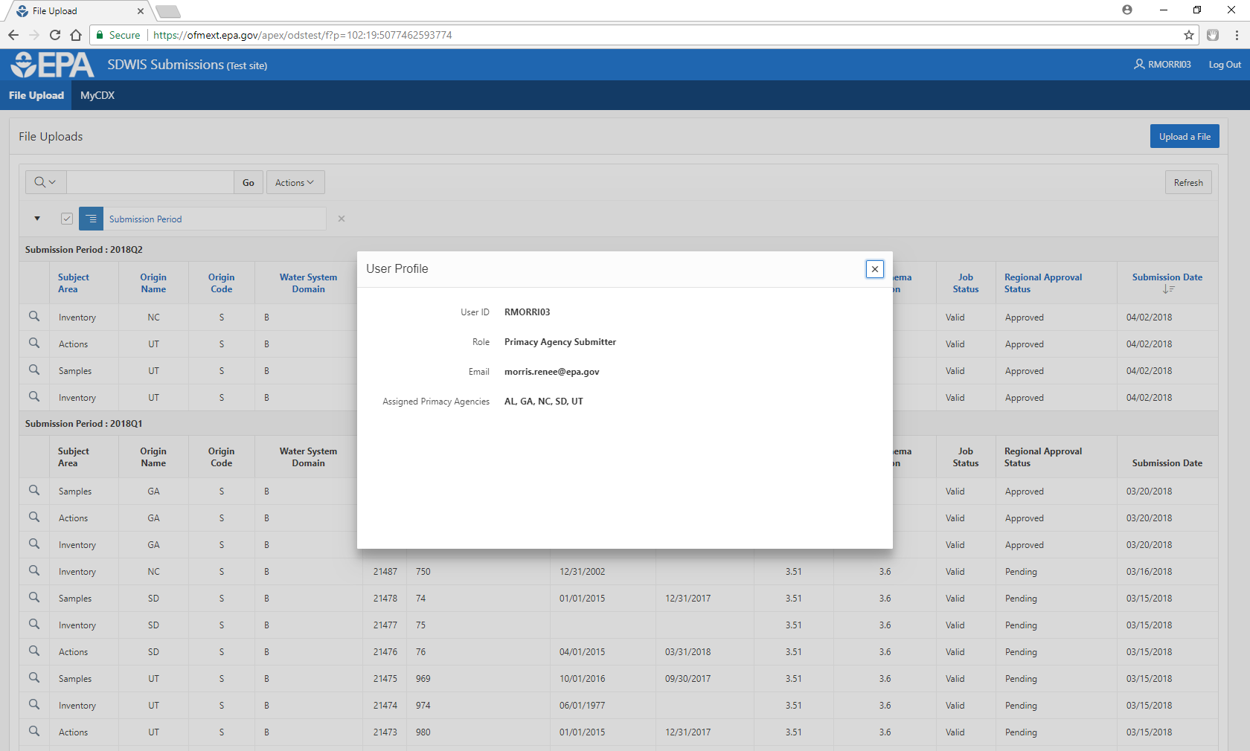
User Access
4/26/2018

Slide 28
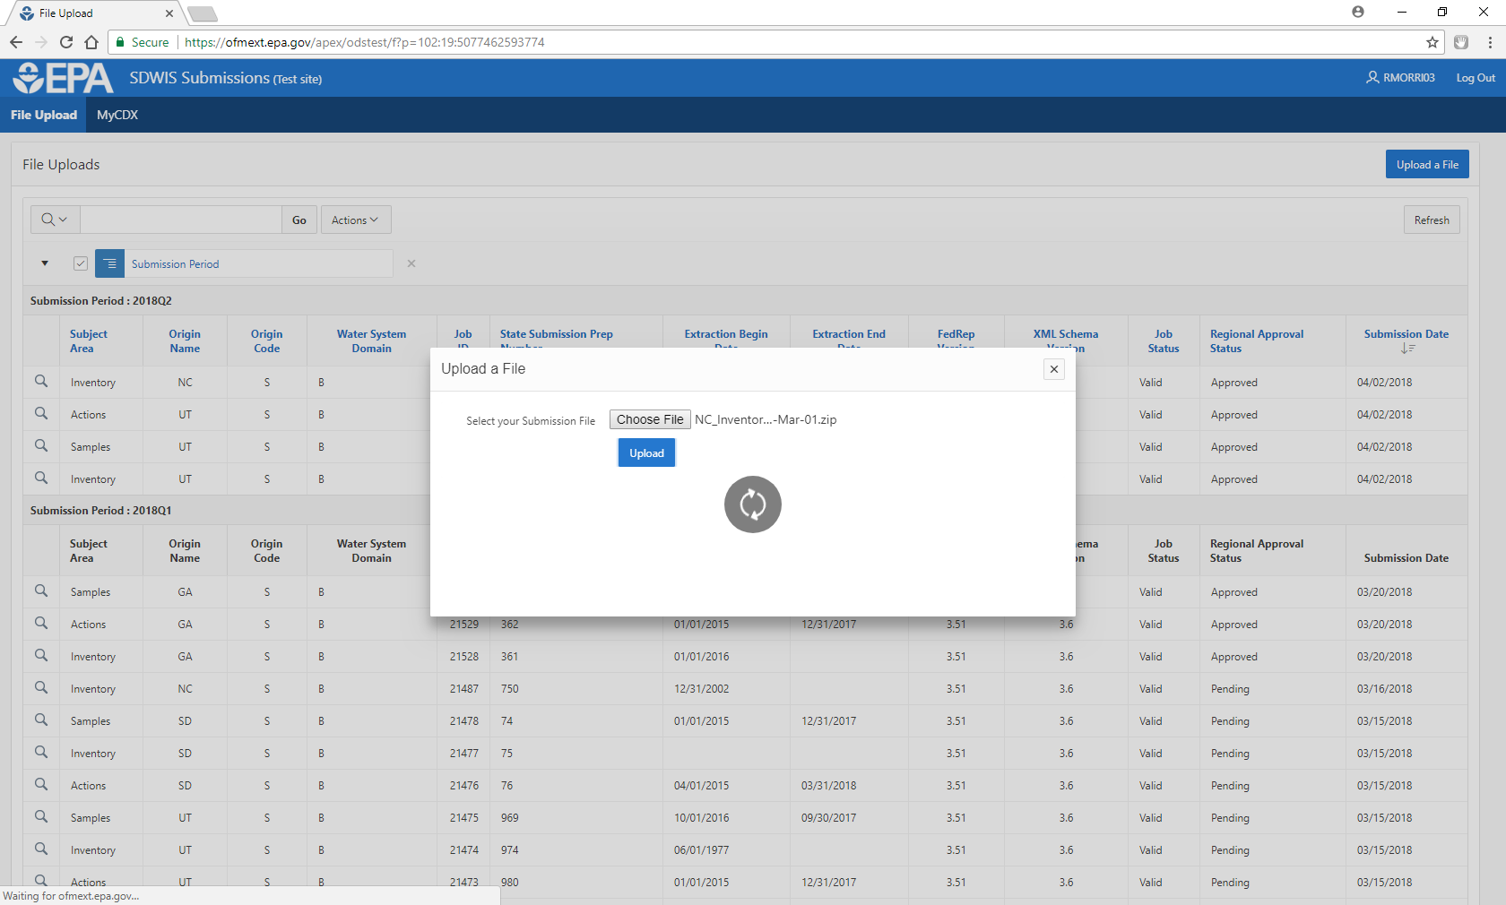
File Upload
4/26/2018

Slide 29
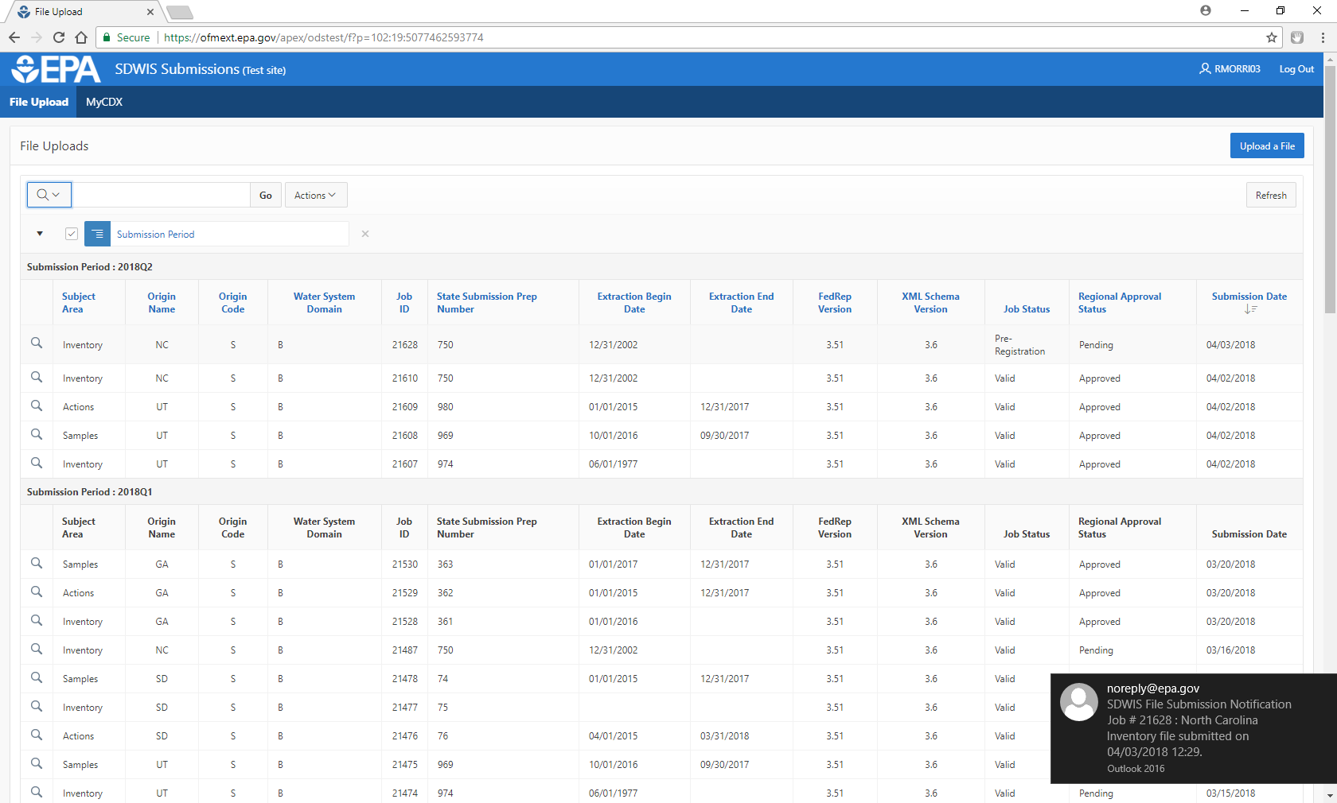
File Upload
4/26/2018
Email received by file submitter and Regional Administrator

Slide 30
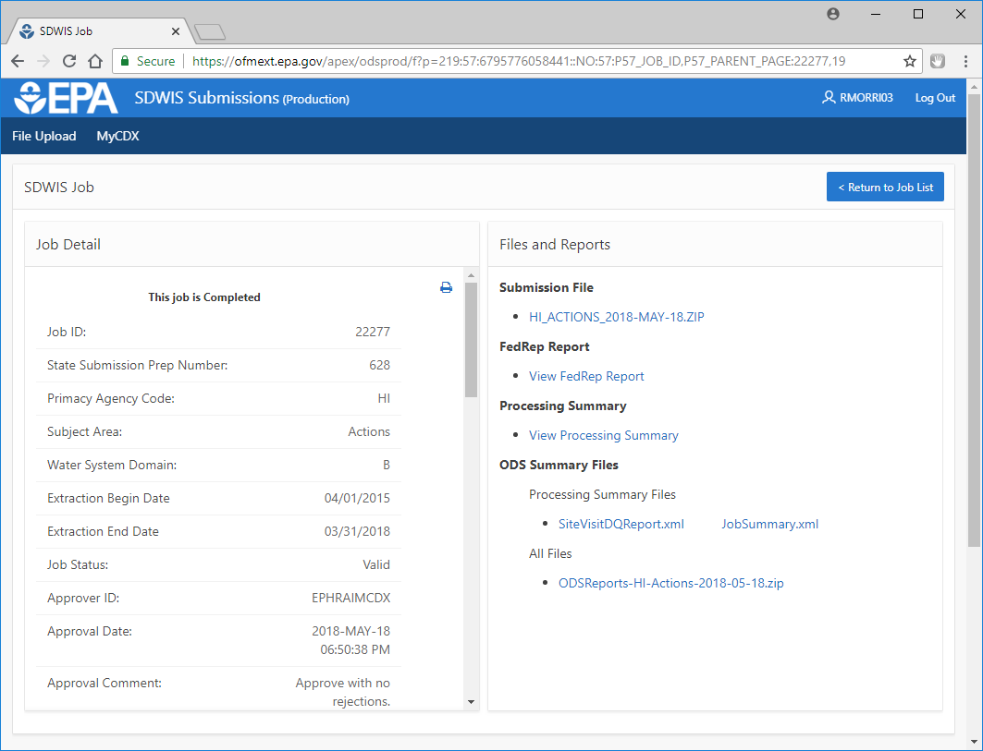
File Reports
4/26/2018

Slide 31
FedRep Report

Slide 32
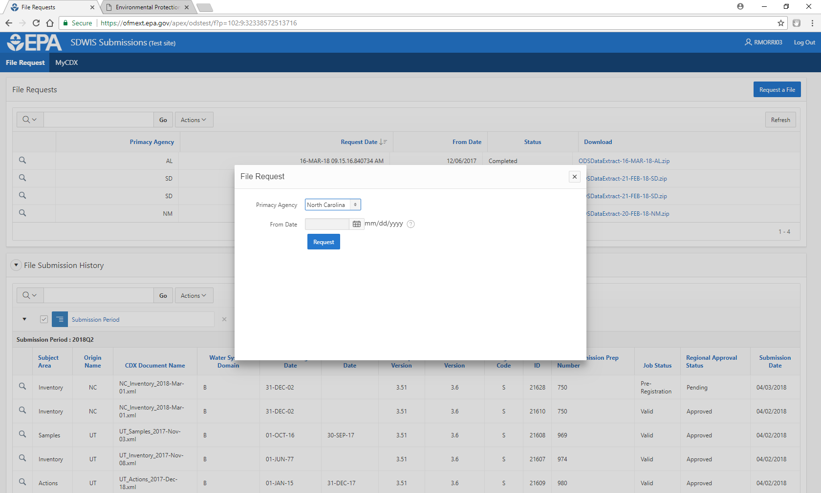
File Request
4/26/2018

Slide 33
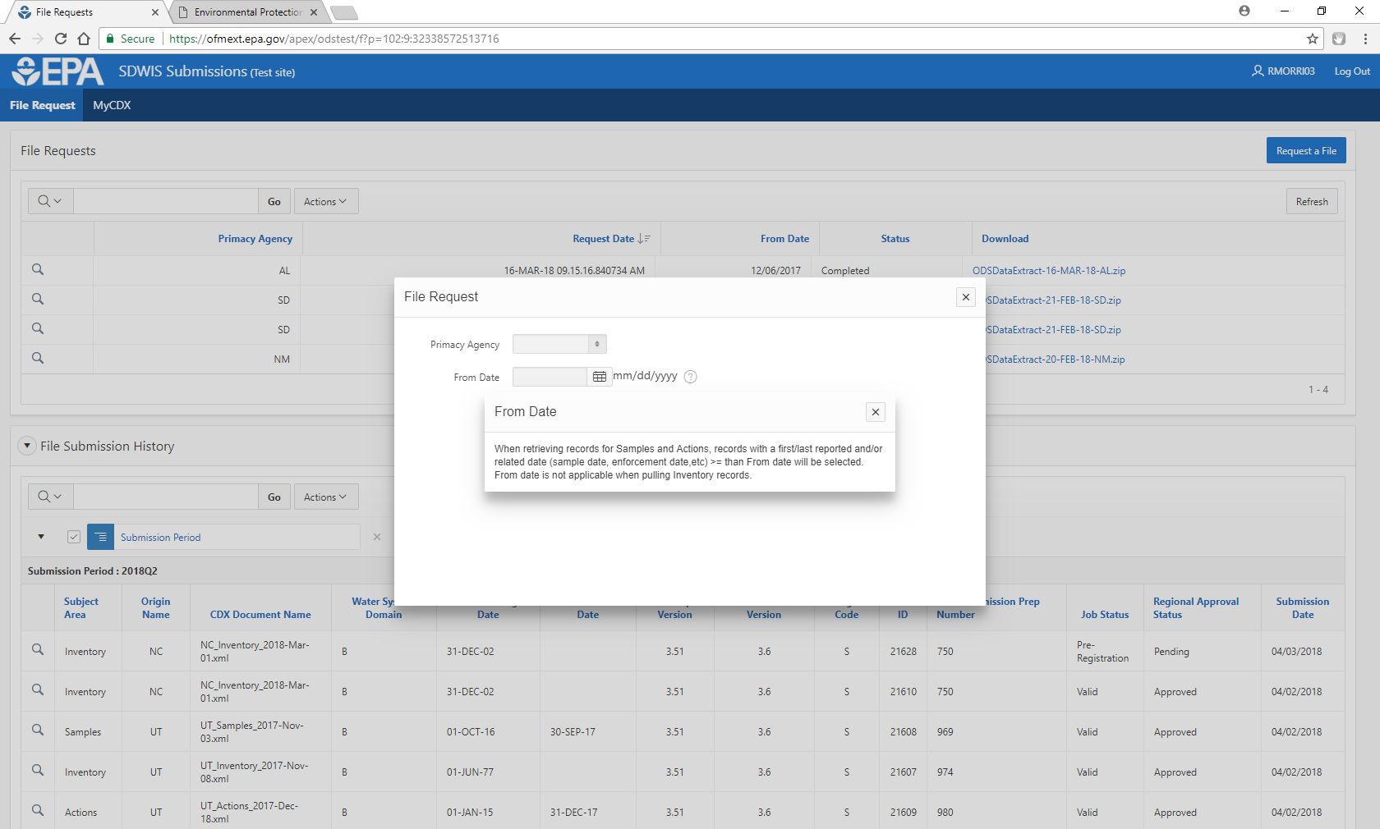
File Request
4/26/2018

Slide 34
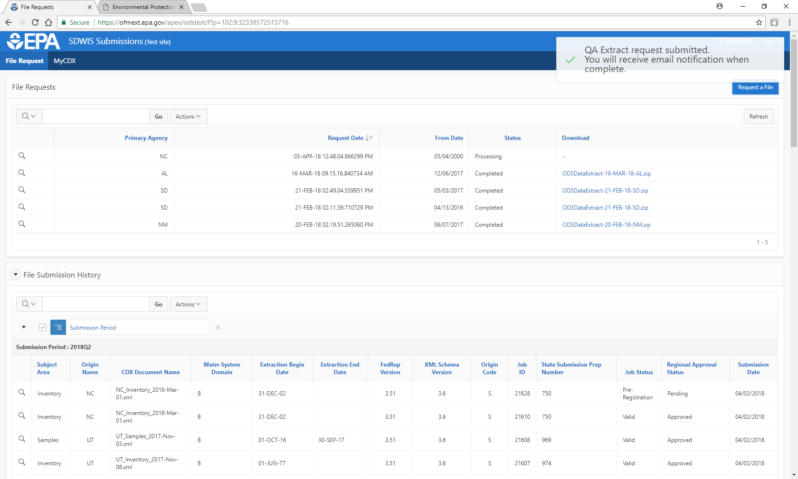
File Request
4/26/2018

Slide 35
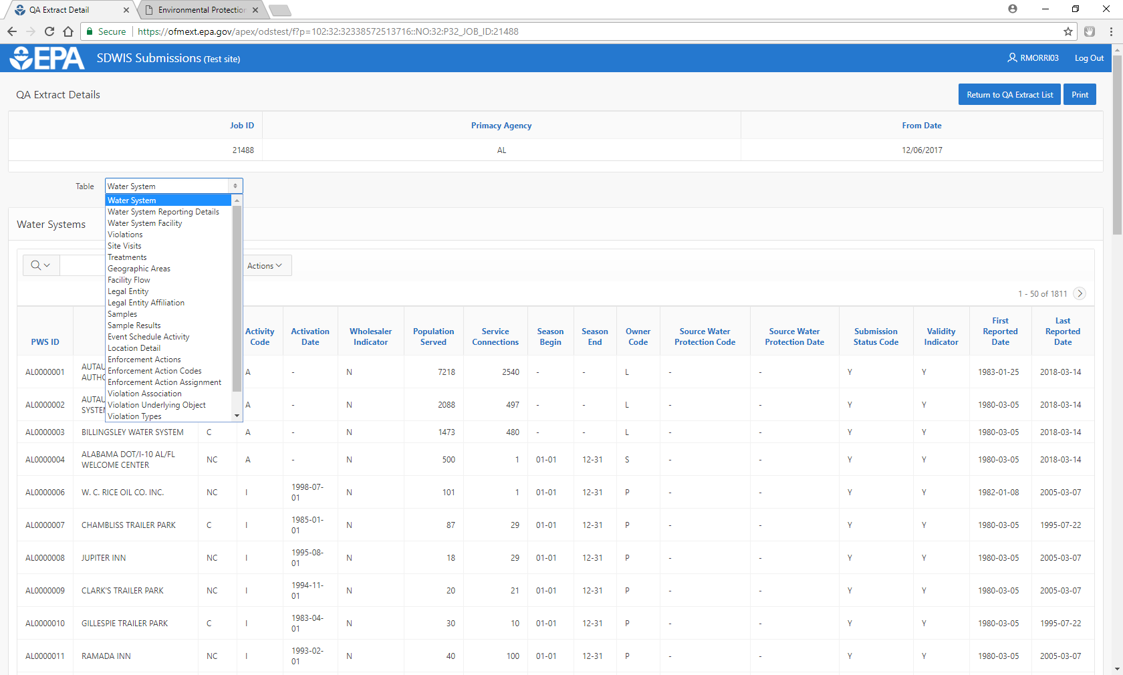
File Review
4/26/2018

Slide 36
ODS Extract
Open the ODS Extract on the Production Control Tool
Download the zip file with the error report folder
Import data set into SDWIS/ODS QA Import Utility 3.32
Microsoft Access database allows you to view your primacy agency’s data and perform ad-hoc queries and reporting on data from your most recent submission
Use Version 3.32 (dated 2/28/2012 and posted on SDWIS SharePoint site) regardless of SDWIS/FedRep version your agency uses
Use SDWIS/ODS Quality Assurance Utility 3.3 Installation and User Guide (5/18/2011) for assistance (also on SDWIS SharePoint)
4/26/2018

Slide 37
Data Warehouse
Data source for all uses or services of DW data reporting
Updated quarterly based on data submitted to ODS Production
Data is extracted from ODS Production
Transformed data is loaded into appropriate SDWIS Fed Data Warehouse tables and views
Added a number of calculated field to help with data analyses (i.e. Compliance Status Code)
SDWIS Fed Data Warehouse is the source for all reporting and including for ECHO and envirofacts

Slide 38
SDWIS Fed Data Tools
Tools:
Reporting Services (Public)
Reporting Services (Secure CDX)
Public GPRA Tool
Drinking Water Mapping Application to Protect Source Waters (DWMAPS)

Slide 39
Where are we going from here?
SDWIS Fed Info (on SDWIS SharePoint):
SDWIS Fed data flow
SDWIS FedRep & ODS Data Validation
SDWIS Version Use
SDWIS Reporting Contacts:
EPA Region Coordinators
EPA HQ:
Renee Morris – (202) 564- 8037, Morris.renee@epa.gov
Alex Porteous – (202) 564- 3142, Porteous.alex@epa.gov
Trang Le – (202) 564-1572, Le.trang@epa.gov

Slide 40
Questions?

